Slide 1
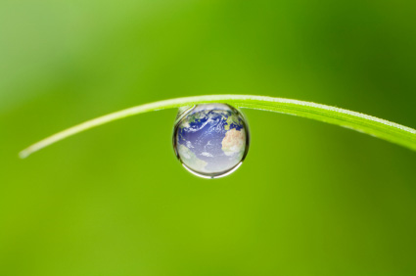
Water Conservation
Making Every Drop Count
Notes:
Welcome to our presentation on Conservation: Living and Working Green.
In today’s presentation we’ll discuss Water Conservation—Making Every Drop Count!
This session covers water uses and water pollution.

Slide 2


Session Objectives
  Conservation and sustainability
  Water conservation
  Water use, pollution: just the facts
  Environmental and economic costs
  Tips, strategies, and opportunities to improve water use
Notes:
By the end of the session, you should understand:
The meaning of conservation and sustainability;
Water conservation;
Some facts about water use and pollution;
The environmental and economic costs of water use and pollution; and
Useful tips, strategies, and opportunities to improve water use.

Slide 3

What Is Conservation?
Why Does It Matter?
  Protection
  Improvement
  Wise use of natural resources
Notes:
What is conservation and why is it important? In a nutshell, conservation is:
The protection,
Improvement, and
Wise use of our natural resources.
And it matters because it benefits your bottom line! In business, conservation equals saving money!

Slide 4
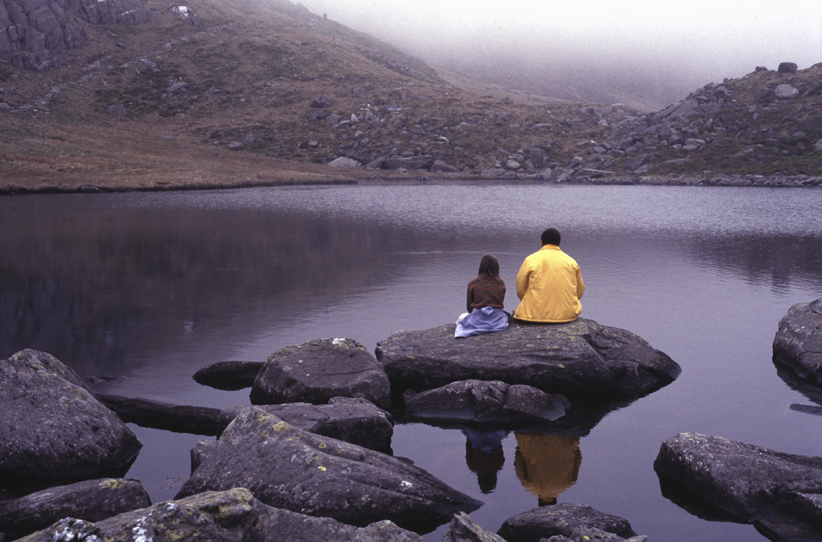
The Goal of Conservation
Sustainability is:
  Meeting the needs of the present generation without compromising the ability of future generations to meet their own needs!
© BLR®—Business & Legal Resources 1408
Notes:
The goal of conservation is sustainability.
The most commonly recognized definition of “sustainability” was issued by the Brundtland Commission in its 1987 report, Our Common Future, as
“Meeting the needs of the present generation without compromising the ability of future generations to meet their own needs!”
Many companies today want to be recognized for having sustainable practices and being viewed as socially responsible.

Slide 5
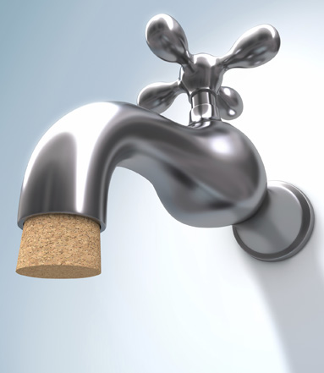
Water Conservation
  Not using more than you need
  Avoiding pollution
Think water conservation
24 hours a day!
Notes:
Water conservation means not using more water than we need.
It is also about not polluting water in a way that reduces its usefulness to humans and other organisms.
To protect our way of life and save money we must think water conservation 24 hours a day!

Slide 6


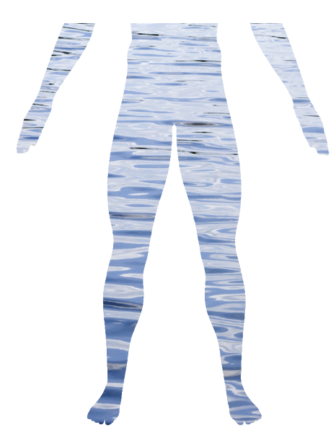
Water: Elixir of Life
  71% of the earth is covered with water
  Human body is about
  60% water
Notes:
Water is the elixir of life.
71 percent of the earth is covered with water. Of this, 97 percent is in the ocean, only 3 percent is freshwater, and only 1 percent of that is drinking water.
The human body is made of about 60 percent water—but that varies between men and women.
If you lose 2.5% of your body water weight, you will lose 25% of your efficiency.
If you lose 5%, a mild fever develops, irritability, headache, light-headedness.
When the body reaches 8%–10% fluid loss, emergency help is needed—the deterioration will include hallucinations.
Death usually occurs in the range of 12%–20% water loss. And that depends on the temperatures—lower if it is hotter, higher if it is colder.

Slide 7
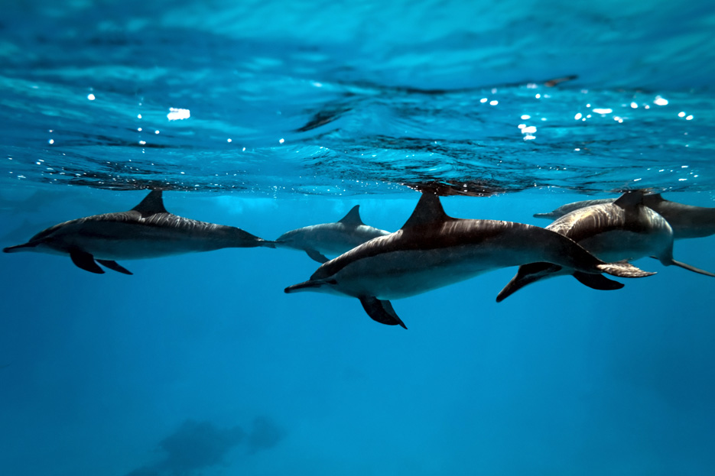
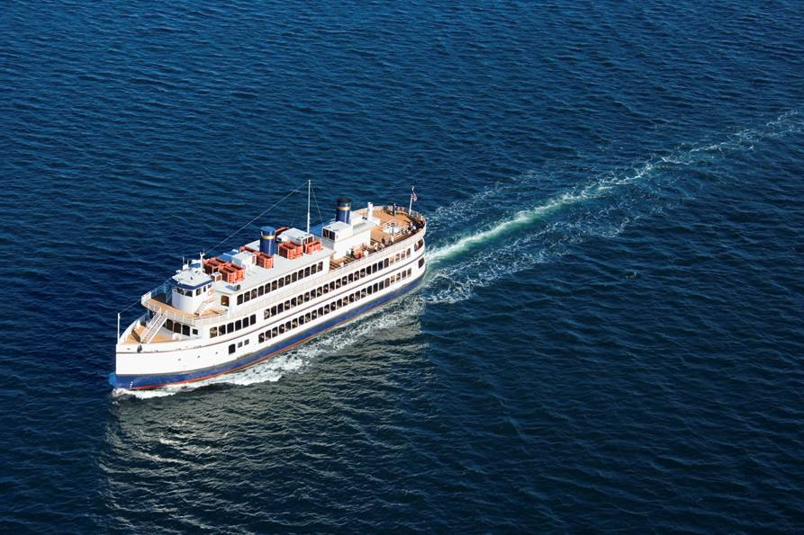
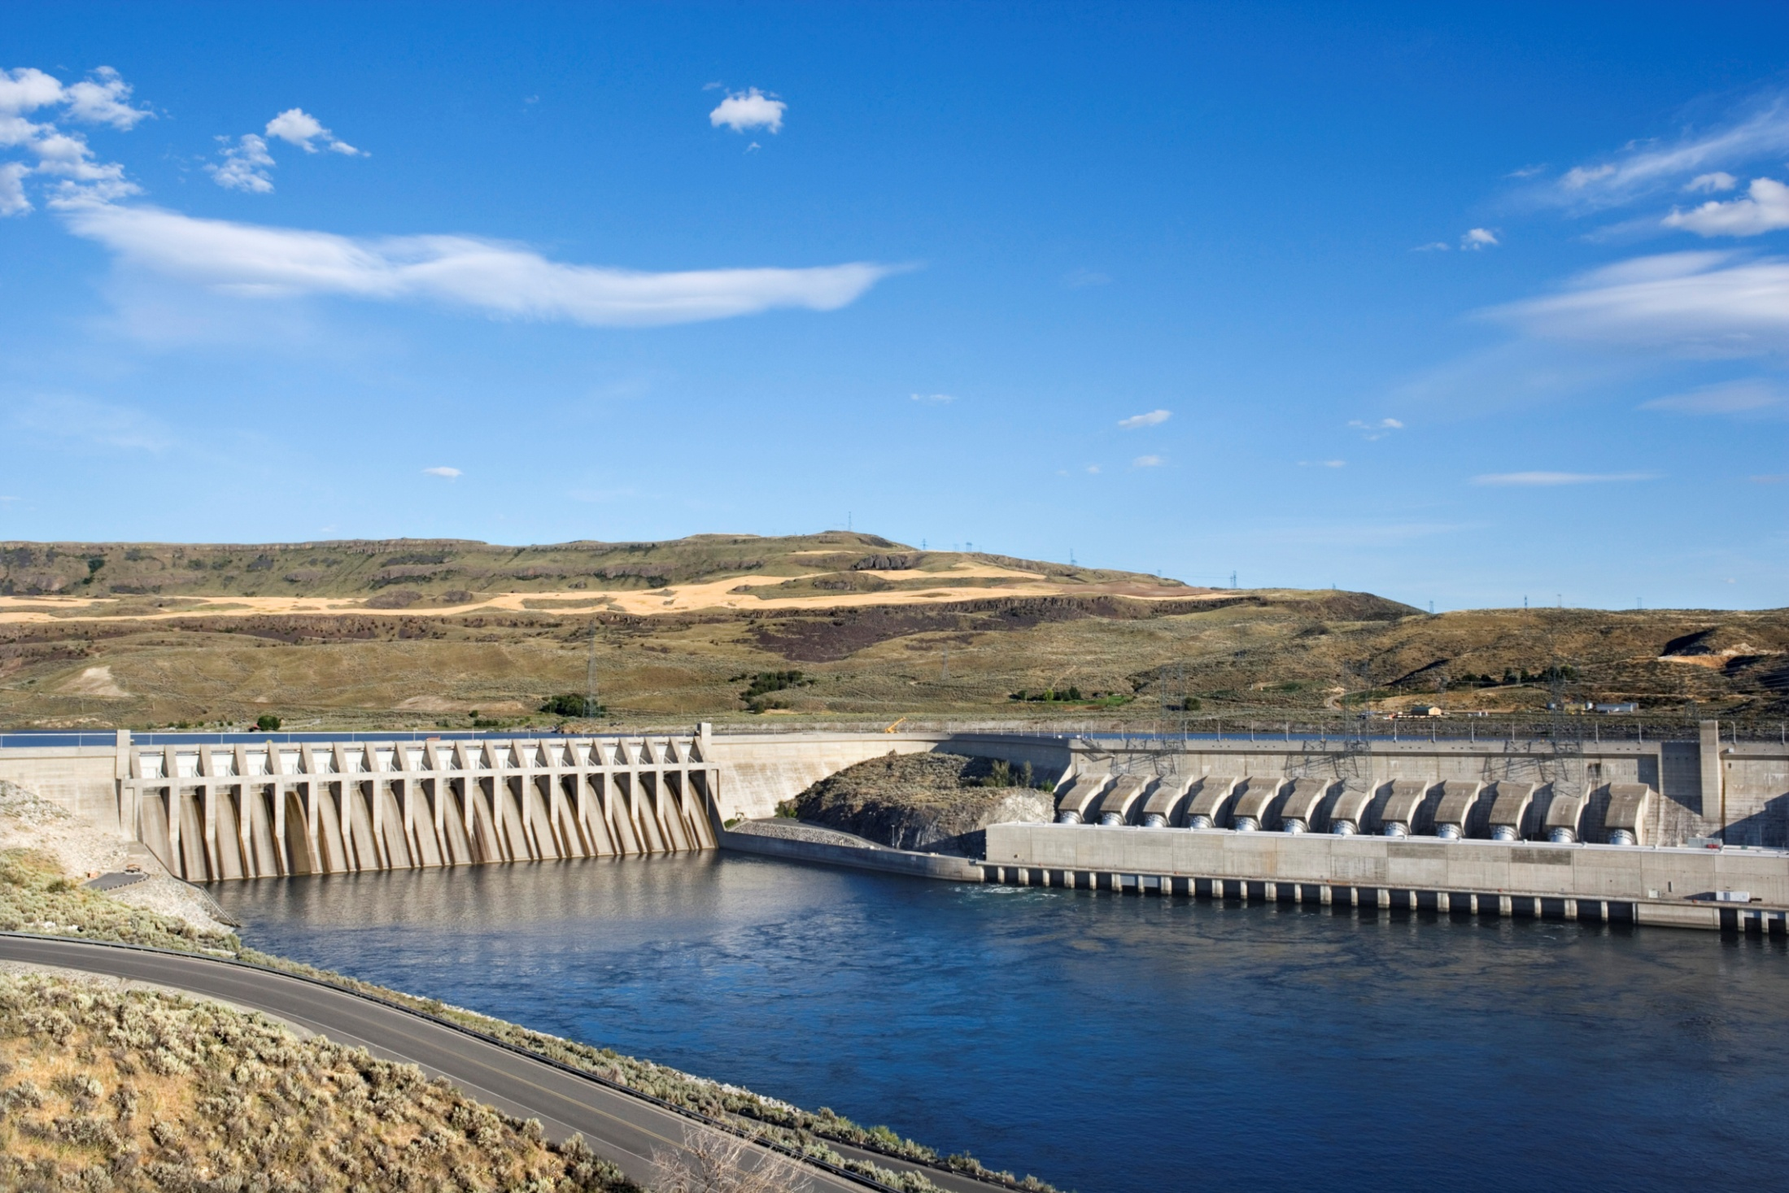
Water, Water, Everywhere!
© BLR®—Business & Legal Resources 1408
Notes:
Water is everywhere.
Water is home to most life forms, including fish, mammals, and plant life.
Water is a means of transportation—for commerce and passengers.
It is a source of energy.

Slide 8
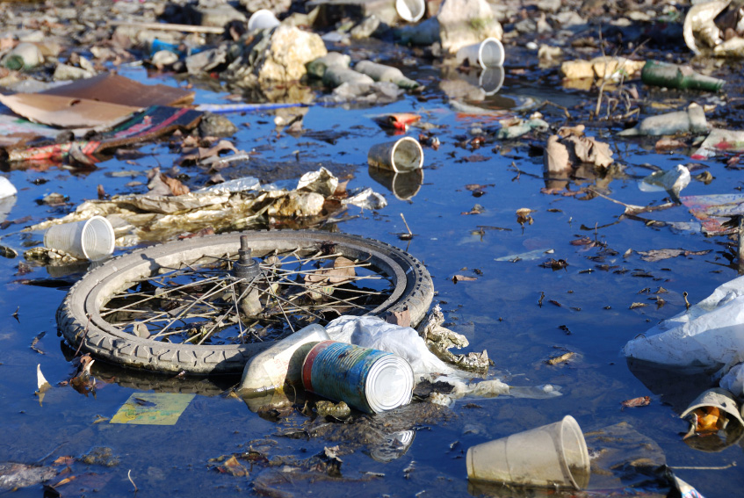
But It’s the Most Abused
Resource on Earth
© BLR®—Business & Legal Resources 1408
Notes:
Water is also the most abused resource on earth.

Slide 9
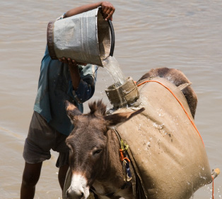

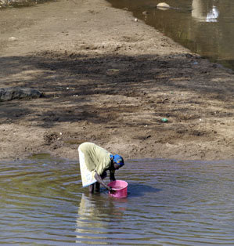
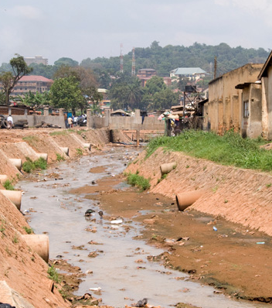
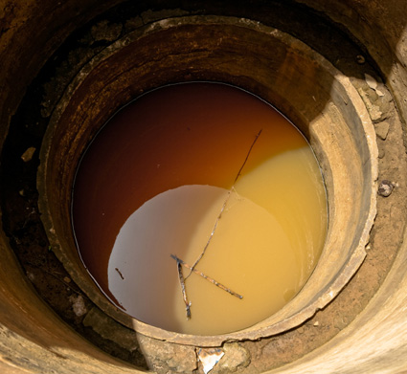
Water Consumption
  Unhealthy water
  Wastewater untreated
  Infection
  Deaths
Notes:
The existence of water on earth is vital to the existence of life on earth. As the world’s population increases, water consumption increases—but potable or drinking water is becoming more scarce.
About 1 million people routinely drink unhealthy water.
In developing countries, 90 percent of wastewater goes untreated into rivers and streams.
Lack of sanitation is the world’s biggest cause of infection.
In fact, one-half of the children’s deaths in third-world countries are caused by waterborne diseases.
Preventing pollution and conserving our water will mean safe water supplies for future generations.

Slide 10
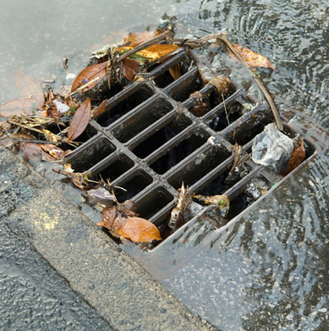
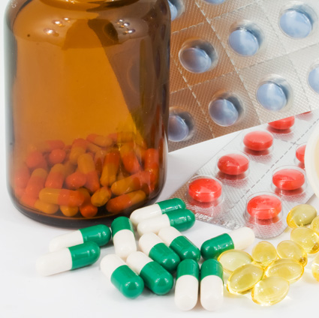
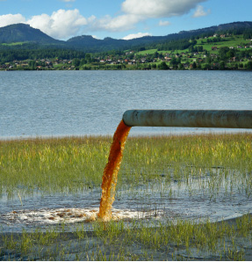

Water Pollution
Pollutants come from:
  Humans
  Specific sources
  Fertilizers and pesticides
  Runoff
Notes:
Pollution comes from a variety of sources:
Humans are huge polluters. Dumping or flushing personal hygiene products and prescription drugs down drains and toilets pollutes our waters.
Specific sources, such as pipes from a factory, can pollute waters.
Farms and agricultural fields using fertilizers and pesticides are another cause.
And rain and snow storms lead to runoff of pollutants from parking lots, sidewalks, roads, and construction sites. Runoff is a major source of water pollution, particularly in urban settings.

Slide 11
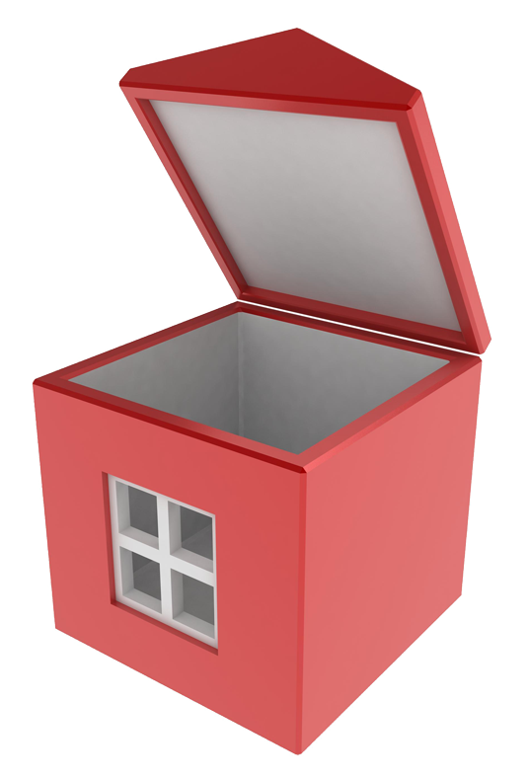
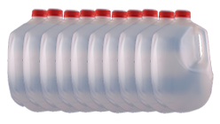
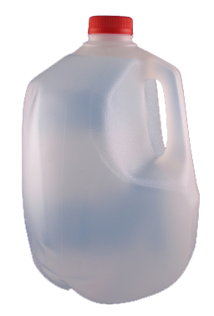
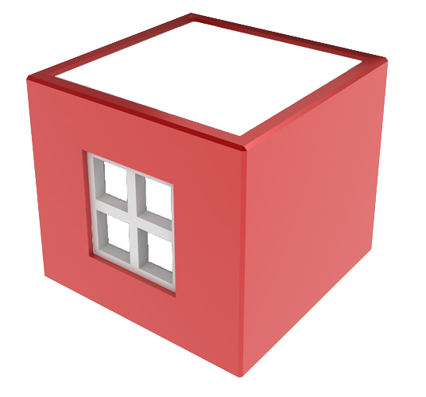
Use and Waste Facts
Third-world countries
use 1–5 gallons a day
Americans use
100 gallons a day
8%
for households
Notes:
Here are some facts about the global use and waste of water.
8 percent of water worldwide is used for household purposes.
The average American uses about 100 gallons of water per day. We are the world’s largest water users—having increased our water use 200% since 1950. The second highest water user is Australia, followed by Europeans, who use about 53 gallons of water per day.
Compare that with people in the third-world countries, who use 1 to 5 gallons each day.

Slide 12
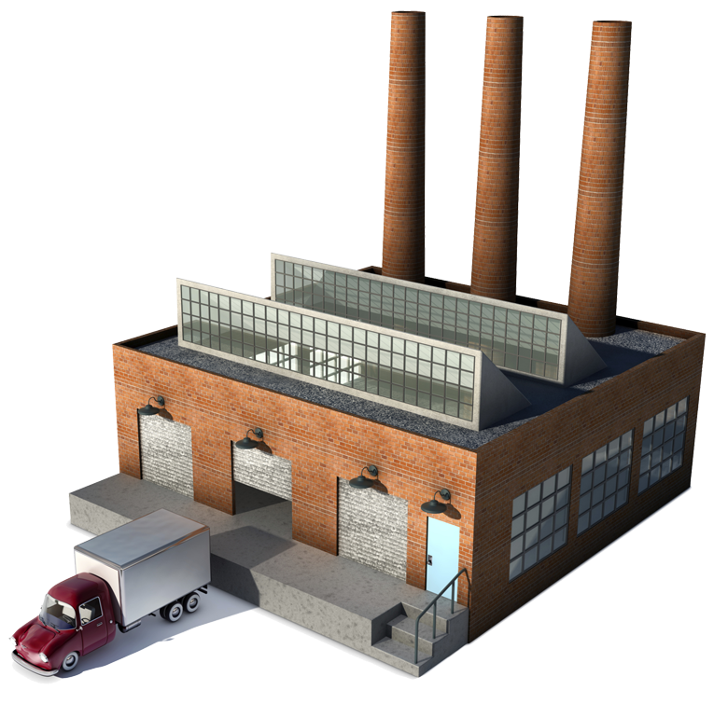
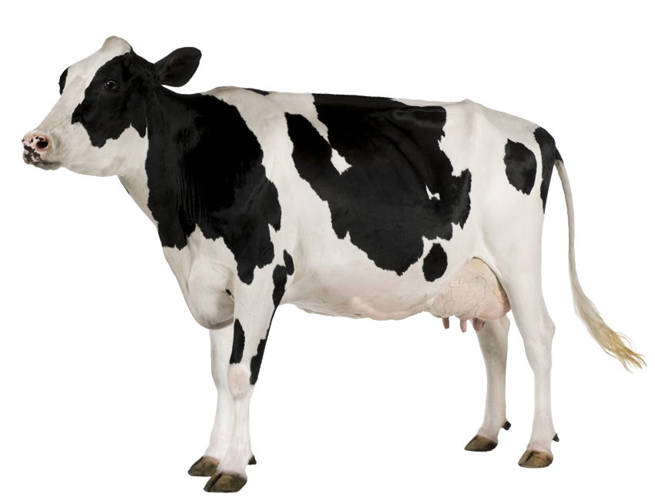
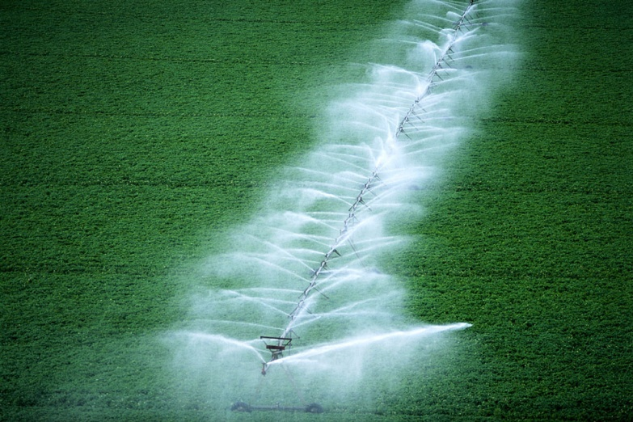
Business Usage Facts
8%
69%
14%
Notes:
Agriculture tops water use by a business source, with 69 percent of worldwide water use for irrigation.
Livestock accounts for 8 percent of global water use.
And, general industry uses about 14 percent.

Slide 13
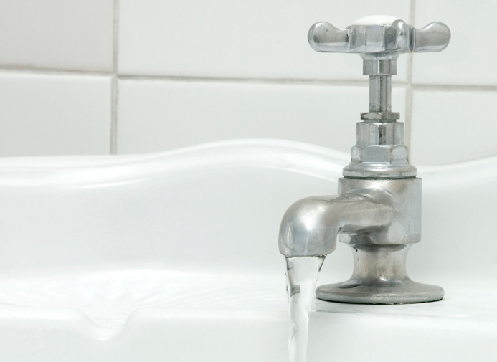
What Do You Know?
How many gallons of water does
the average U.S. family of four use every day?
A. 50 gallons
B. 100 gallons
C. 250 gallons
D. 400 gallons
© BLR®—Business & Legal Resources 1408
Notes:
Do you know approximately how many gallons of water the average U.S. family of four uses per day?
50 Gallons, 100 gallons, 250 gallons, or 400 gallons?
Water is necessary. It’s used in every area of life. The time is now to think about conservation.

Slide 14
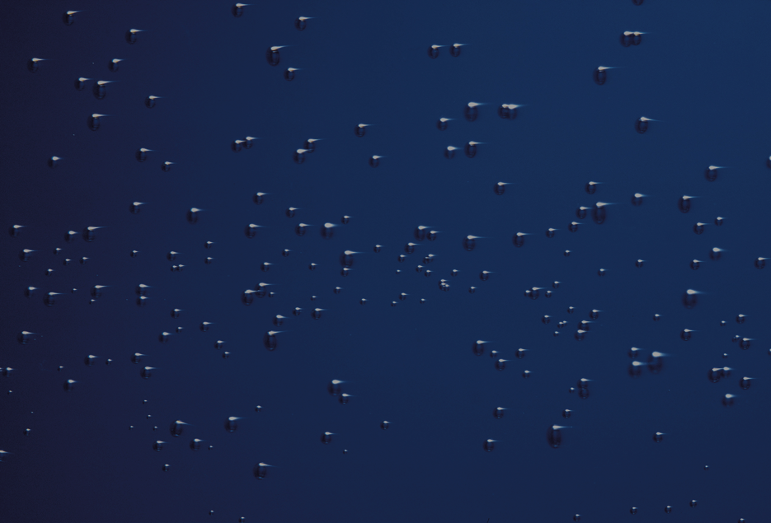
Know the Facts
Flushing a toilet | 5 to 7 gal.
Running a dishwasher | 15 to 25 gal.
Washing dishes by hand | 20 gal.
Watering a small lawn | 35 gal.
Taking a shower | 25 to 50 gal.
Taking a bath | 50 to 70 gal.
Washing a load of clothes | 35 gal.
Brushing teeth (tap running) | 2 to 5 gal.
© BLR®—Business & Legal Resources 1408
Notes:
Let’s start by learning the facts of water use.
Be aware of how much water you use in these simple daily activities. For example:
Flushing a toilet uses 5 to 7 gallons.
Running a dishwasher uses 15 to 25 gallons.
Washing dishes by hand uses 20 gallons.
Watering a small lawn uses 35 gallons.
Taking a shower uses 25 to 50 gallons.
Taking a bath uses 50 to 70 gallons.
Washing a small load of clothing uses 35 gallons.
Brushing teeth with the tap running uses 2 to 5 gallons.

Slide 15
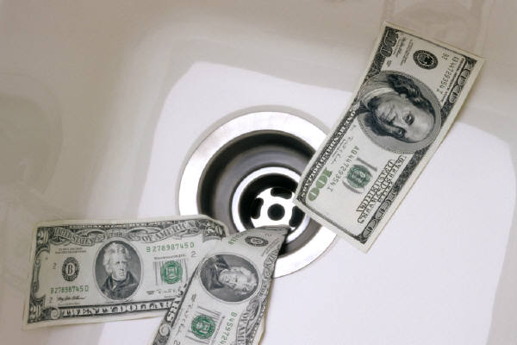
Costs Add Up…
  $500/yr average spent on water and sewer bill
  More than 14%
  never used
© BLR®—Business & Legal Resources 1408
Notes:
The costs of water use and waste are climbing.
The average American household spends about $500 each year on water and sewer costs.
And on average, more than 14% of those costs involves water we never use because it leaks down the drain.
But there is good news! We can make a measurable difference by taking simple water-saving steps in our lives.

Slide 16
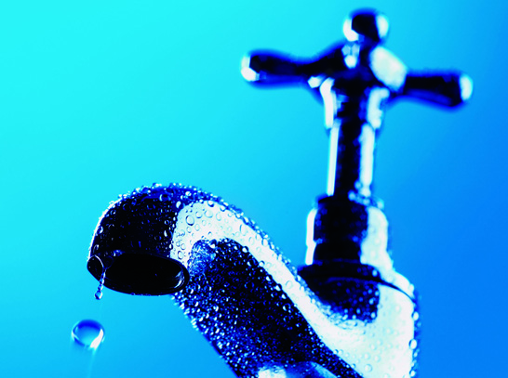
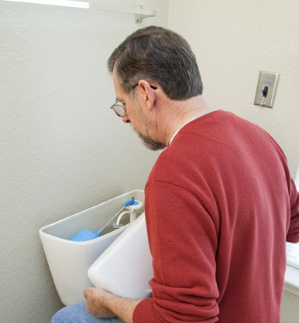
First, Stop Leaks!
  1 drip per second = 3,000 gallons per year
  Check for toilet leaks
Notes:
The first step you want to take to conserve water is to see if you have any leaks in your home. By taking action to fix a leak, a significant amount of water won’t wastefully go down the drain.
For instance, a drop rate of one drip per second on a leaky faucet or showerhead can waste more than 3,000 gallons per year.
To check if you have a leak in your toilet, add food coloring to the tank. Color will appear in the bowl within 15 minutes if there is a leak.

Slide 17
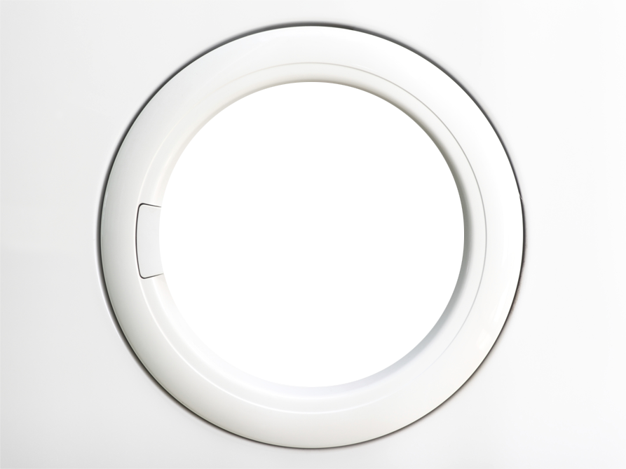
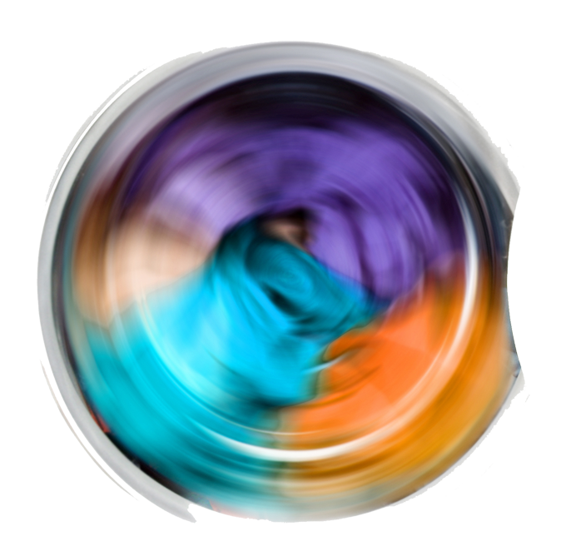
In Your Home…
  Wash only full loads
  of dishes and clothes
  Use water-efficient fixtures and practices
© BLR®—Business & Legal Resources 1408
Notes:
When you are washing dishes in the dishwasher or clothing in a washing machine, make sure you wash only full loads. If you are hand washing dishes, remember not to keep the water running! Turn it off when you are soaping and scrubbing the dishes, and turn it back on to rinse the soap off.
To conserve even more water, the next step is to install water-efficient fixtures. Look into fixtures that have EPA’s WaterSense® label. For instance, a WaterSense-labeled toilet can save $50 to $100 per year in water costs.

Slide 18
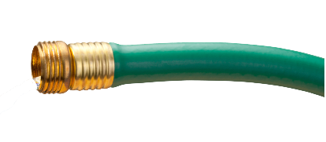
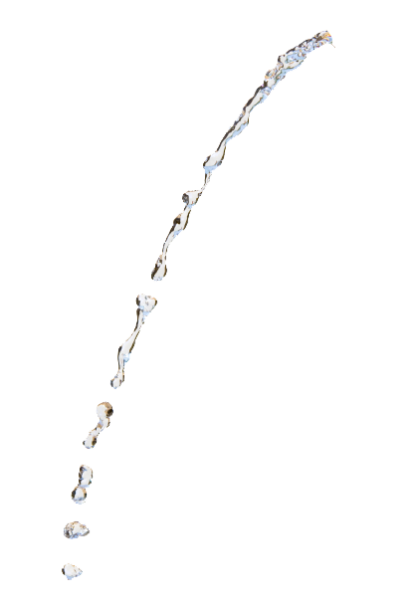
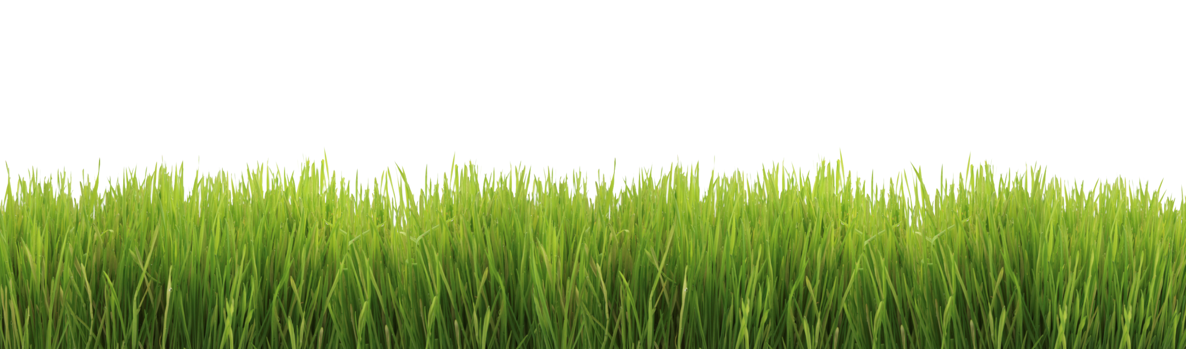
In Your Yard…
  Water lawns during the cool morning hours
  Use soaker hoses or trickle irrigation
  Don’t wash your
  car at home
© BLR®—Business & Legal Resources 1408
Notes:
More water conservation opportunities exist with lawn care.
First, make sure to water your lawn or garden during the cool morning hours instead of during midday to avoid evaporation.
When watering, use a sprinkler that produces droplets rather than mist, which quickly evaporates, or use soaker hoses or trickle irrigation. And remember to water only grassy areas or gardens—not sidewalks and driveways.
Although it may seem like washing your car at home is a good idea, it actually takes more water than commercial car washes. And when you wash your car in your driveway, the wastewater goes down street storm drains. Commercial car washes are required to collect wastewater and treat it.

Slide 19
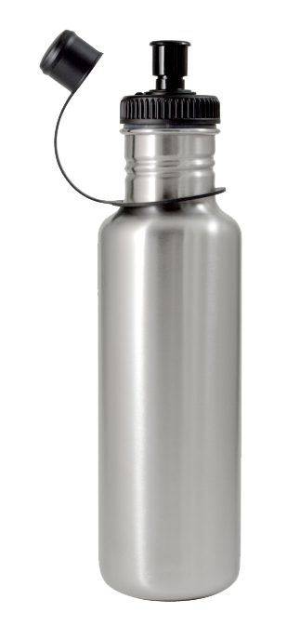
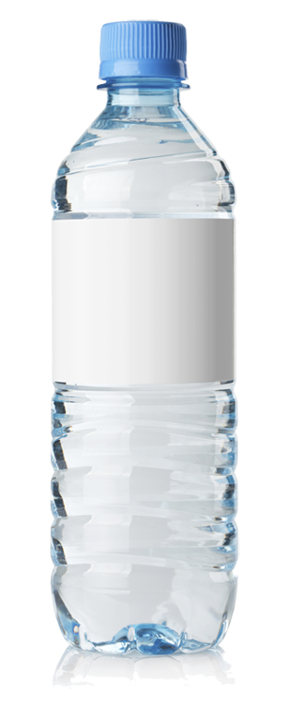
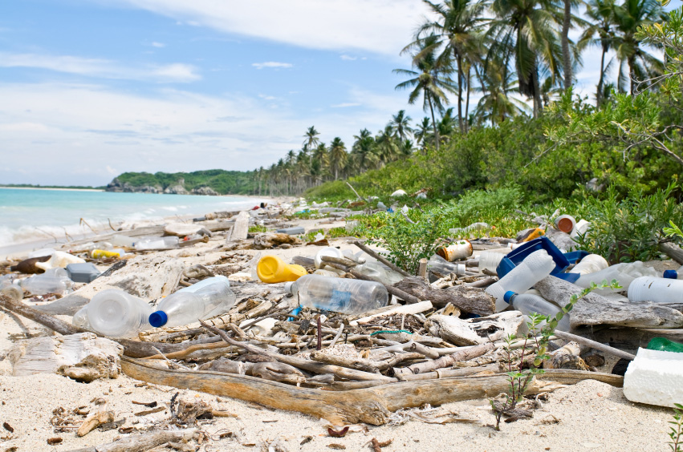
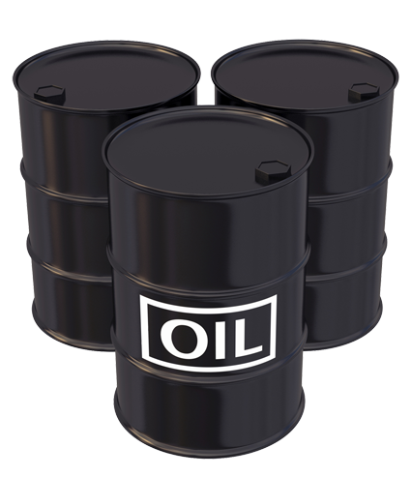

Ditch the Plastic
17 million
gallons/year
© BLR®—Business & Legal Resources 1408
Notes:
We live in a country that has the cleanest public drinking water supply in the world.
Although bottled water is convenient, the bottled water industry creates 1.5 million tons of plastic waste per year and requires
17 million gallons of oil each year in the United States alone.
Instead of buying water in disposable water bottles, invest in a good reusable travel water bottle and refill it as necessary. You’ll be preventing plastic bottles from entering landfills and saving money at the same time.

Slide 20
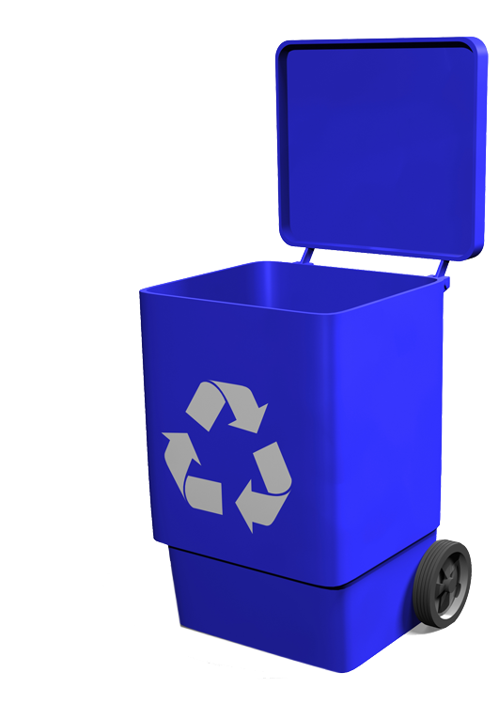
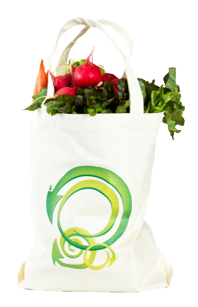
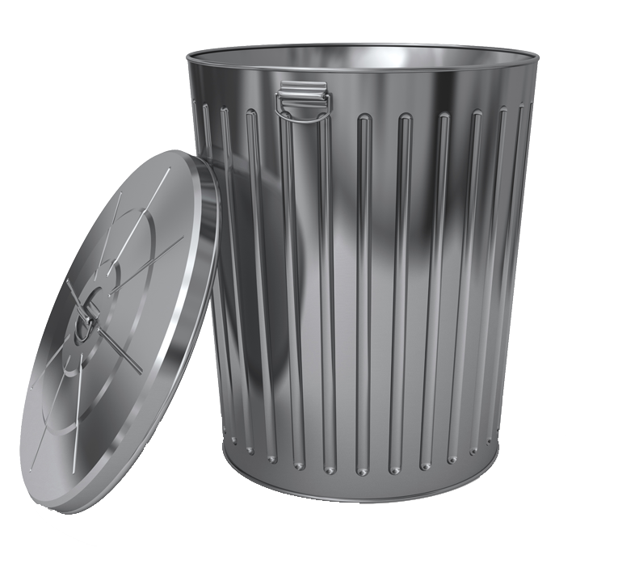
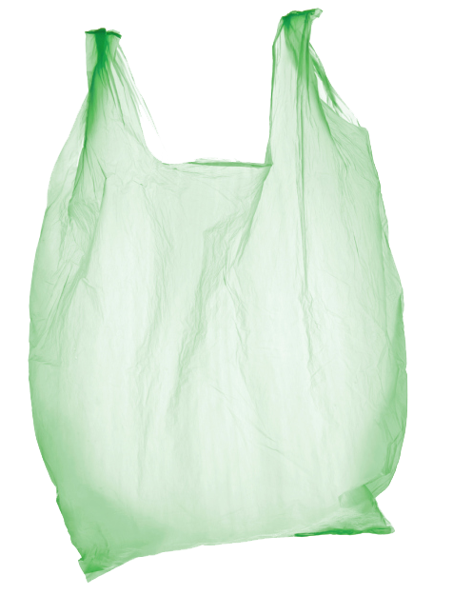
Don’t Pollute!
Don’t Pollute!
© BLR®—Business & Legal Resources 1408
Notes:
Often when we think of water pollution, we imagine chemicals, oils, and wastewater entering our waters. But a major cause of water pollution is trash.
To prevent trash from entering waterways and oceans, dispose of trash in proper receptacles and use recycle bins as directed.
Also, to avoid the entrance of plastics into waterways, remember to use a reusable cloth or canvas bag when shopping. These types of bags are much stronger, too!

Slide 21
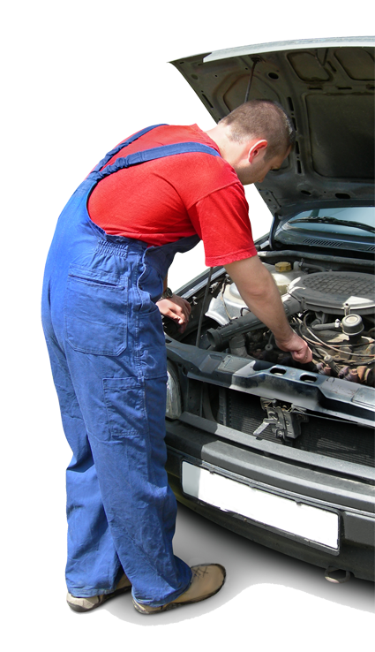
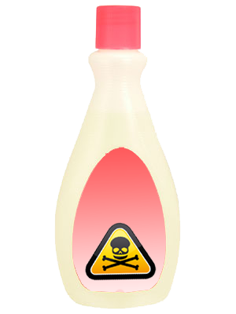
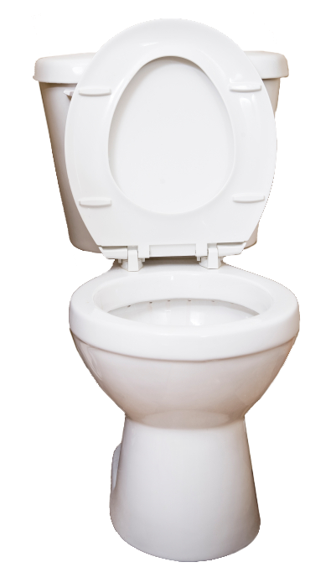
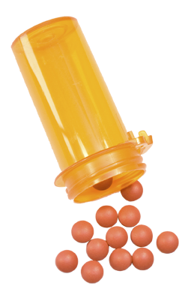

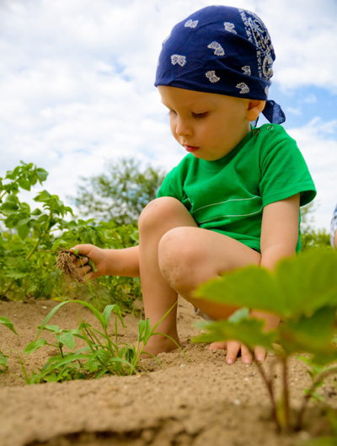
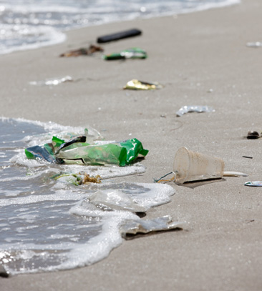
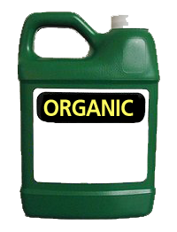
A Little
Helps a Lot!
  Don’t flush medications
  Don’t throw toxic products
  down drains or toilets
  Don’t throw trash in
  water
  Use organic fertilizers
  and pesticides
  Keep car well maintained
Notes:
In general, taking a few simple actions in your daily routine can go a long way in preventing water pollution and preserving clean water supplies.
Do not flush medications down the drain or toilet. Many towns have organized events to collect old medications. If you must dispose of a medication at home, combine it with coffee grounds or kitty litter and wrap it up well.
Do not throw paints, oils, polishes, or other toxic products down drains or toilets.
Do not throw trash in waterways or down drains.
When treating your lawn or garden, use organic fertilizers and pesticides.
Maintain your car in good condition to avoid unnecessary leaks.

Slide 22

What Can Your Company Do?
1. Make a commitment to conserve
2. Appoint a coordinator
3. Determine how and
where you use water
4. Set a goal
5. Develop a long-range plan
6. Purchase WaterSense products
7. Involve employees
Upper Management Commitment Is KEY!
© BLR®—Business & Legal Resources 1408
Notes:
Your company can do many things to become water efficient.
Step 1. Make a commitment to conserve water. Meet with the executives at your company to decide that you will allocate resources toward that goal.
Step 2. Appoint a conservation coordinator—someone who is organized and gets things done.
Step 3. Determine how and where you use water—this may involve interviewing employees or sending out surveys.
Step 4. Set a goal of how much water you want to conserve.
Step 5. Develop a long-range plan.
Step 6. Purchase WaterSense products—these are products proven to be water efficient.
Step 7. Involve employees—make sure everyone plays an important role.
Experience shows that successful business conservation programs require support from top-level management. Companies that assign responsibilities to an individual (a respected employee) or to a committed group, such as a green team, have better results.

Slide 23

What More Can YOU Do?
Promote sustainability
Change your technology
Push for a
green committee
Reduce your
water usage
Share your ideas
© BLR®—Business & Legal Resources 1408
Notes:
We can all contribute to water conservation efforts in our workplace, in our homes, and in our communities by:
Sharing your water conservation ideas;
Pushing for a green team or committee to help with your company’s conservation efforts;
Reducing water use;
Promoting sustainability, serving as an example of a “water conserver” to those around you; and
Changing the technology you use to improve water use efficiency.

Slide 24

Question
Between 1950 and 2000,
the U.S. population grew 89%;
about how much has our water
use increased in the same
period?
A. 200%
B. 150%
C. 50%
D. 25%
Notes:
Here’s a question to test your memory:
Between 1950 and 2000, the population of the United States grew 89 percent. During that same period, approximately how much did our water use increase?
200%, 150%, 50%, or 25%?

Slide 25

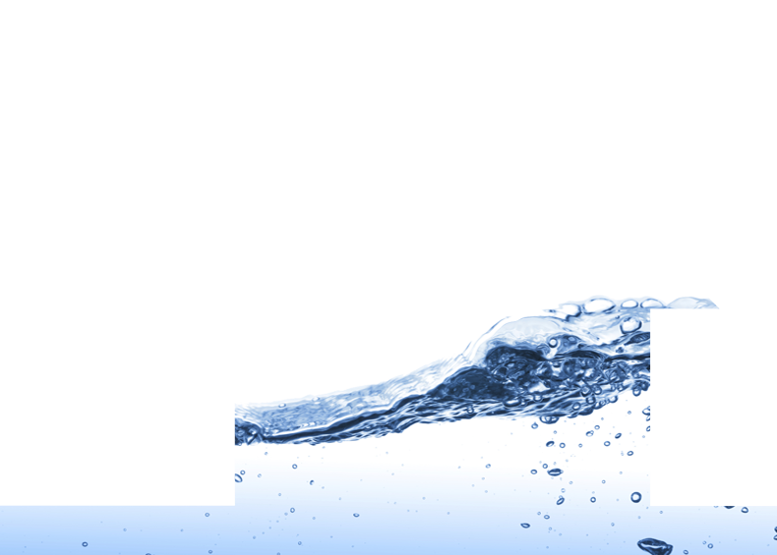
What Do You Think?
In the average household, which of the following wastes the most water every day?
A. Running the tap
while washing dishes
B. Using a garbage
disposal
C. A leaky toilet
D. Long showers
© BLR®—Business & Legal Resources 1408
Notes:
Let’s test your knowledge.
In the average household, which of these wastes the most water every day:
Running the tap while washing dishes, using a garbage disposal, a leaky toilet, or long showers?

Slide 26
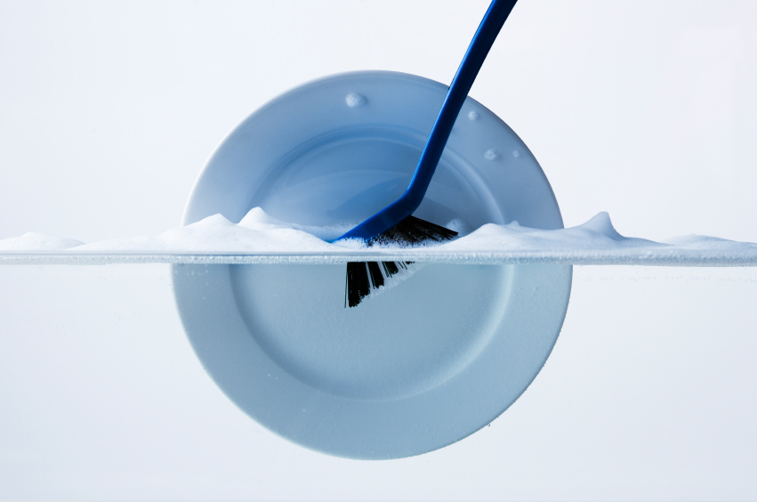

True or False?
Washing dishes in a dishwasher
uses less water than washing
by hand.
© BLR®—Business & Legal Resources 1408
Notes:
True or false?
Washing dishes in a dishwater uses less water than washing by hand.

Slide 27
Key Points to Remember
  Think conservation
  24 hours a day!
  Develop a routine that
  makes you most efficient.
  Strive for continuous improvement.
  Find new ways to conserve water.
  Saving your company money
  is good for you, too!
Notes:
Remember these key points:
THINK conservation 24 hours a day—at work and at home.
Develop a routine that makes you the most efficient.
Strive for continuous improvement.
Find new ways to conserve water, and share those new ways with your fellow employees, friends, and family members.
Saving your organization money is good for you, too!

