Slide 1
ENROLLMENT MANAGER USER GUIDE
SCHOOL CERTIFYING OFFICIAL

Slide 2
Table of Contents
Certifications by Facility Type
Institution of Higher Learning
Add a Preset Enrollment
Edit a Preset Enrollment
Add and Submit an Enrollment
Amend an Enrollment
Non-College Degree
Add a Preset Enrollment
Edit a Preset Enrollment
Add and Submit an Enrollment
Amend an Enrollment
On-the-Job Training / Apprenticeship
Add and Submit an Enrollment
Amend an Enrollment
Add a Monthly Certification
Terminate an Enrollment
Flight
Create Flight Instructions
Add and Submit an Enrollment
Amend an Enrollment
Add a Monthly Certification
End an Enrollment
Helpful Resources
Billie, The GI Bill Chatbot
Additional Resources
Overview
Accessing Enrollment Manager
Accessing the VA Education Platform
Create an ID.me account
Create a Login.gov account
Sign in with ID.me
Sign in with Login.gov
Requesting First-Time Access
SCO – Requesting First-Time Access
Assistants and SCOs Read Only – Requesting First-Time Access
SCO – Approving, Denying, and Revoking Enrollment Manager Access
Approving and Denying Access
Revoking Access
Assigning/Unassigning Facilities
Enrollment Management Main Tabs
Dashboard Tab
Students Tab
Finding a Student
Adding a Student
Student Profile
Enrollments Tab
Student Info Tab
Programs Tab
Benefits Tab
Notes Tab
History Tab
Schools Tab
Reports Tab
School Certifying Official Enrollment Manager User Guide
Version History
Date | Version | Description | Authors
09/12/2023 | 2.2 | Grammatical refinements throughout. | NTT-S
08/30/ 2023 | 2.1 | Updated User Guide to include VBA Remarks Guide in the Helpful Resources section. | NTT-S
08/01/ 2023 | 2.0 | Updated User Guide to PowerPoint format. Additionally, updated the document to include new procedures and new functionality. | NTT-S
02/27/ 2023 | 1.0 | Initial User Guide for School Certifying Officials to navigate Enrollment Manager. | NTT-S

Slide 3
Overview

Slide 4
Purpose
The purpose of this document is to provide information and tutorials on how to use Enrollment Manager (EM), the system for entering enrollments, changes, and monthly certificates. Within EM, School Certifying Officials (SCOs) can do the following:
Create shared student records between VA and EM
Associate a student with a facility
View student information
Submit student certifications
Add notes to a student profile and their enrollment
Notes: All information contained in this manual is based on fictitious names, Social Security numbers (SSN), and other personally identifiable information. The SCO EM User Guide is a general reference guide. Also, located in the top-right, a labeled rectangle indicates the specified user/audience the subsequent section is aligned to (i.e., Assistant, SCO, Flight, NCD/IHL, etc.).
Return to Table of Contents

Slide 5
Enrollment Manager
EM is a modernized platform for SCOs that replaced VA-Online Certification of Enrollment (VA-ONCE). It is an enhancement of the previous system as a part of the Digital GI Bill® effort. EM allows SCOs to submit the following VA forms:
Enrollment Certification (22-1999)
Notice of Change in Student Status (2-1999b)
Monthly Certification of Flight Training (22-6553c)
Monthly Certification of On-The-Job and Apprenticeship Training (22-6553d)
Return to Table of Contents

Slide 6
VA Education Platform
The VA Education Platform is the sign-in page for external users to gain access to VA systems, such as EM, through an approved authentication method (ID.me or Login.gov).
Access the VA Education Platform by navigating to http://iam.education.va.gov.
This authentication provides an additional layer of security to keep all personal information safe and provides a Single Sign On (SSO) experience, where one set of user credentials provides access to multiple platforms (i.e., AskVA, EM, etc.).
Return to Table of Contents

Slide 7
VA Education Platform Portal
Once properly authenticated, the user will be directed to the VA Education Platform Portal page. This page is where all Digital GI Bill applications are housed. This is also where SCOs can manage EM access requests for assistant accounts.
First-time users select the "Request Access link". If the user is an SCO, the request goes to VA for approval. If the request is for an assistant account, the SCO grants access.
Return to Table of Contents

Slide 8
Definitions
Terminology | Definition
Amendment | Any change made to an enrollment after it is submitted
Assistant (SCO Assistant, Certifying Official Assistant, School Certifying Official Assistant) | Assistants have full access such as View Bio, Certs, VA Data, Log, History tabs; Edit Bio, Certs, and Log tabs; and delete unsubmitted certs. They can enter data in EM but cannot submit trainee enrollment information to VA. Assistants are not listed on the VA Form 22-8794 and do not complete any required SCO training. New Assistants are granted access to EM by their designated facility SCO.
SCO Read Only (Read-only Users, Read Only SCO, Read Only Certifying Official) | SCO Read Only users are representatives with permission to access training information, request information from VA, and submit inquiries to VA to assist an authorized designated SCO with obtaining accurate information to certify a student’s enrollment. SCO Read Onlys cannot certify a student’s enrollment to VA.
Vacation Period | The dates of official facility vacation periods which are seven or more consecutive days. Used when certifying non-standard enrollment periods for all benefits
Online Credits | Web-based learning using one or more technologies to deliver instruction to students
Student, Trainee | Individual using their VA education benefits to pursue educational programs, training, certifications, etc.
Facility, Institution | Includes all institutions of higher learning as well as nontraditional courses/programs where education or training is pursued
Program | Student’s chosen path of study that is pursued at a school or training facility.
In progress | Enrollment/Amendment/Certification in in draft state
Pending SCO Review | Draft entered by an Assistant or SCO Read Only must be verified and submitted by SCOs
Submitted | Enrollment/Amendment/Certification was sent for processing
Under Review | Enrollment/Amendment/Certification was off-ramped for manual review
Processed | Enrollment/Amendment/Certification has been adjudicated
Return to Table of Contents

Slide 9
Accessing Enrollment Manager

Slide 10
Accessing the VA Education Platform

Slide 11
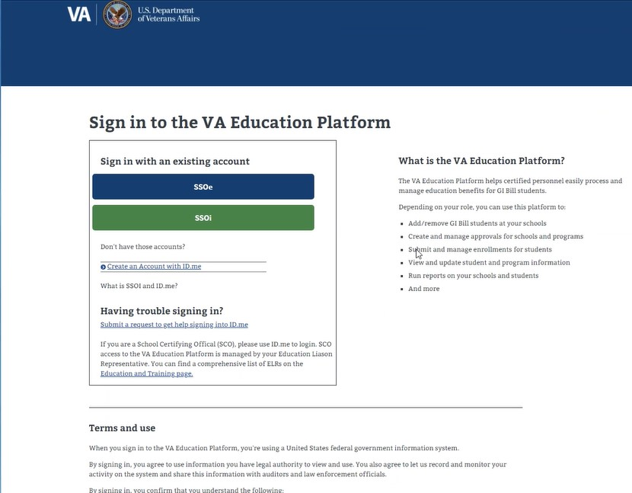
Accessing the VA Education Platform
Navigate to the VA Education Platform sign-in page and select “SSOe”. The “e” stands for “external”.
Note: Please have your SSN, driver’s license/passport, mobile phone number, and work email address on hand. Provide these documents for initial identity verification. Identity verification keeps your information safe and prevent fraud.
Return to Table of Contents

Slide 12
Accessing the VA Education Platform Cont'd
To continue the authentication process to access the VA Education Platform, you must verify your identity using ID.me or Login.gov. Select the hyperlinked text or navigate to the corresponding page number.
To Create an Account with ID.me – Navigate to page 13
To Create an Account with Login.gov – Navigate to page 21
To Sign in with ID.me Account – Navigate to page 31
To Sign in with Login.gov Account – Navigate to page 39
Return to Table of Contents

Slide 13
Create an ID.me account

Slide 14
Create an ID.me Account Cont'd
Select “Sign in with ID.me” after navigating to the VA Education Platform sign-in page and selecting “SSOe”.
Return to Table of Contents

Slide 15
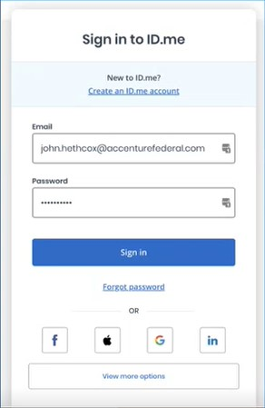
Create an ID.me Account Cont'd 1
Select “Create an ID.me account” and follow the prompts to enter an email address and create a password.
Return to Table of Contents

Slide 16
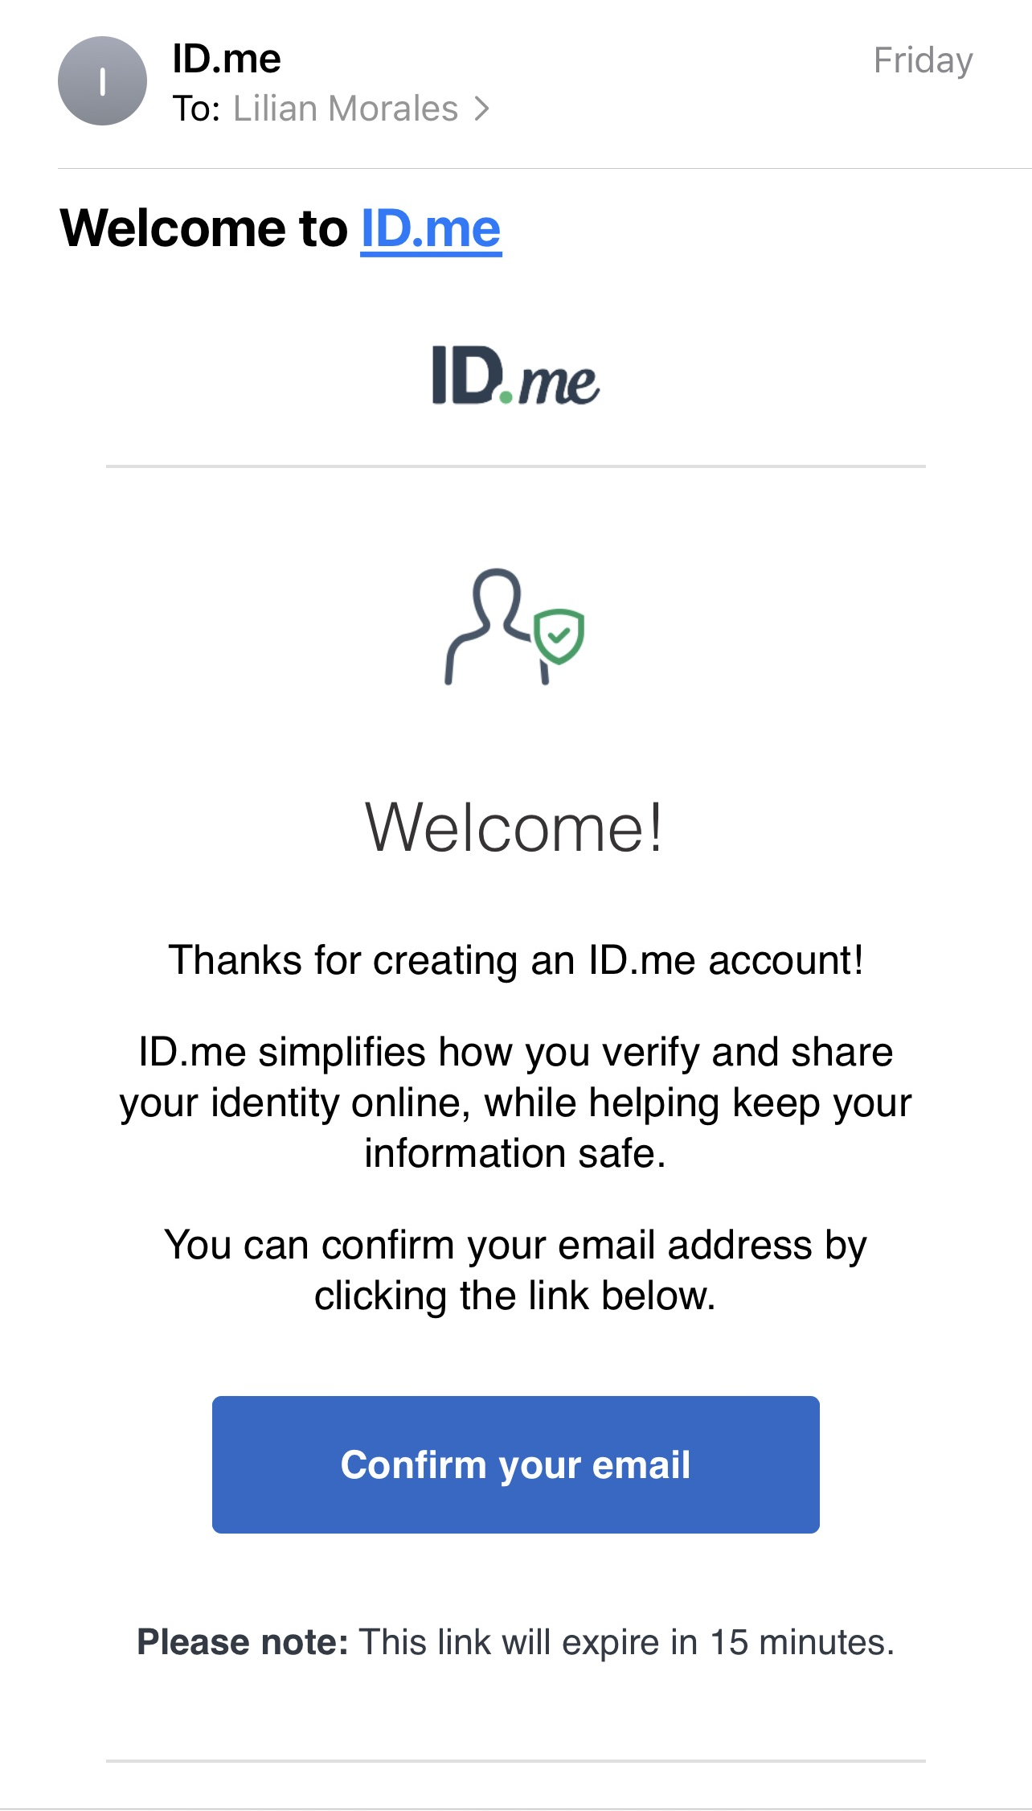
Create an ID.me Account Cont’d 2
Open the email from ID.me and select the “Confirm your email” button. This directs you to set up multi-factor authentication.
Return to Table of Contents

Slide 17
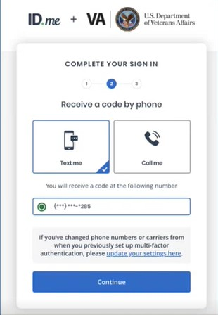
Create an ID.me Account Cont’d 3
Choose an authentication method by selecting the “Text me” or “Call me” option. Select the “Continue” button.
Note: If the work number submitted uses a switchboard or an extension to contact you, there is a possibility the call may not go through. Using a cell number is suggested.
Return to Table of Contents

Slide 18
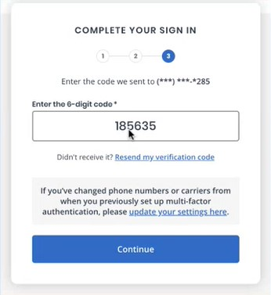
Create an ID.me Account Cont’d 4
Option 1 – If you selected the “Text me” option and you receive your message code, input the 6-digit code and select the “Continue” button.
OR
Option 2 – If you selected “Call me” option, you receive a phone call asking you to follow the prompts by selecting numbers on your phone. This authenticates you.
Note: If the work number submitted uses a switchboard or an extension to contact you, there is a possibility the call may not go through. Using a cell number is suggested.
Return to Table of Contents

Slide 19
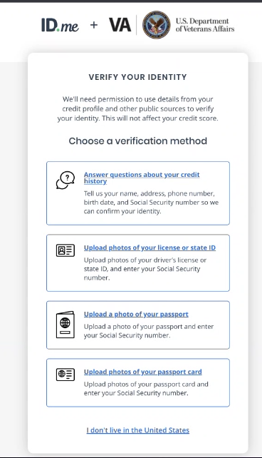
Create an ID.me Account Cont'd 5
Select a verification method and follow the prompts to verify your identity. This process might take 5-10 minutes to complete. You need to upload a photo of your driver’s license, state ID, or passport to verify your identity.
Note: Should you encounter problems with verifying your identity, please access the ID.me Help Center.
Return to Table of Contents

Slide 20
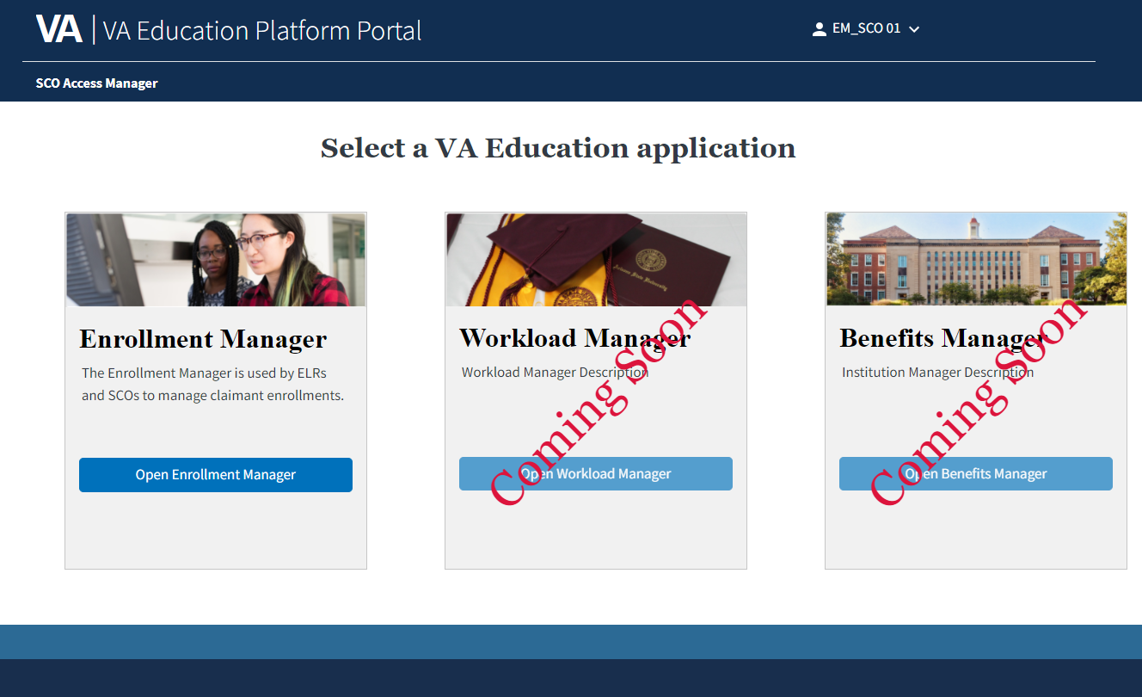
Create an ID.me Account Cont'd 6
Congratulations! You have successfully created and verified your ID.me account.
Go to the VA Education Platform Portal and select the “Open Enrollment Manager” button.
Navigate to page 46 or select the hyperlink here to proceed to the next section.
Note:
EM’s system can be accessed with any Internet browser, excluding Internet Explorer.
Access to Workload Manager and Benefits Manager is solely for internal users with PIV credentials.
Foreign SCOs experiencing trouble with ID.me or with authenticating your ID.me, please contact ID.me support.
Return to Table of Contents

Slide 21
Create a login.gov account

Slide 22
Create a Login.gov Account Cont’d
Select “Sign in with Login.gov” after navigating to the VA Education Platform sign-in page and selecting “SSOe”.
Return to Table of Contents

Slide 23
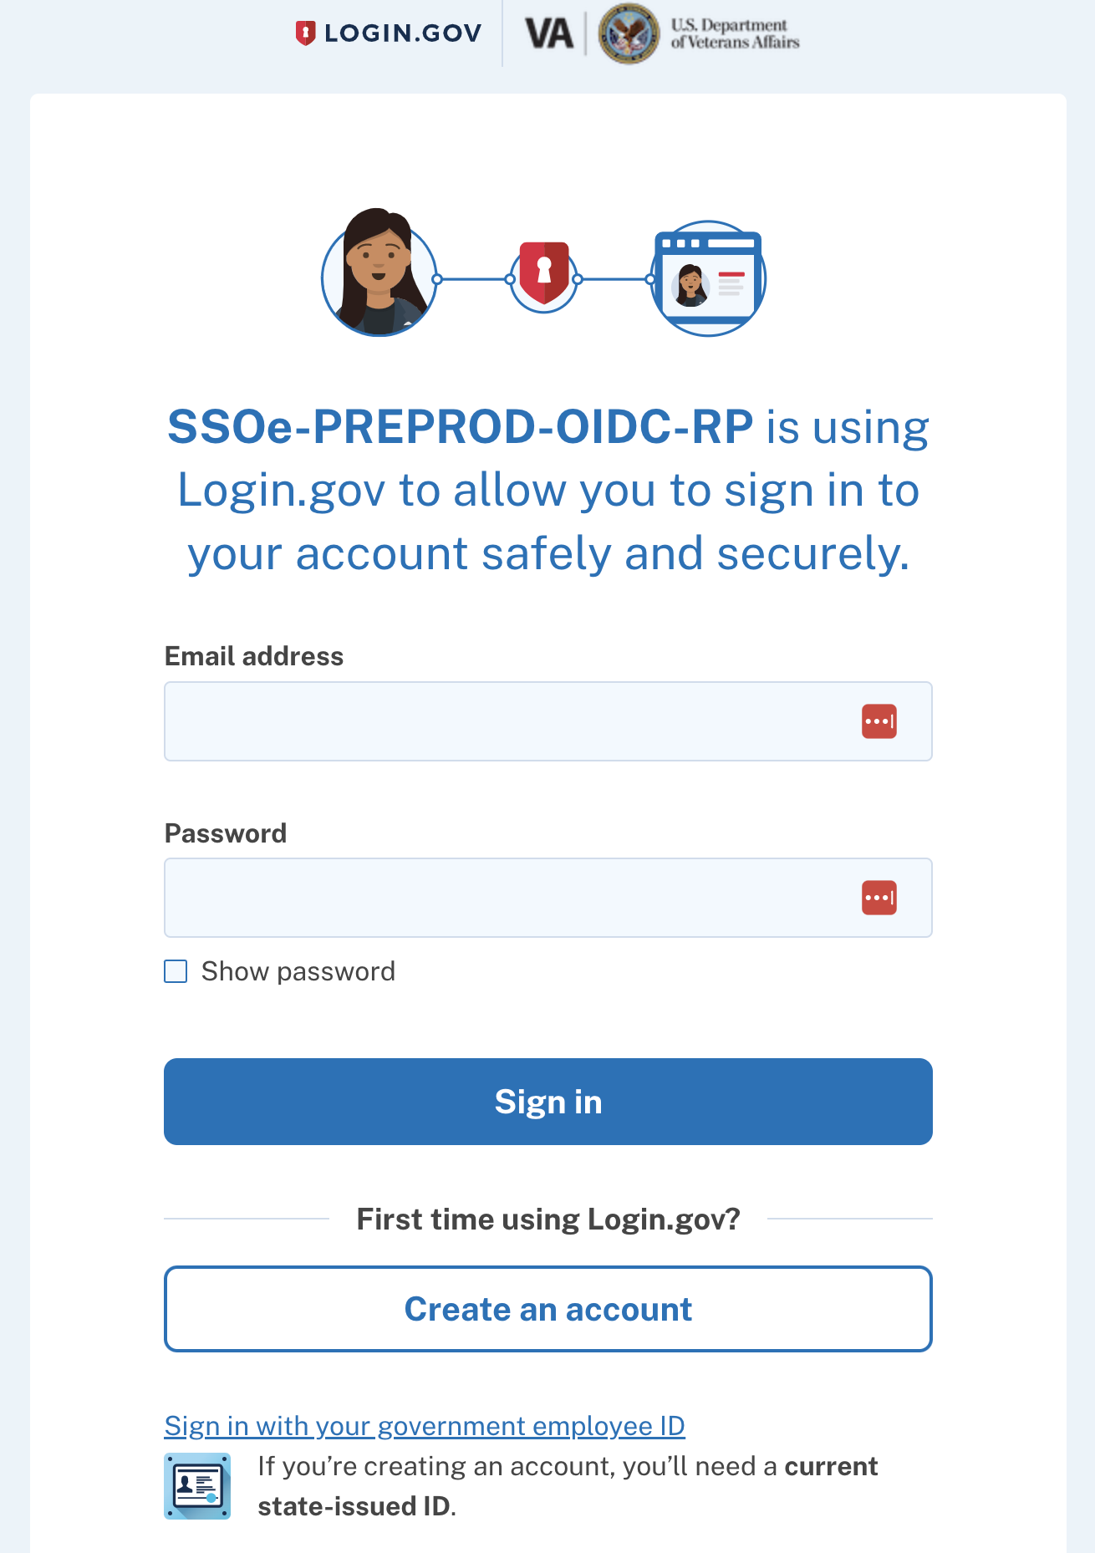
Create a Login.gov Account Cont’d 1
Select the “Create an account” button.
0
Return to Table of Contents

Slide 24
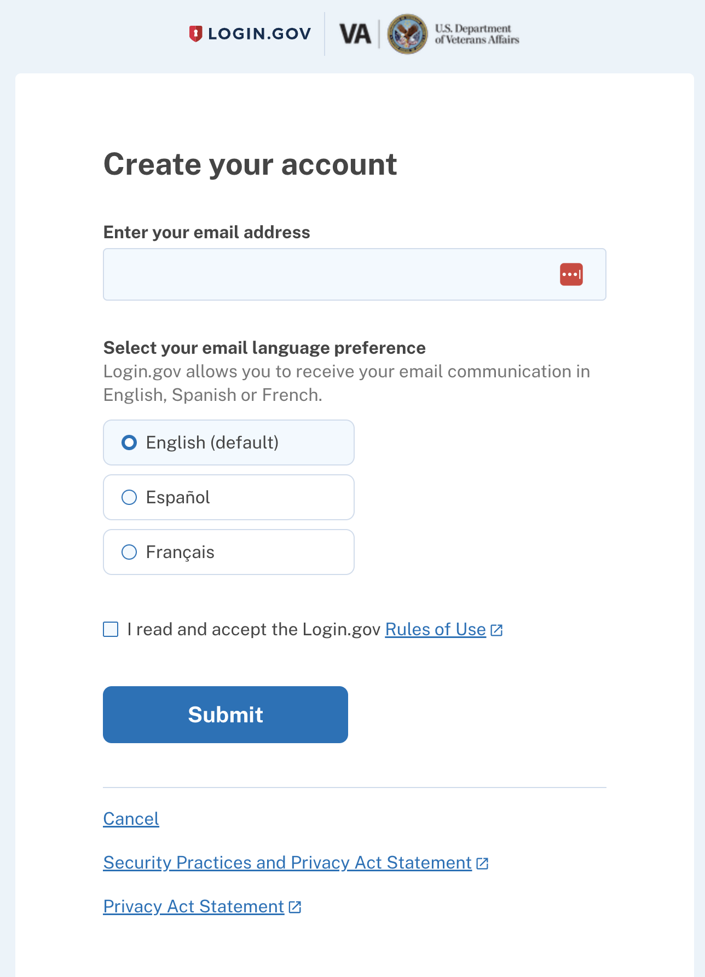
Create a Login.gov Account Cont’d 2
Enter your work “email address”, “select your email language preferences”, and check the box to agree to the terms.
Select the “Submit” button.
Return to Table of Contents

Slide 25
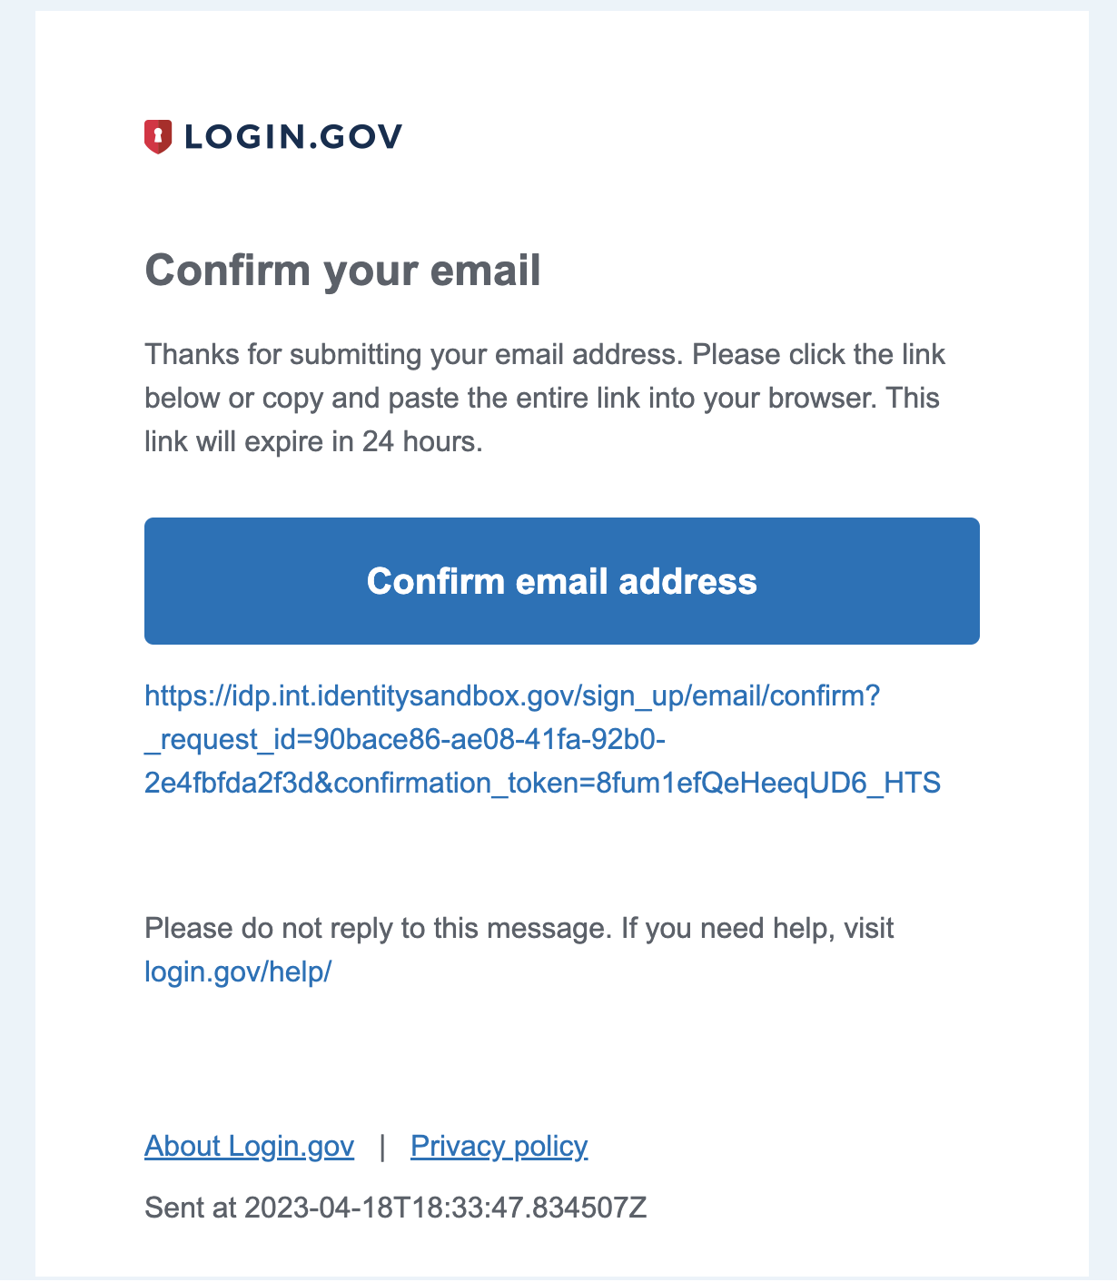
Create a Login.gov Account Cont’d 3
Open your email account for the email provided, and then open the email from Login.gov and select the “Confirm your email” button. This allows you to set up multi-factor authentication.
Return to Table of Contents

Slide 26
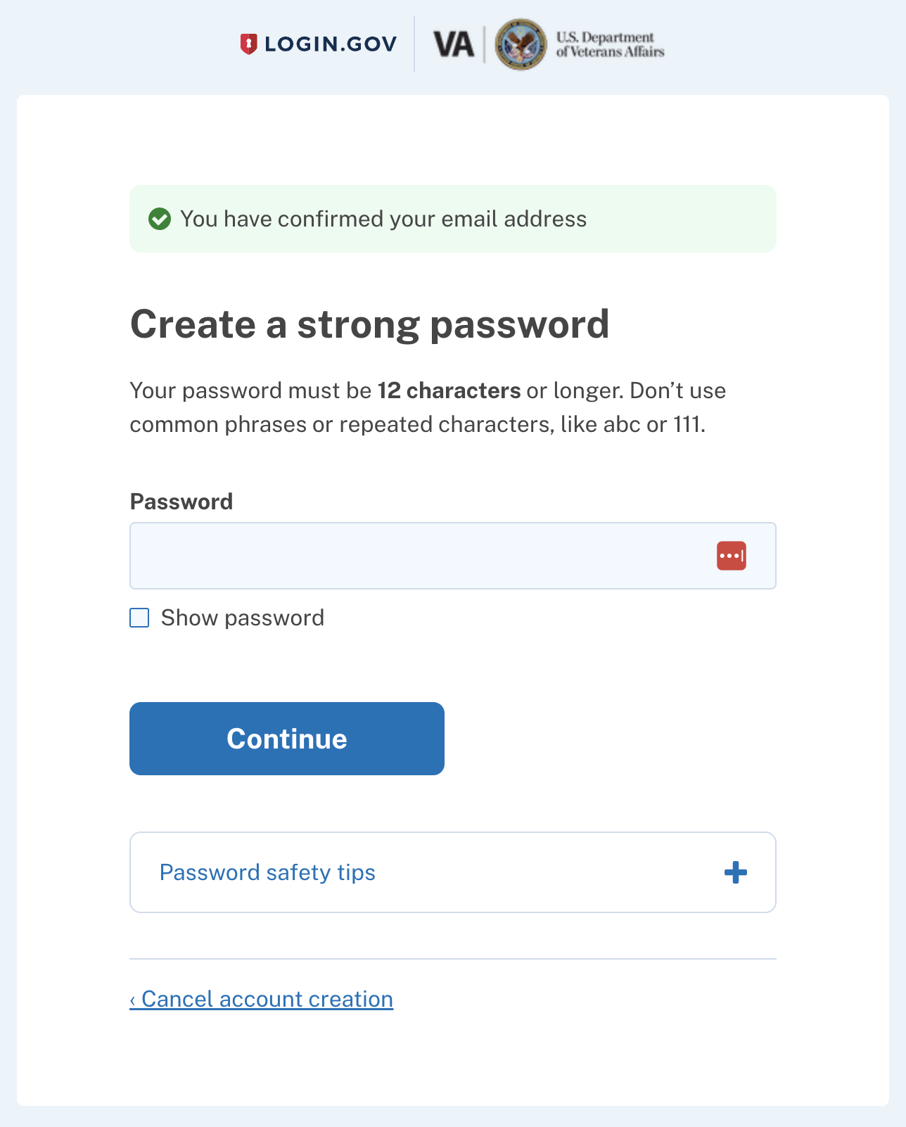
Create a Login.gov Account Cont'd 4
Once your email is confirmed, the system prompts you to create a password. The password must be 12 characters or longer.
Select the “Continue” button once complete.
Return to Table of Contents

Slide 27
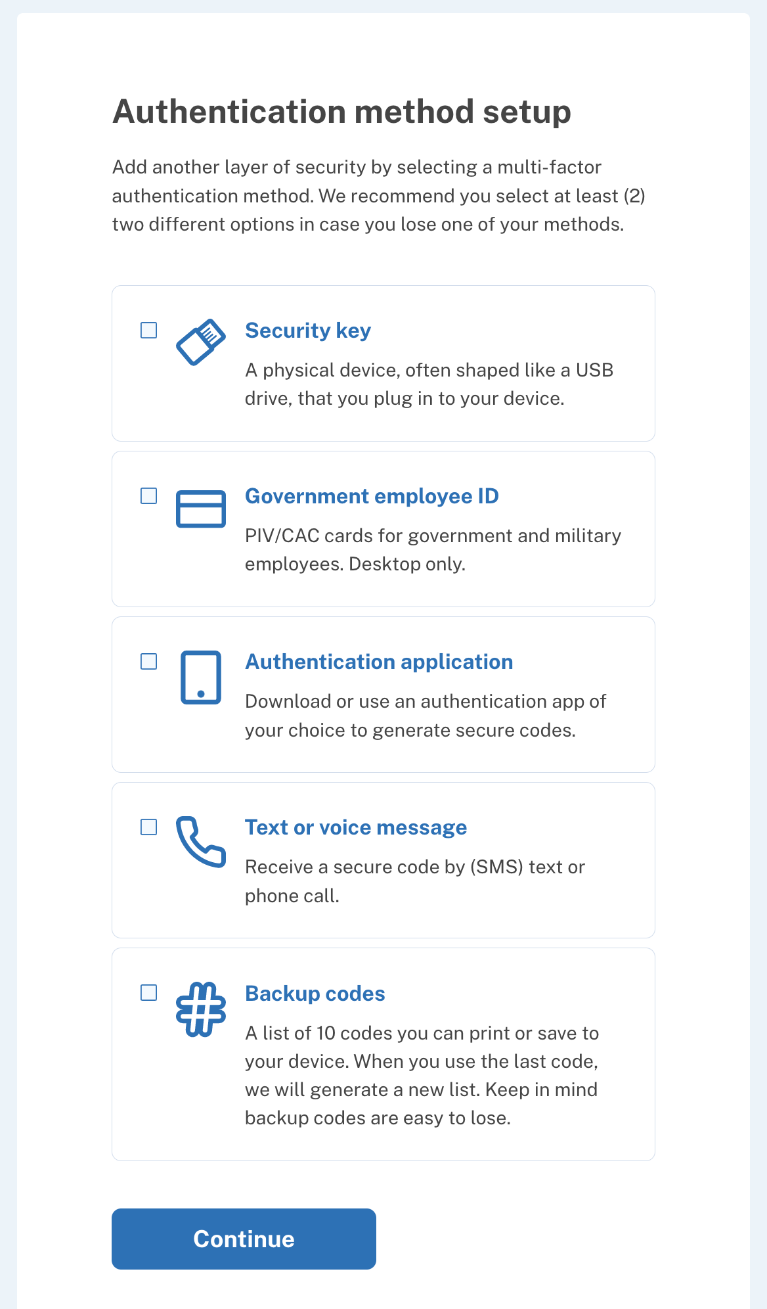
Create a Login.gov Account Cont'd 5
Select a preferred authentication method from the options provided.
Once you select your preferred authentication method, select the “Continue” button to continue the authentication process.
Return to Table of Contents

Slide 28
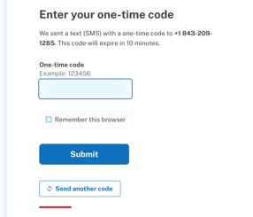
Create a Login.gov Account Cont'd 6
If you selected the “Text or voice message” option, enter the “one-time code” received. Then select the “Submit” button.
Note: If you selected another verification method, please follow the steps provided by Login.gov.
Return to Table of Contents

Slide 29
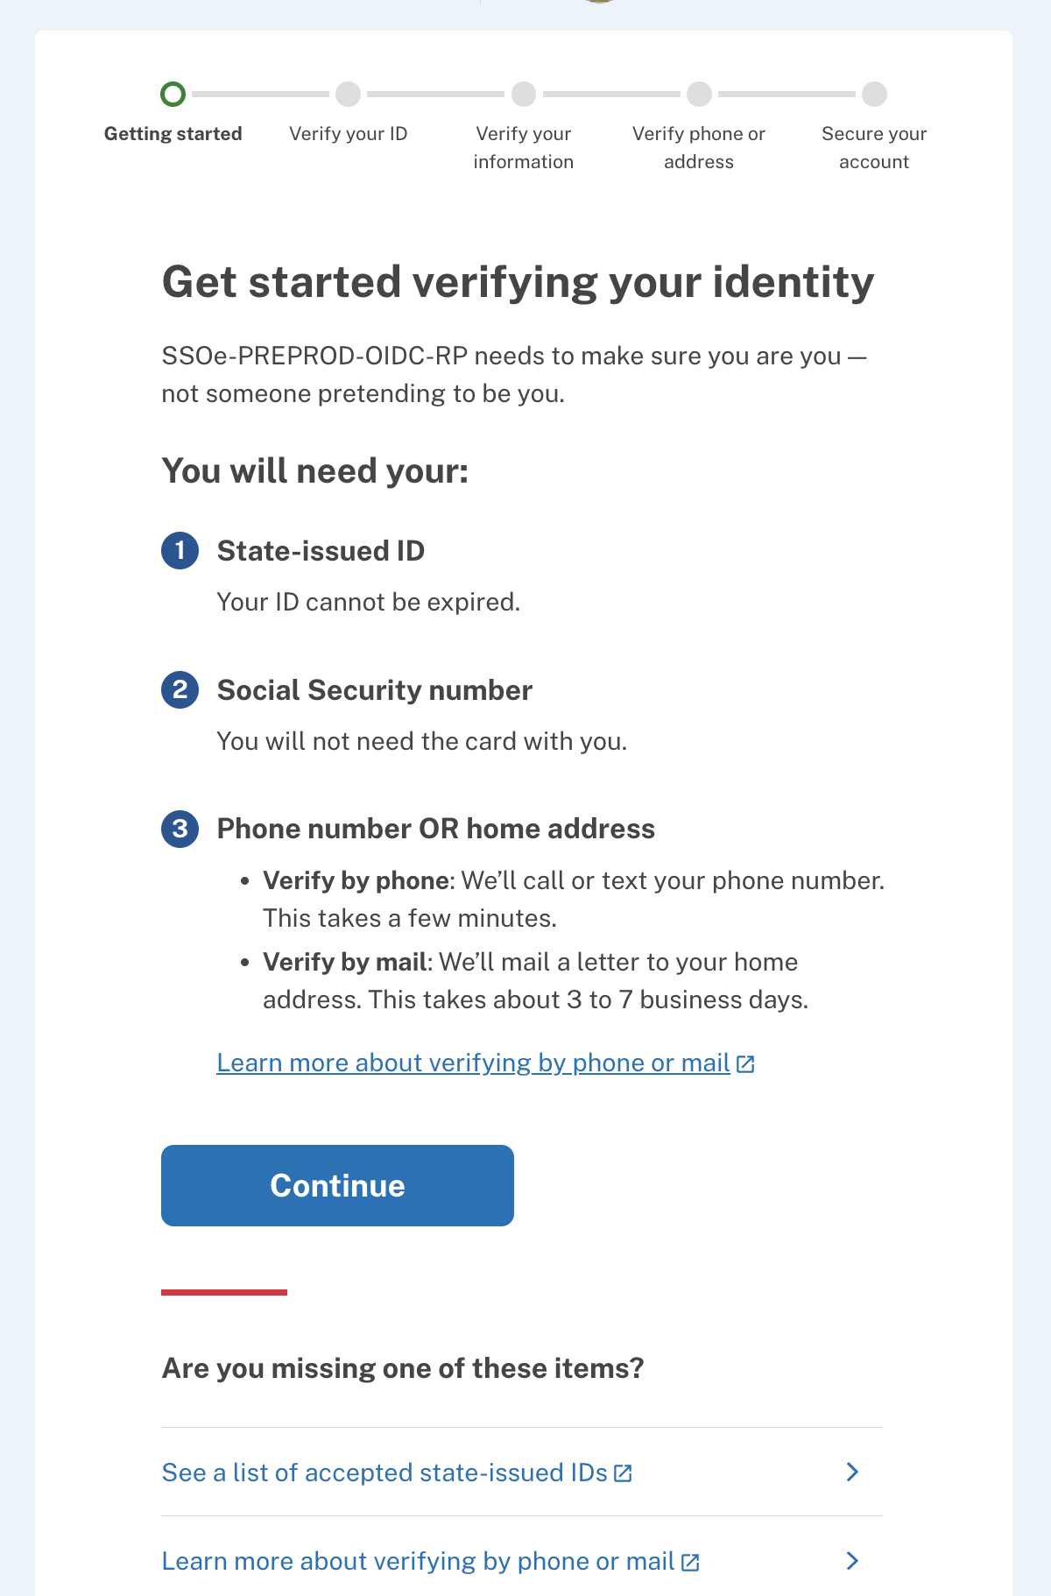
Create a Login.gov Account Cont'd 7
Follow the prompts to verify your identity. This process might take 5-10 minutes to complete and includes uploading a photo of your driver’s license, state ID, or passport to verify your identity.
Note: Should you encounter problems with verifying your identity, please access the Login.gov Help Center.
Return to Table of Contents

Slide 30
Create a Login.gov Account Cont'd 8
Congratulations! You have successfully created and verified your Login.gov account.
Go to the VA Education Platform Portal and select the “Open Enrollment Manager” button.
Navigate to page 45 or select the hyperlink here to proceed to the next section.
Note:
EM’s system can be accessed with any Internet browser, excluding Internet Explorer.
Access to Workload Manager and Benefits Manager is solely for internal users with PIV credentials.
ID.me is the preferred authentication method for Foreign SCOs
Return to Table of Contents

Slide 31
Sign in with id.me

Slide 32
Sign in with ID.me Cont'd
Select the “Sign in with ID.me” button.
Return to Table of Contents

Slide 33
Sign in with ID.me Cont'd 1
Input your email and password and select the “Sign in” button.
Return to Table of Contents

Slide 34
Sign in with ID.me Cont'd 2
Choose an authentication method by selecting “Text me” or “Call me”. Select the “Continue” button.
Note: If you select "Text me", a 6-digit code is sent via text message. If you select "Call me", follow the prompts in the phone call to complete multi-factor authentication. If you choose “Text me" navigate to page 35. If you choose “Call me" navigate to page 36.
Return to Table of Contents

Slide 35
Sign in with ID.me Cont'd 3
Option 1 – If you selected the “Text me” option and you receive your message code, input the 6-digit code and select the “Continue” button.
OR
Return to Table of Contents

Slide 36
Sign in with ID.me Cont'd 4
Option 2 – If you selected the “Call me” option, you receive a phone call asking you to follow the prompts by selecting numbers on your phone. This authenticates you.
Note: If the work number submitted uses a switchboard or an extension to contact you, there is a possibility the call may not go through. Using a cell number is suggested.
Return to Table of Contents

Slide 37
Sign in with ID.me Cont'd 5
If you have not done so previously, follow the prompts to verify your identity.
Note: Should you encounter problems with verifying your identity, access the ID.me Help Center.
Return to Table of Contents

Slide 38
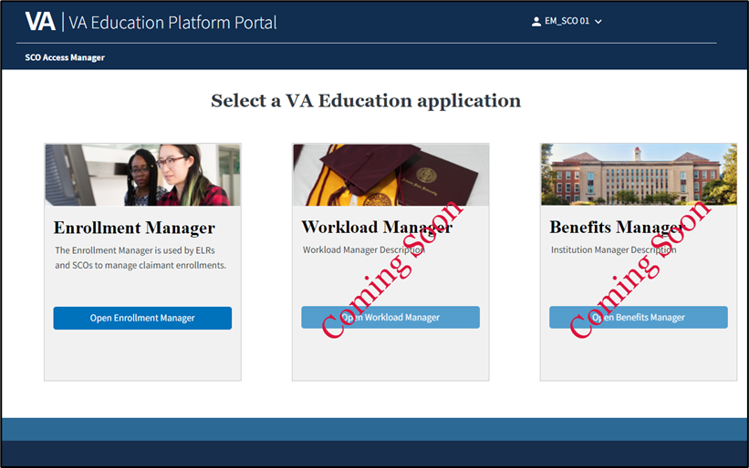
Sign in with ID.me Cont'd 6
Congratulations! You have successfully verified your ID.me account.
Go to the VA Education Platform Portal and select the “Open Enrollment Manager” button.
Navigate to page 45 or select the hyperlink here to proceed to the next section.
Note:
EM’s system can be accessed with any Internet browser, excluding Internet Explorer.
Access to Workload Manager and Benefits Manager is solely for internal users with PIV credentials.
Foreign SCOs experiencing trouble with ID.me or with authenticating your ID.me, please contact ID.me support.
Return to Table of Contents

Slide 39
Sign in with login.gov

Slide 40
Sign in with Login.gov Cont'd
Select the “Sign in with Login.gov” button.
Return to Table of Contents

Slide 41
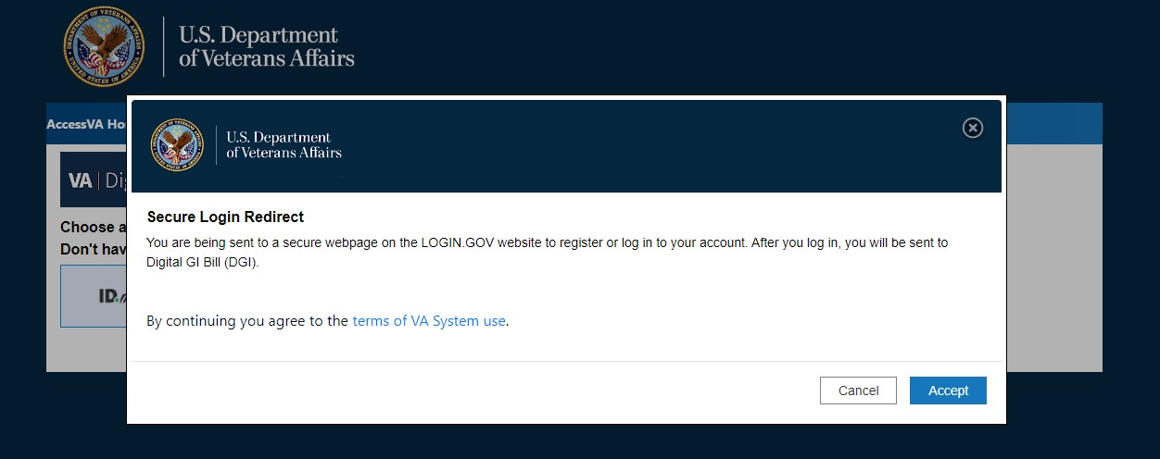
Sign in with Login.gov Cont'd 1
Select the “Accept” button to agree to the terms to be redirected to the Login.gov sign-in page to use multifactor authentication to verify your identity.
Return to Table of Contents

Slide 42
Sign in with Login.gov Cont'd 2
Enter your Login.gov email address and password and select the “Sign in” button.
Return to Table of Contents

Slide 43
Sign in with Login.gov Cont'd 3
Input the 6-digit code and select the “Submit” button.
Note: The system will send you a 6-digit code by text or voice message, depending on the authentication method you chose when you created your Login.gov account.
Return to Table of Contents

Slide 44
Sign in with Login.gov Cont'd 4
Congratulations! You have successfully verified your Login.gov account.
Go to the VA Education Platform Portal and select the “Open Enrollment Manager” button.
Navigate to page 45 or select the hyperlink here to proceed to the next section.
Note:
EM’s system can be accessed with any Internet browser, excluding Internet Explorer.
Access to Workload Manager and Benefits Manager is solely for internal users with PIV credentials.
ID.me is the preferred authentication method for Foreign SCOs
Return to Table of Contents

Slide 45
Requesting first time access

Slide 46
Requesting First-Time Access
Guidance for requesting first-time access to EM depends on your role. Locate your role in the bulleted list below. Select the hyperlinked text or navigate to the corresponding page number:
SCO – Navigate to slide 47
Assistant and SCO Read Only – Navigate to slide 57
Return to Table of Contents

Slide 47
SCO – Requesting First-Time Access

Slide 48
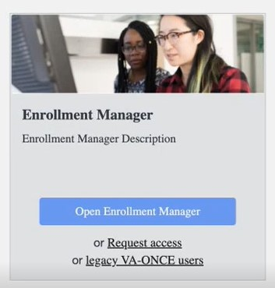
SCO – Requesting First-Time Access
School Certifying Official
Once you are on the VA Education Platform Portal, follow these steps to request access to EM:
Once you’ve been authenticated, navigate to the VA Education Platform Portal and select “Request access”.
Return to Table of Contents

Slide 49
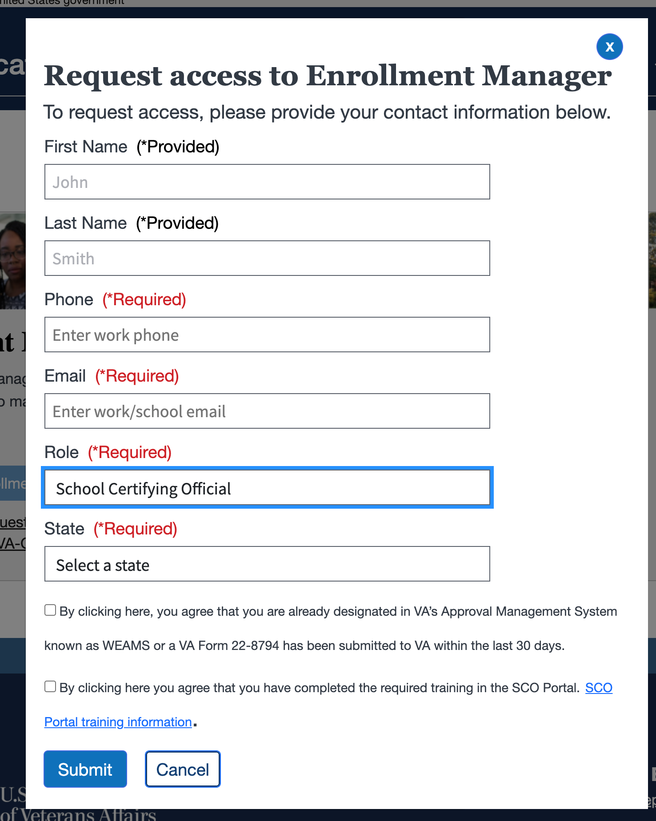
SCO – Requesting First-Time Access Cont'd
School Certifying Official
Verify that your pre-populated “First Name” and “Last Name” are accurate.
Note:
If the pre-populated name listed in EM is incorrect, please contact ID.me for assistance.
Return to Table of Contents

Slide 50
SCO – Requesting First-Time Access Cont'd 1
School Certifying Official
Input your primary “Phone” and “Email” associated with your role. These fields are required.
Note:
It is recommended to use a work/school email address.
Due to EM not recognizing foreign phone numbers, Foreign SCOs should input a mock phone number in the corresponding field (i.e., 123-456-7890) when requesting access.
z
Return to Table of Contents

Slide 51
SCO – Requesting First-Time Access Cont'd 2
School Certifying Official
Select “School Certifying Official” for the “Role". Once you select your role, the “State” and “Facility Code” fields appear.
Return to Table of Contents

Slide 52
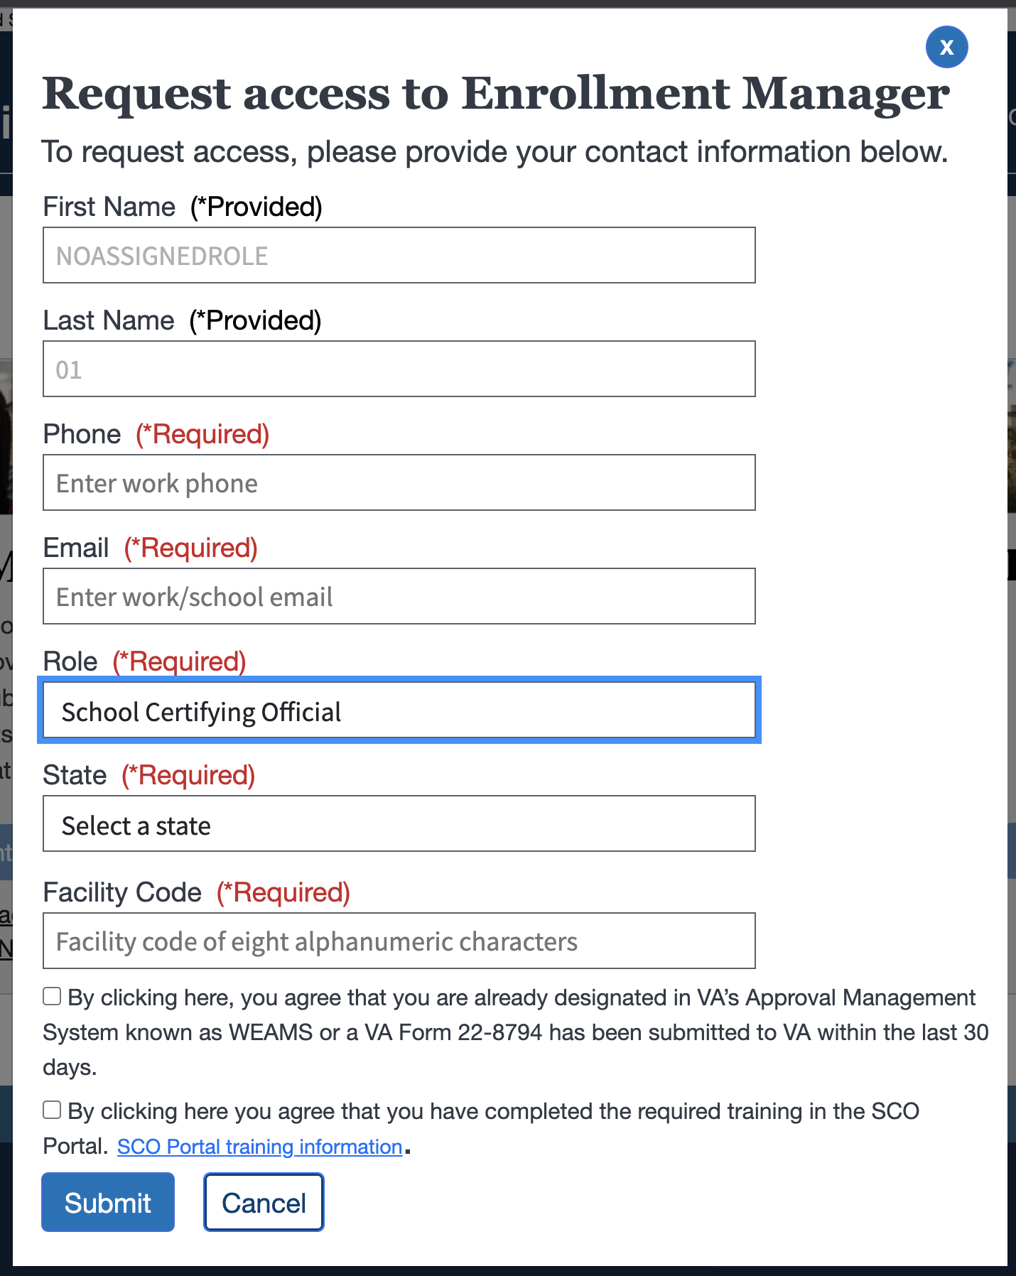
SCO – Requesting First-Time Access Cont'd 3
School Certifying Official
Select the appropriate “State” from the dropdown and then enter the “Facility Code” in the text entry field where your main facility is located. Both are required.
Note:
While you may report to more than one state or jurisdiction, input the most relevant state to gain access before working to gain approval for additional locations.
Foreign SCOs select Foreign Schools and have the ability to select a listed country they are at a foreign facility.
Federal agencies select federal approvals.
VET TEC/Certifying officials select VET TEC Providers from the dropdown options.
Return to Table of Contents

Slide 53
SCO – Requesting First-Time Access Cont'd 4
School Certifying Official
Select the checkboxes for the two fields, if applicable:
“By clicking here, you agree that you are already designated in VA’s Approval Management System known as WEAMS or a VA Form 22-8794 has been submitted to VA within the last 30 days".
“By clicking here, you agree that you have completed the required training in the SCO Portal”.
Note: This is in reference to the SCO Annual Training Requirements for New and Existing SCOs in the SCO Portal. Checkboxes selection are not required to submit your request.
Return to Table of Contents

Slide 54
SCO – Requesting First-Time Access Cont'd 5
School Certifying Official
Select the “Submit” button.
Return to Table of Contents

Slide 55
SCO – Requesting First-Time Access Cont'd 6
School Certifying Official
A message appears noting that access has been requested and you will receive two emails: one upon submission of your request; one upon approval/denial.
Return to Table of Contents

Slide 56
SCO – Requesting First-Time Access Cont'd 7
School Certifying Official
After approval, the “Open Enrollment Manager” button is enabled on the VA Education Platform Portal.
Select here or navigate to page 66 to go to the next SCO section: Approving, Denying, and Revoking Access to EM.
Note: Once you have completed these steps to log in to EM for the first time, you can access the EM link directly and login with your VA.gov credentials (ID.me or Login.gov). For direct future access, subsequently, bookmark the EM login page.
Return to Table of Contents

Slide 57
Assistants and SCO Read Only – Requesting First-Time Access

Slide 58
Assistants and SCO Read Only – Requesting First-Time Access
Assistants and SCO Read Only
In EM, Assistants have the ability to enter data into EM that must be reviewed and submitted to VA by an official SCO. SCO Read Only have the ability to view student information.
Once you've verified your identity with ID.me or Login.gov, you can navigate back to the VA Education Platform where you can login. Follow the steps on the following slides to request first-time access to EM as an Assistant and a SCO Read Only.
Return to Table of Contents

Slide 59
Assistants and SCO Read Only – Requesting First-Time Access Cont'd
Assistants and SCO Read Only
Once you have been authenticated, navigate to the VA Education Platform Portal and select “Request access”.
Return to Table of Contents

Slide 60
Assistants and SCO Read Only – Requesting First-Time Access Cont'd 1
Assistants and SCO Read Only
Verify that your pre-populated “First Name” and “Last Name” are accurate.
Note:
If the pre-populated name listed in EM is incorrect, please contact ID.me for assistance.
Return to Table of Contents

Slide 61
Assistants and SCO Read Only – Requesting First-Time Access Cont'd 2
Assistants and SCO Read Only
Input your primary “Phone” and “Email” associated with your role. These fields are required.
Note:
It is recommended to use a work/school email address.
Return to Table of Contents

Slide 62
Assistants and SCO Read Only – Requesting First-Time Access Cont'd 3
Assistants and SCO Read Only
For “Role”, select your appropriate title from the dropdown options. Once you select your role, the “Facility Code” field appears.
Note: If you select the “School Certifying Official Read Only” dropdown option for your “Role”, two checkboxes will appear under the “Facility Code” field, which say the following:
“By clicking here, you agree that you are already designated in VA’s Approval Management System known as WEAMS or a VA Form 22-8794 has been submitted to VA within the last 30 days".
“By clicking here, you agree that you have completed the required training in the SCO Portal”.
Return to Table of Contents

Slide 63
Assistants and SCO Read Only – Requesting First-Time Access Cont'd 4
Assistants and SCO Read Only
Input your school’s 8-digit “Facility Code”. If you are unsure of the facility code, ask the designated SCO at your school.
Note: If you select the “School Certifying Official Read Only” dropdown options, if applicable, please select the checkboxes.
Return to Table of Contents

Slide 64
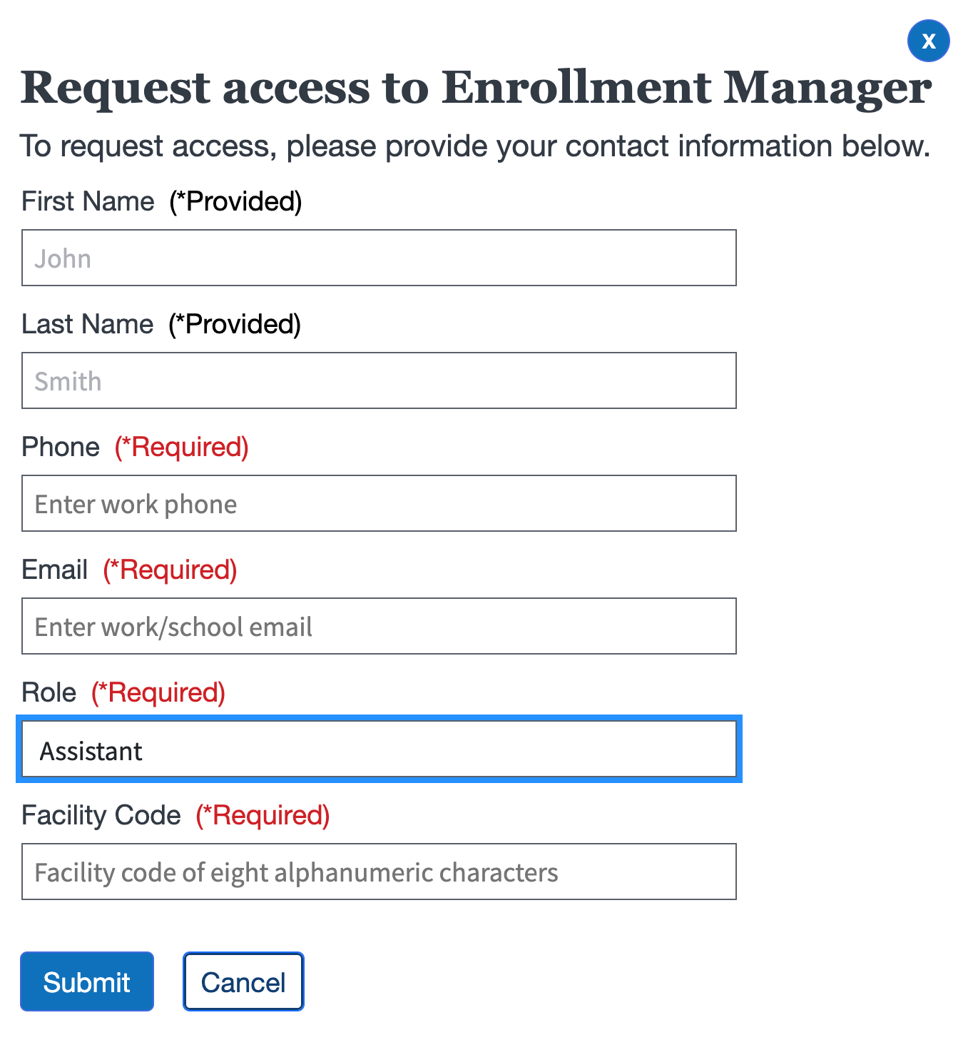
Assistants and SCO Read Only – Requesting First-Time Access Cont'd 5
Assistants and SCO Read Only
Once all fields have been acknowledged and addressed, select the “Submit” button and the request is sent to an assigned SCO to review for approval or denial.
Return to Table of Contents

Slide 65
Assistants and SCO Read Only – Requesting First-Time Access Cont'd 6
Assistants and SCO Read Only
Once your SCO receives and reviews the request, access to EM is granted or denied.
Select the hyperlink here or navigate to page 86 to go to the next Assistant and SCO Read Only relevant section: Navigating the EM Dashboard.
Note: While Assistants may have more than one facility code they report to, only one request needs to be submitted. The SCO may grant access to any and all facilities where they have access.
Return to Table of Contents

Slide 66
SCO – Approving, Denying, and Revoking Enrollment Manager Access

Slide 67
SCO – Approving, Denying, and Revoking Enrollment Manager Access
School Certifying Official
Select the hyperlinked text or navigate to the corresponding page number:
Approving Access – Navigate to page 68
Revoking Access – Navigate to page 75
Assigning/Unassigning Facility Access – Navigate to page 80
Return to Table of Contents

Slide 68
Approving and Denying Access

Slide 69
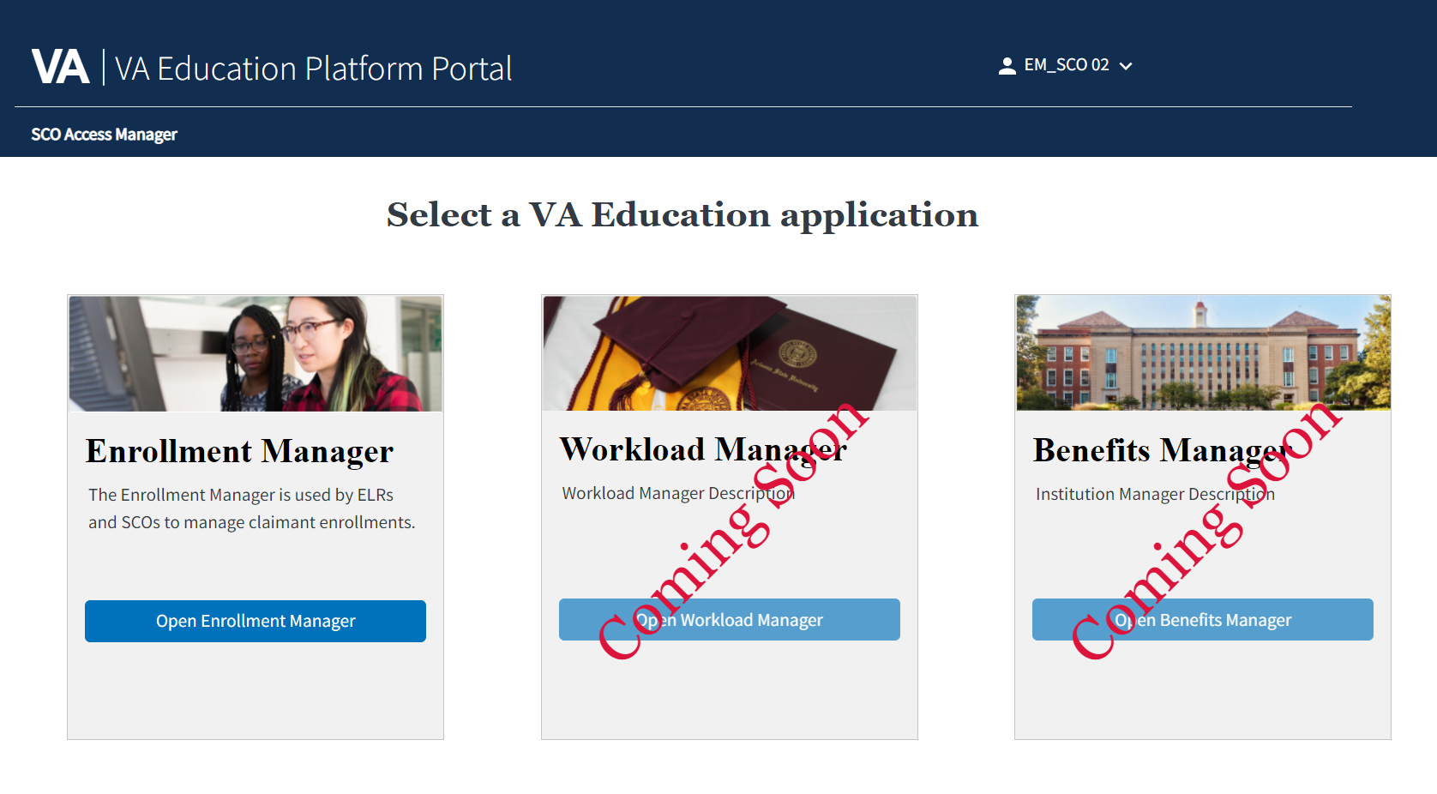
Approving and Denying Access – Approving
School Certifying Official
Follow the steps below to approve an access request for an Assistant or SCO Read Only user.
Once logged into the VA Education Platform Portal, select the “SCO Access Manager” button.
Note: If you are reviewing an access request from an SCO Read Only user, please confirm that the email address and name listed in WEAMS or the VA Form 22-8794 match the name and email provided on the access request. SCOs who are approving Assistants or SCO Read Only users do not receive an email when access to EM is being requested.
Return to Table of Contents

Slide 70
Approving and Denying Access – Approving Cont'd
School Certifying Official
Select the "Approve” button if the Assistant or SCO Read Only user has met all requirements to access EM.
Return to Table of Contents

Slide 71
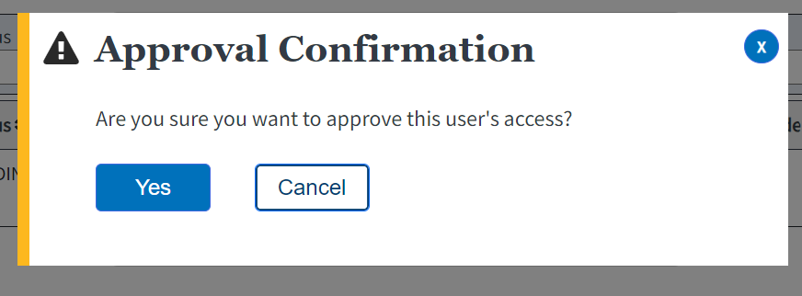
Approving and Denying Access – Approving Cont'd 1
School Certifying Official
Select the “Yes” button on the “Approval Confirmation” screen to grant the user access.
Return to Table of Contents

Slide 72
Approving and Denying Access – Denying
School Certifying Official
If you are unfamiliar with the user requesting access or they do not need access, you should deny their access request. To do so, select the “Deny” button.
Return to Table of Contents

Slide 73
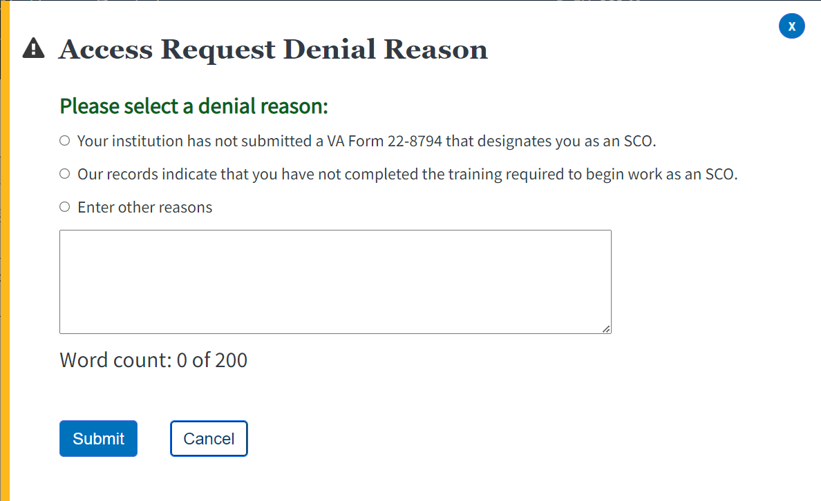
Approving and Denying Access – Denying Cont'd
School Certifying Official
When selecting a denial reason for Read-Only SCOs, SCOs may choose between three options:
Option 1 – “Your institution has not submitted a VA Form 22-8794 that designates you as an SCO”
Option 2 – “Our records indicated that you have not completed the training required to begin work as an SCO”
Option 3 – “Enter other reasons” – If selected, SCOs must fill in the denial reason within the text box provided.
Note: While EM gives SCOs the option to select from all three options, Option 2 is not a valid denial reason for SCO Read Only users, as these users do not have training requirements.
Return to Table of Contents

Slide 74
Approving and Denying Access – Denying Cont'd 1
School Certifying Official
Select the “Submit” button.
Note: Once the Submit button is selected, an email with the denial reason is sent to the requestor informing them of the denial so they can submit a new request once the requirements are met.
Return to Table of Contents

Slide 75
Revoking Access

Slide 76
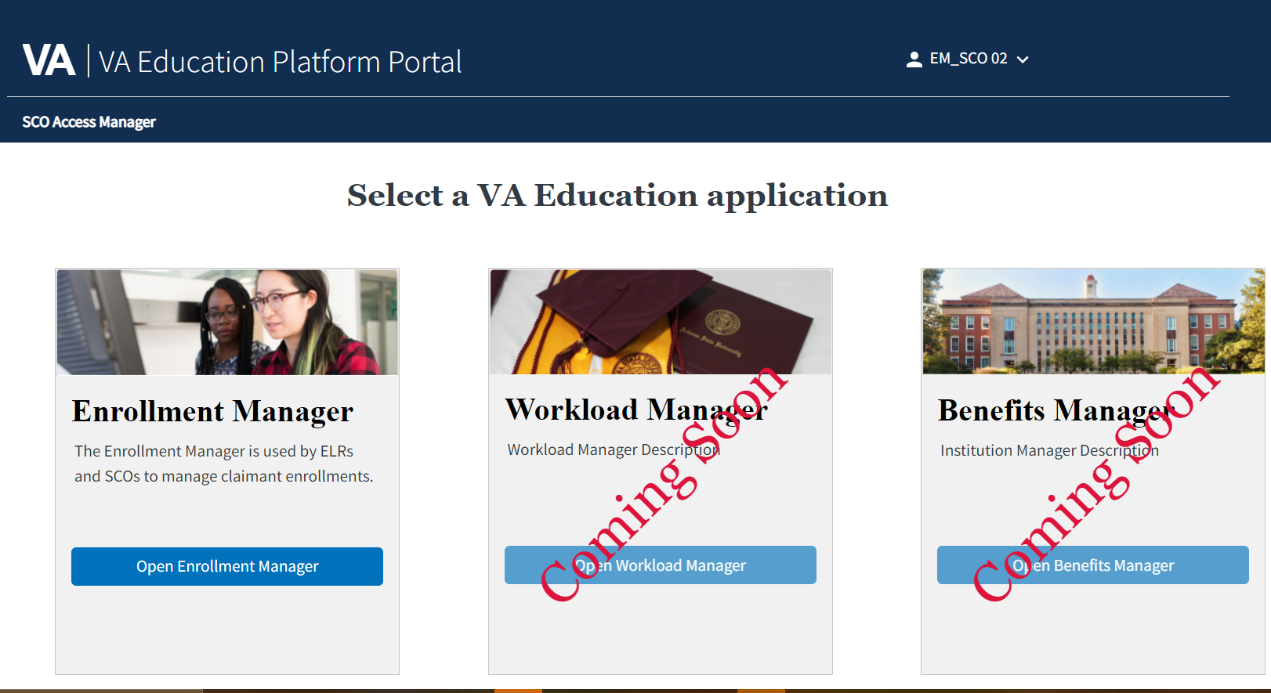
Revoking Access Cont'd
School Certifying Official
If an Assistant or SCO Read Only user leaves an institution, use the following steps below to revoke their access from EM:
Once logged into the VA Education Platform Portal, select the “SCO Access Manager” button.
Return to Table of Contents

Slide 77
Revoking Access Cont'd 1
School Certifying Official
Search for the user that needs their access revoked by utilizing the following search fields:
“First name”
“Last name”
“Email”
“Status”
After selecting, then select the “Revoke” button on their profile.
Return to Table of Contents

Slide 78
Revoking Access Cont'd 2
School Certifying Official
Select the “Yes” button in the “Revocation Confirmation” screen to confirm the user’s access is revoked.
Return to Table of Contents

Slide 79
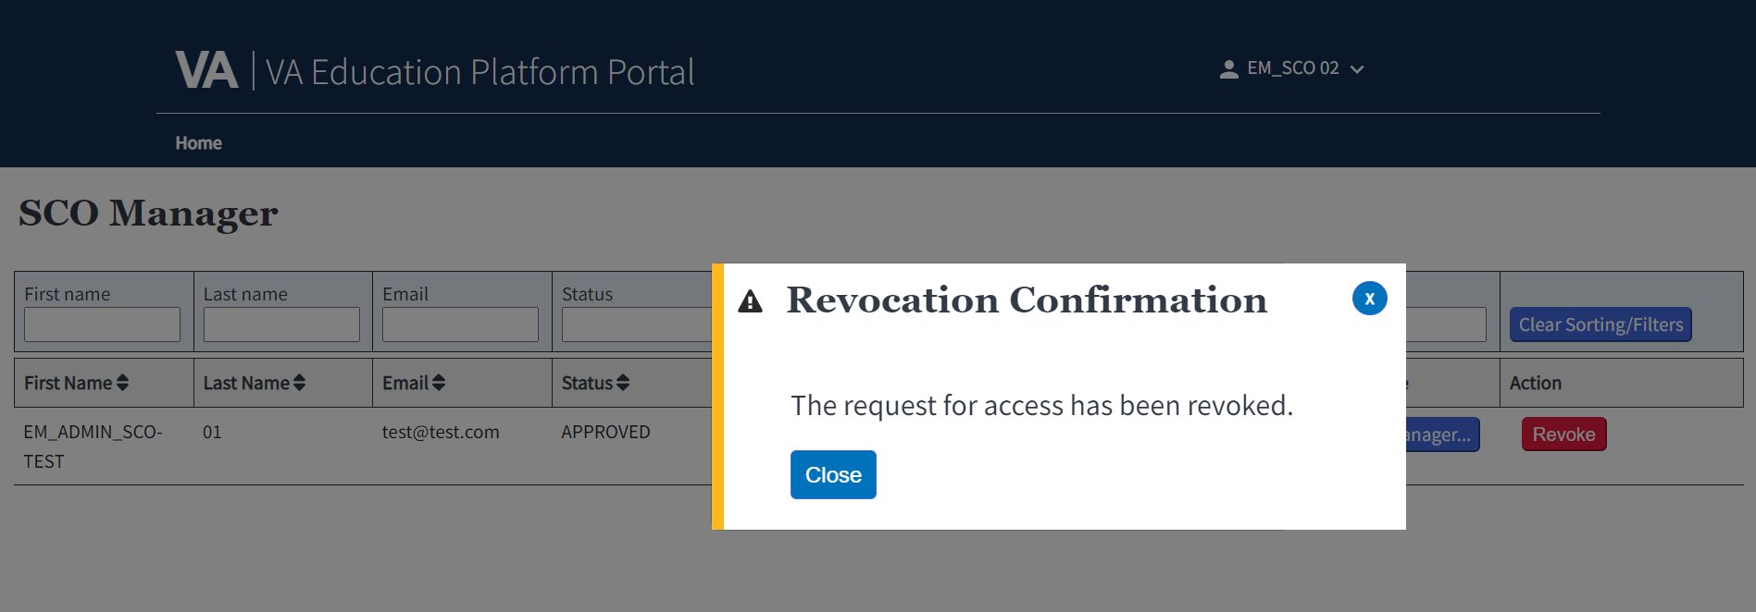
Revoking Access Cont'd 3
School Certifying Official
Select the “Close” button in the “Revocation Confirmation” screen to exit the screen.
Return to Table of Contents

Slide 80
Assigning and Unassigning Facilities

Slide 81
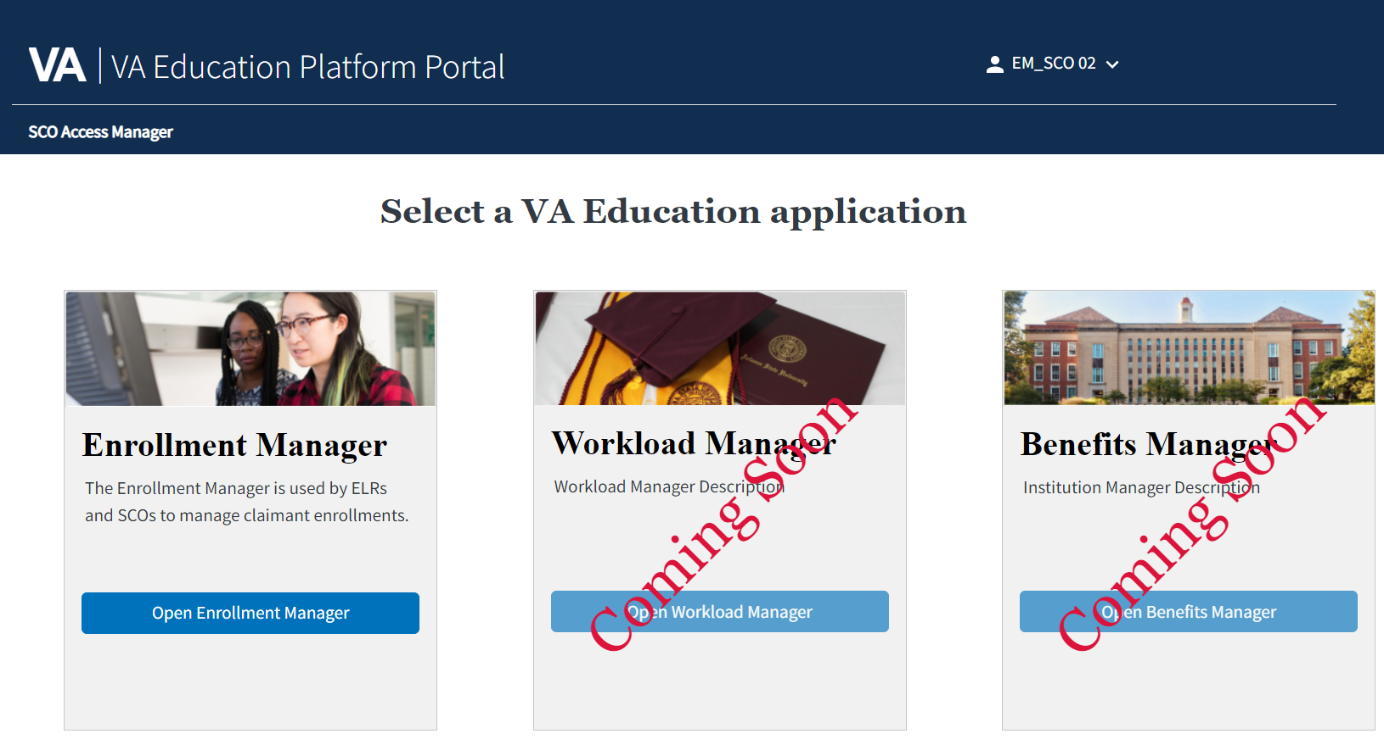
Assigning/Unassigning Facilities
School Certifying Official
SCOs can manage facility access for Assistants and SCO Read Only users who have access to EM.
Use the following steps to assign or unassign facilities from user profiles:
Once logged into the VA Education Platform Portal, select the “SCO Access Manager” button.
Return to Table of Contents

Slide 82
Assigning/Unassigning Facilities Cont'd
School Certifying Official
Search for the appropriate user profile by using the following search fields:
“First name”
“Last name”
“Email”
“Status”
Once the correct user is located, select the “Facility Manager” button.
Return to Table of Contents

Slide 83
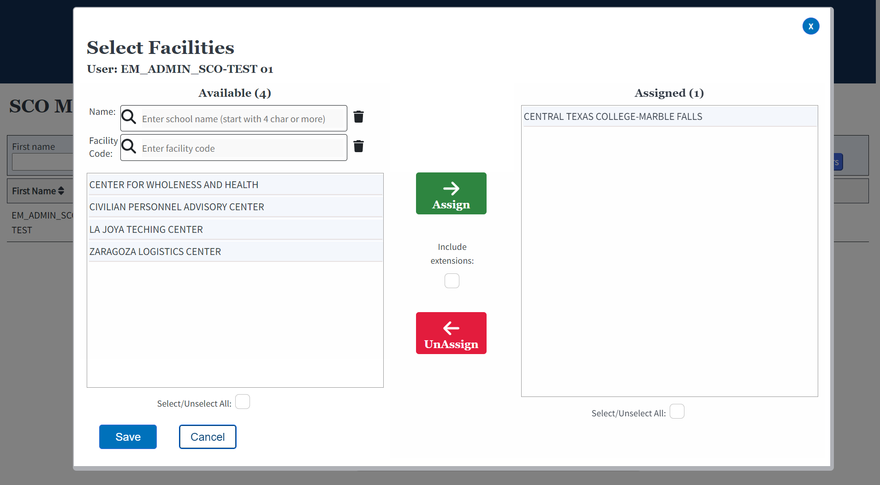
Assigning/Unassigning Facilities Cont'd 1
School Certifying Official
Search for facilities to assign to this user using the “Name” or “Facility Code” fields. On the right-hand side of the screen, SCOs can view a list of facilities already assigned to the Assistant or SCO Read Only user.
Note:
SCOs should reference WEAMS or the VA Form 22-8794 to confirm the facility codes the SCO Read Only user should have access to. SCO Read Only user access must be reviewed with every updated VA Form 22-8794.
Schools with Centralized Certification have designated Points of Contact (POCs) at branch campuses versus Certifying Officials on site. POCs must have access to EM in order to provide certification information to students and VA/SAA representatives; however, they do not have the capability to submit certifications and their access is read-only. SCOs are responsible for approving and managing access for POCs.
Return to Table of Contents

Slide 84
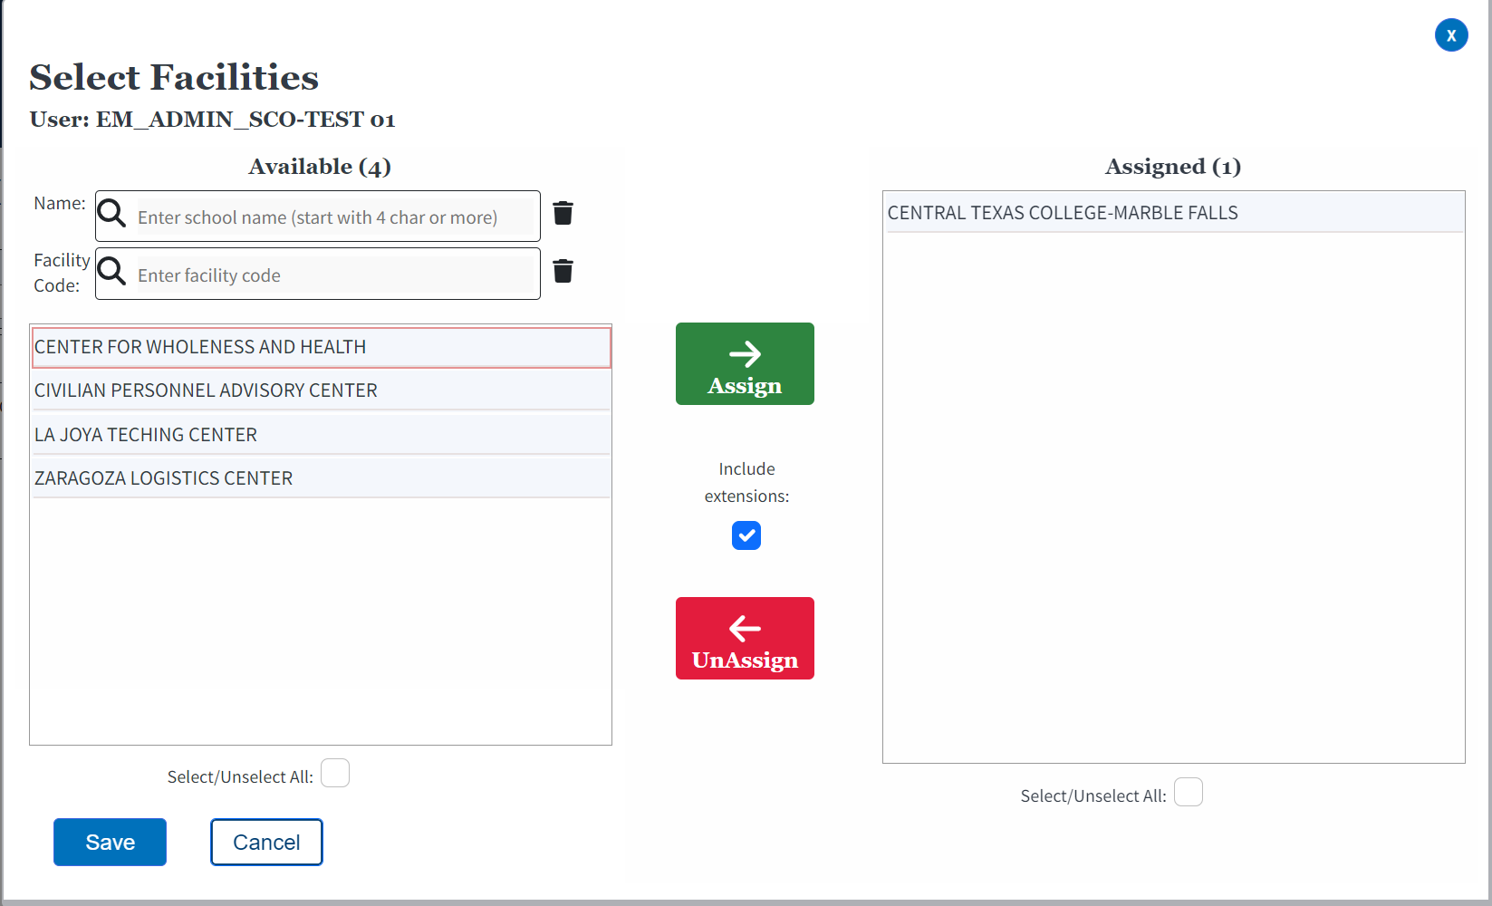
Assigning/Unassigning Facilities Cont'd 2
School Certifying Official
Select the appropriate facility or facilities, select the “Assign” arrow, then select the “Save” button to add the facility to the user.
By default, the "Include extensions" checkbox is selected when the main campus indicated has extension campuses. The associated extensions will be automatically added to the selected user. If unapplicable, uncheck the button.
Note:
Users must manually search for branch campuses to assign them to an Assistant or SCO Read Only user.
Users using Windows computers can hold the “Control” key on their keyboard to select multiple facilities in the “Assigned” column simultaneously.
Users using Mac computers can hold the “Command” key to select multiple facilities.
Return to Table of Contents

Slide 85
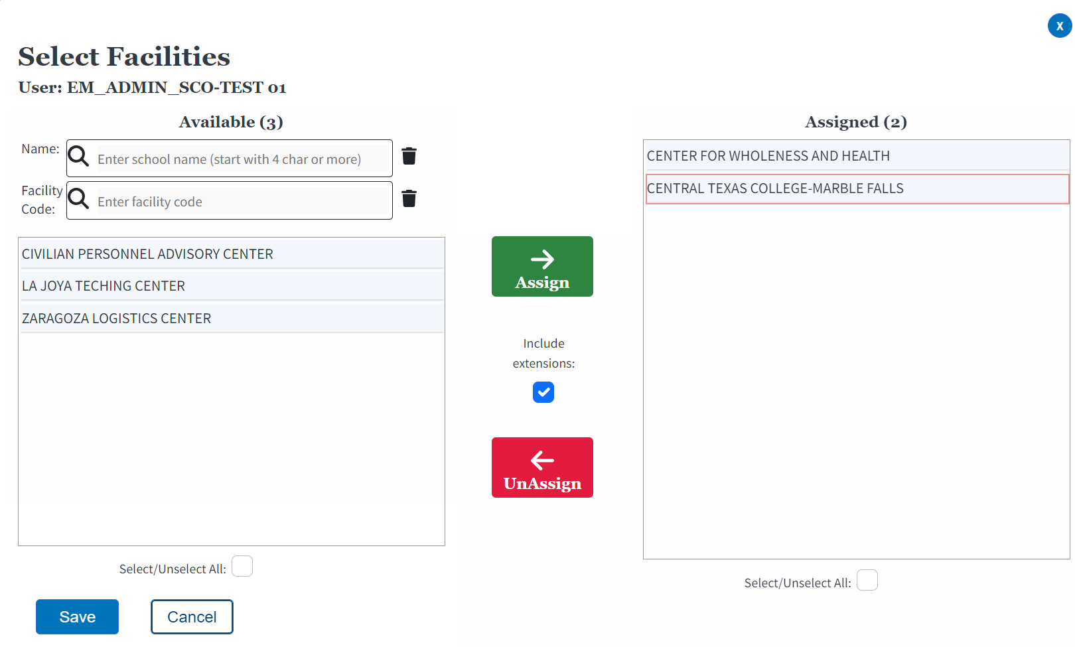
Assigning/Unassigning Facilities Cont'd 3
School Certifying Official
To remove facility access for an Assistant or SCO Read Only user, select the facility name under the “Assigned” column and select the “UnAssign” arrow, then select the “Save” button.
Note: Multiple facilities can be unassigned simultaneously using the same method used in the previous step to assign multiple facilities.
Return to Table of Contents

Slide 86
Enrollment manager main tabs

Slide 87
Enrollment Manager Main Tabs Cont'd
The four main navigation tabs for EM are detailed at the top of the screen. The next section details the main features of each tab.
Dashboard (Default Section) – Navigate to page 88
Students Tab – Navigate to page 91
Including Search and Add a Student, and main navigation of the Student profile
Schools – Navigate to page 126
Reports – Navigate to page 129
Note: The actions completed in each tab are dependent on the facility type you support. The rest of the tabs are described in each facility type section.
Return to Table of Contents

Slide 88
Dashboard tab

Slide 89
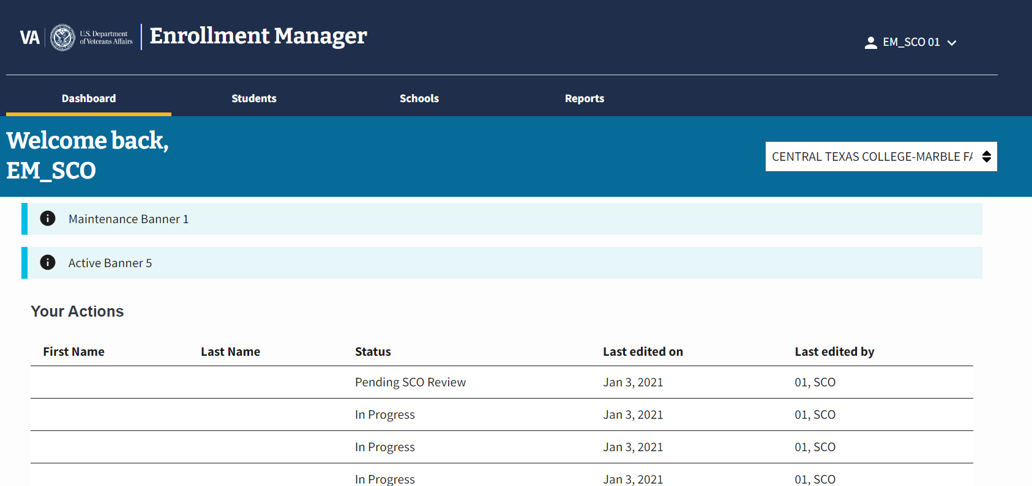
Dashboard Tab Cont'd
The Dashboard includes helpful resources for users and the “Your Actions” section. This section organizes system actions by:
“First Name”
“Last Name”
“Status”
“Last edited on”
“Last edited by”
Note:
Actions noted in the “Your Actions” section display students currently being worked on and have not yet been completed. It is a convenient way to access forms in-progress. Forms can be selected through the facility code dropdown function.
Return to Table of Contents

Slide 90
Dashboard Tab Cont'd 1
Below the “Your Actions” section of the Dashboard are links in the “Helpful Resources” section. Links include the SCO Handbook and the GI Bill Comparison Tool.
Return to Table of Contents

Slide 91
Students tab

Slide 92
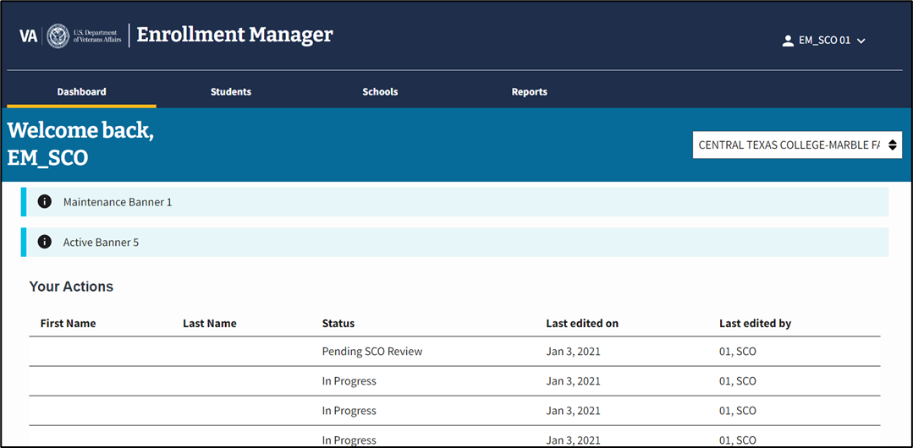
Students Tab Cont'd
From the “Students” tab, users can search for a student, add a student to a school, and review a student profile.
To begin, select the “Students” tab on the Dashboard menu.

Slide 93
Finding a student
Students tab

Slide 94
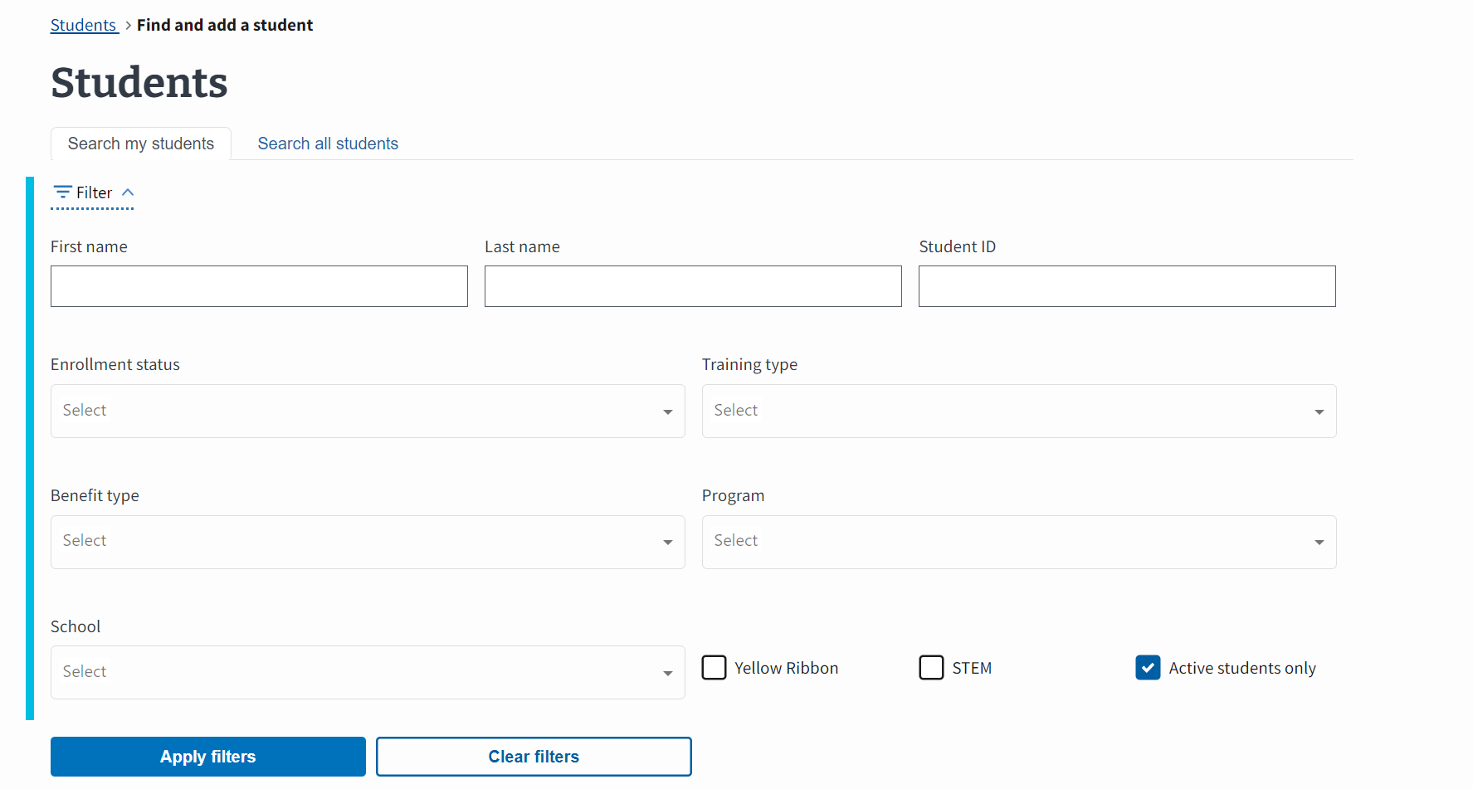
Students Tab – Finding a Student
Once you select the “Students” tab, select one of the two search options:
Search my students – Navigate to page 95
Search all students – Navigate to page 96
Using the “Search all students” functionality searches all data within the system. The “Search my students” function displays/searches all students that are at a facilities where the SCO has access. Depending on which option you select, different search field options populate.
Note:
Before searching for a student, this page defaults to display “Active” students in alphabetical order.
Neither search option allows users to search for a student by SSN.
Return to Table of Contents

Slide 95
Students Tab – Finding a Student Cont'd
a. Search my students - Search for a student by entering their “First name”, “Last name”, or “Student ID”. There are several filters to help narrow your search results such as, “Enrollment status”, “Training type”, and “Program”. “Program” is populated by the programs approved in WEAMS. In addition, non-matriculated and undeclared are available dropdown options that are enabled and displayed if the “Training type” is IHL.
Return to Table of Contents

Slide 96
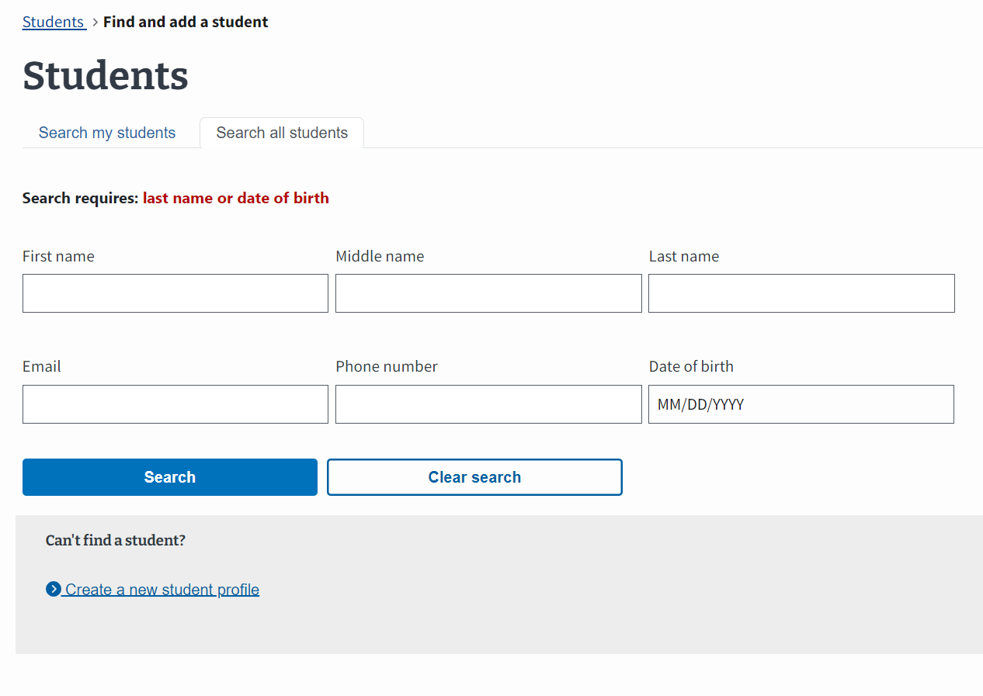
Students Tab – Finding a Student Cont'd 1
b. Search all students - Search for a student by “First name”, “Middle name”, Last name”, “Email”, “Phone number”, or “Date of birth”.
Note:
Although all fields are not required to populate search results, there is minimum search criteria of first two letters of Last name or Date of Birth.
If an SCO can’t find a student using the correct Date of Birth, use 1/1/1900 and the correct last name when searching. This is will resolved in future iterations of EM.
Return to Table of Contents

Slide 97
Adding a student
Students tab

Slide 98
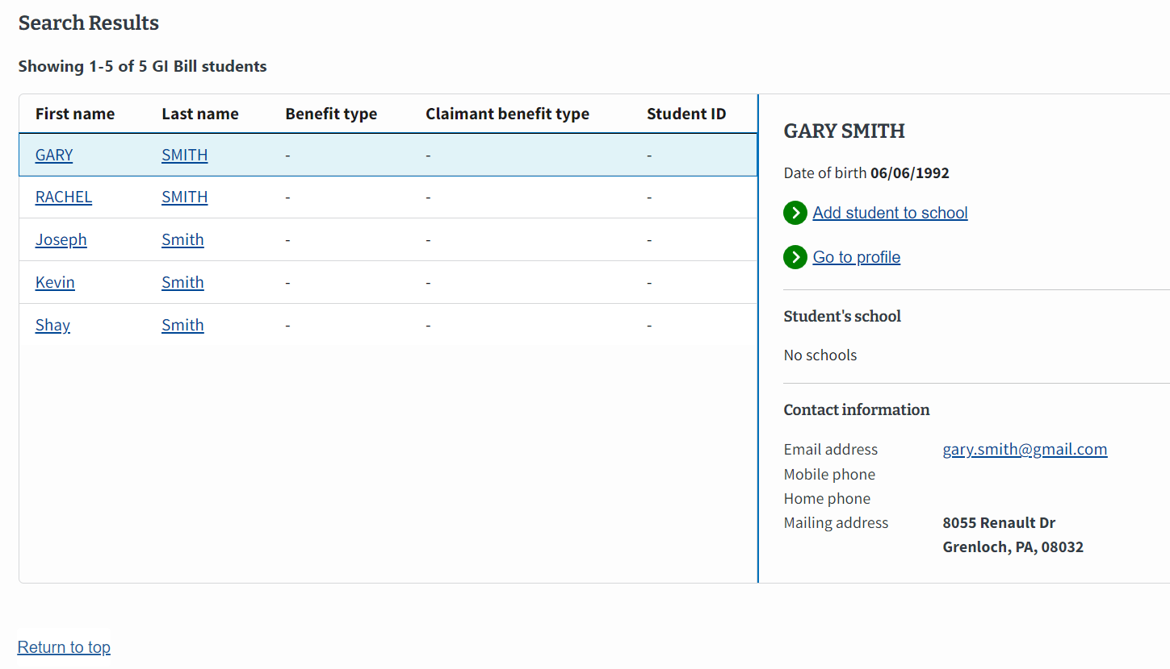
Students Tab – Adding a Student to a School
Once you have searched for a student, select the correct student from the list of results. Then, select the “Add student to school” button.
Return to Table of Contents

Slide 99
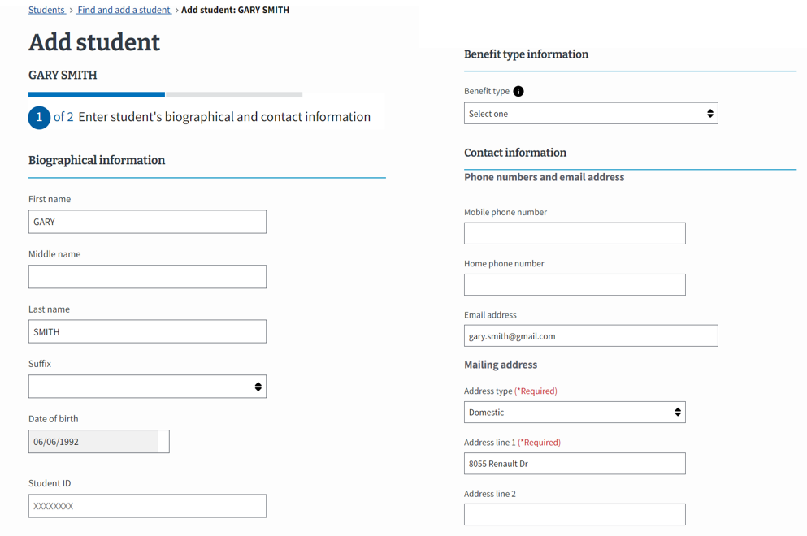
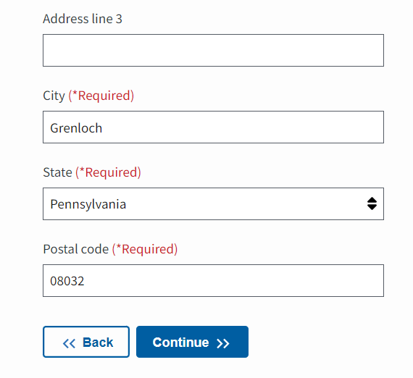
Students Tab – Adding a Student to a School Cont'd
The student’s known biographical, benefit type, and contact information appears. Select the “Continue” button after you verify all the information.
Note:
In the first release of EM, a SCO could edit biographical information; however, due to the system integration affecting multiple VA Systems, SCOs must not edit an existing student’s address or other biological information.
It is the responsibility of each student to update their address and any other biographical information. If the information is incorrect, students need to reach out to the Education Call Center (ECC) or AskVA (AVA).
Return to Table of Contents

Slide 100
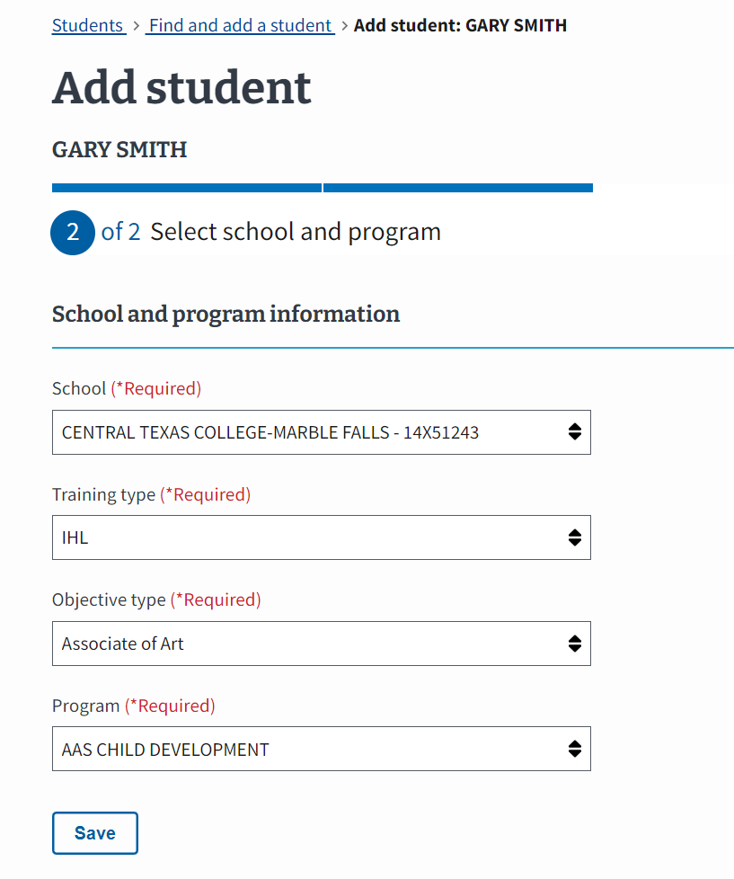
Students Tab – Adding a Student to a School Cont'd 1
Input the corresponding school and program information for the student. Once the information is entered, select the “Save” button.
Note:
If a student is under the age of 18 years, a warning message displays.
Each dropdown arrow highlights the following information:
School – Contains all the facilities to which the SCO has access.
Training type – Contains the unique training types available at the selected facility
Objective type – Contains the various degree or certificates available at the selected facility. If the student is a guest student, you may still select the appropriate objective type within EM.
Program – Contains a list of the programs listed in WEAMS which are available at the selected facility. In addition, non-matriculated and undeclared are available drop-down options that are enabled and displayed if the Training Type is IHL.
Return to Table of Contents

Slide 101
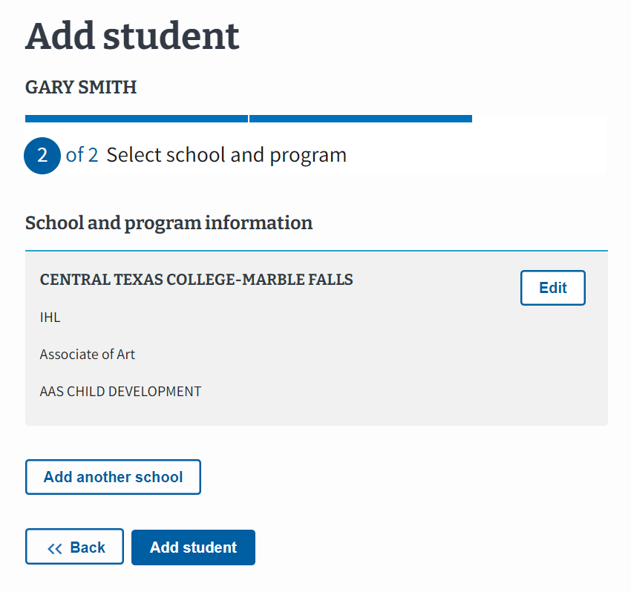
Students Tab – Adding a Student to a School Cont'd 2
Select the “Add student” button to complete adding this facility to the student.
Note: If the student is attending multiple facilities, including branches or extensions, the SCO should select “Add another school”.
Return to Table of Contents

Slide 102
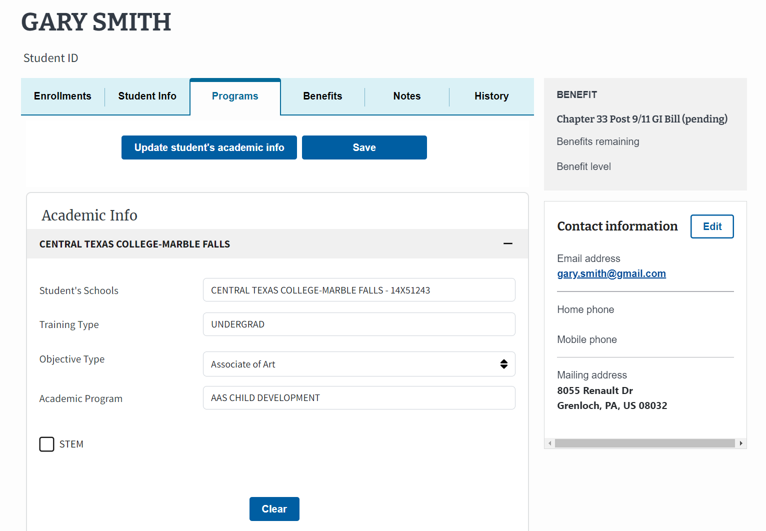
Students Tab – Adding a Student to a School Cont'd 3
View the successfully added program under the student’s “Programs” tab.
Return to Table of Contents

Slide 103
Student profile

Slide 104
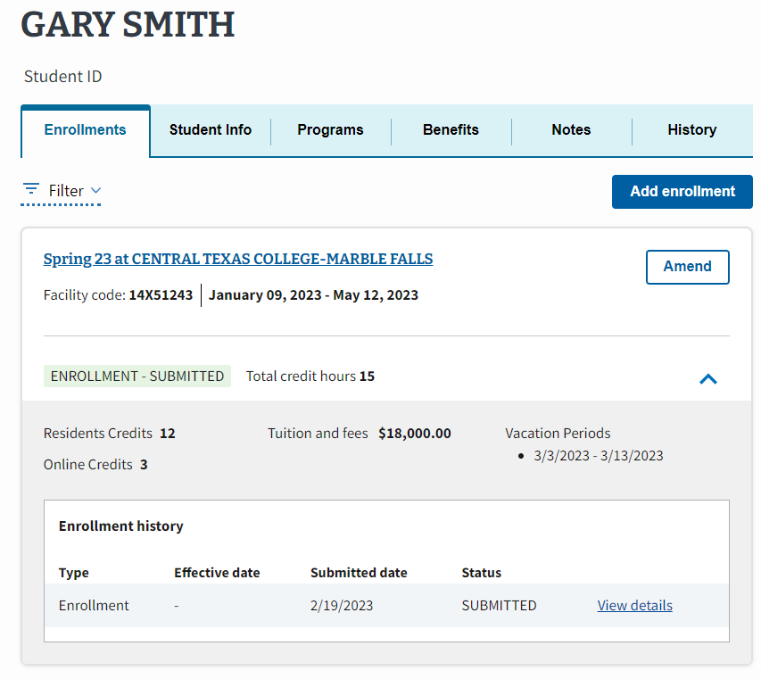
Student Profile Cont'd
Once you are in the “Students” tab and selected a student, there are several tabs on a student’s profile. Select the hyperlinked text or navigate to the corresponding page number:
Enrollments Tab – Navigate to page 105
Student Info Tab – Navigate to page 107
Programs Tab – Navigate to page 111
Benefits Tab – Navigate to page 120
Notes Tab – Navigate to page 122
History Tab – Navigate to page 124
Reports Tab – Navigate to page 129
Return to Table of Contents

Slide 105
ENROLLMENTS TAB
STUDENT PROFILE

Slide 106
Student Profile – Enrollments Tab
The first tab in the student profile is the “Enrollments” tab. From this tab, SCOs can view all student enrollments and enrollment statuses, add enrollments, and amend enrollments. Additional details including the “Enrollment history” are displayed by selecting the “˅” button to expand.
Note: The original enrollment, associated amendments, and corresponding monthly certifications are viewed by selecting the blue dropdown arrow and then selecting “View Details”.
Return to Table of Contents

Slide 107
STUDENT INFO TAB
STUDENT PROFILE

Slide 108
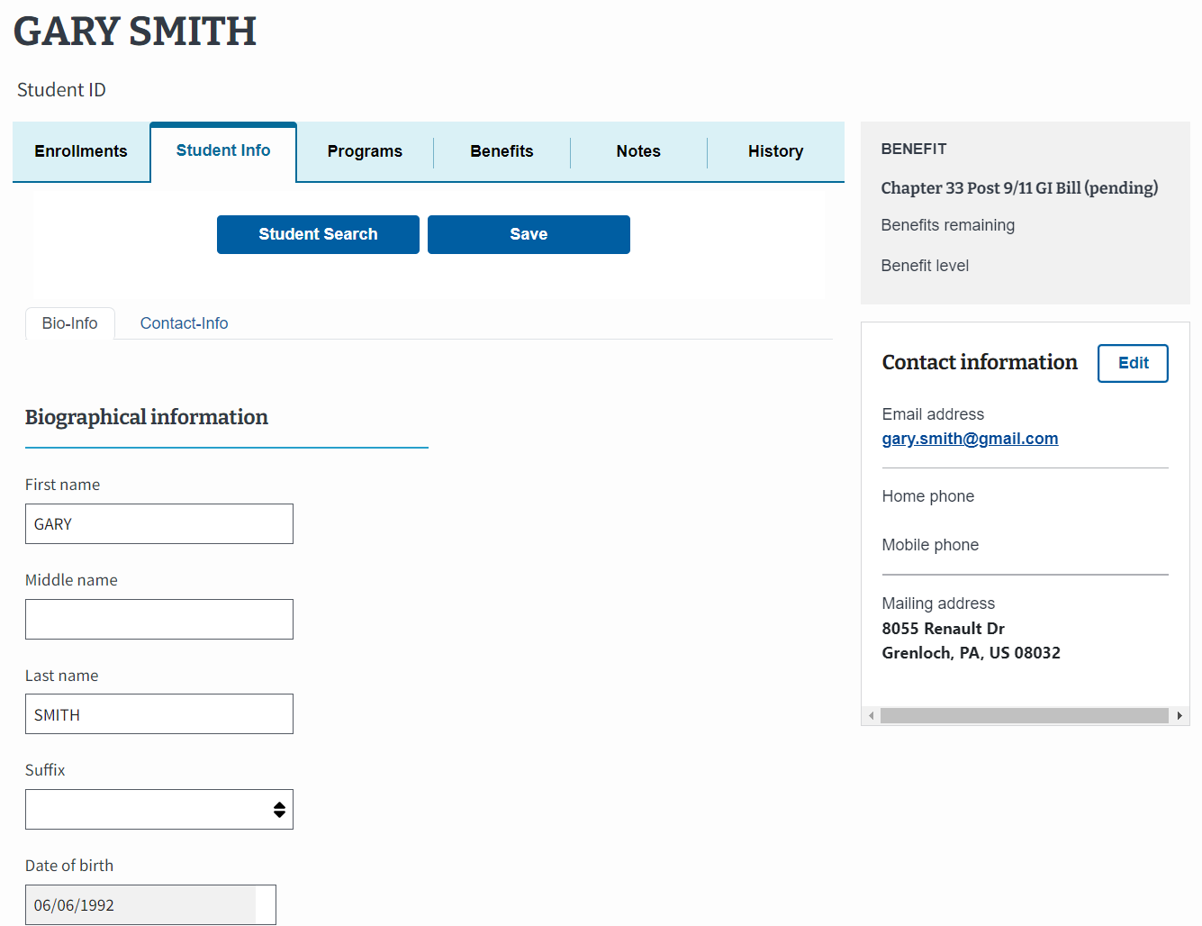
Student Profile – Student Info Tab
The second tab in the student profile is “Student Info”. The “Student Info” tab includes two additional tabs, “Bio-Info” and “Contact-Info”.
Return to Table of Contents

Slide 109
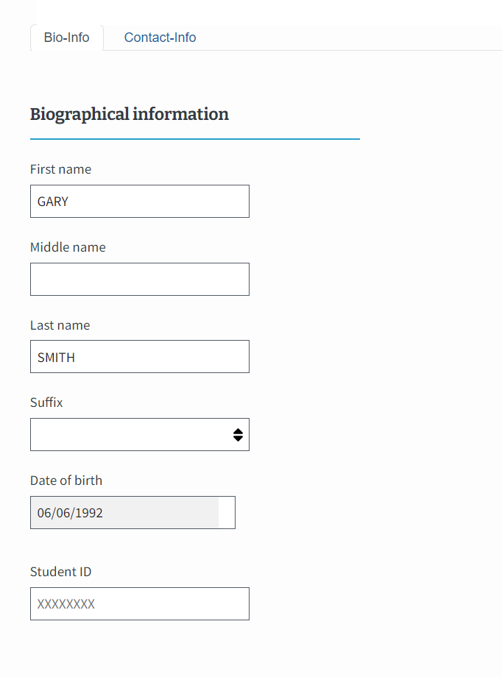
Student Profile – Student Info Tab Cont'd
Section 1: The “Bio-Info” tab lists a student’s personal information, such as “First name”, “Last name”, “Date of birth”, and “Student ID”.
Note:
Information can be updated in the corresponding fields, excluding the Date of Birth. If the Date of Birth is inaccurate, students need to reach out to VA and request their information is correctly updated.
Return to Table of Contents

Slide 110
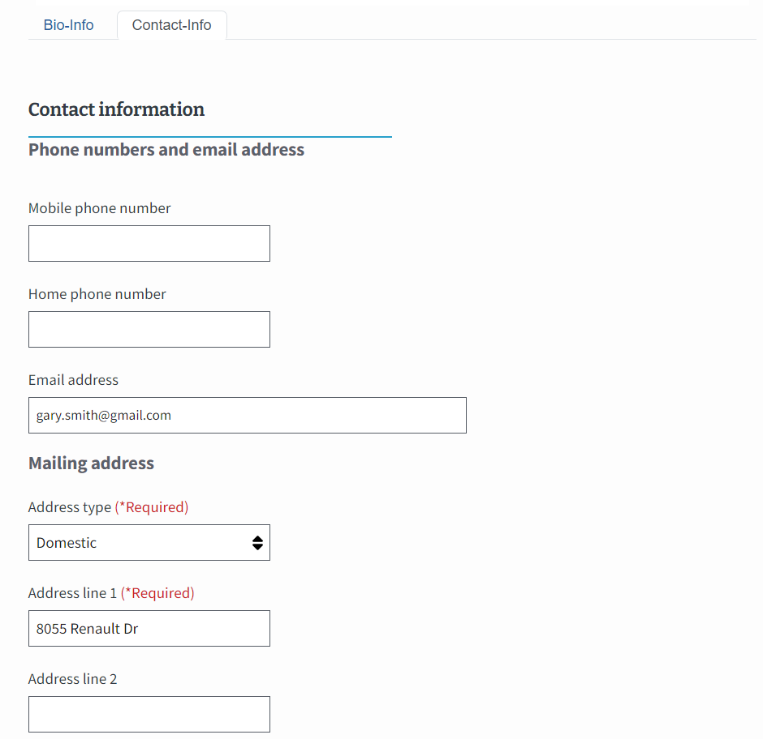
Student Profile – Student Info Tab Cont'd 1
Section 2: The “Contact-Info” tab includes a student’s phone number, email address, and mailing address.
Note: Please do not change the contact information. If any of the fields are inaccurate have the student reach out to VA to request their information is correctly updated.
Return to Table of Contents

Slide 111
PROGRAMS TAB
STUDENT PROFILE

Slide 112
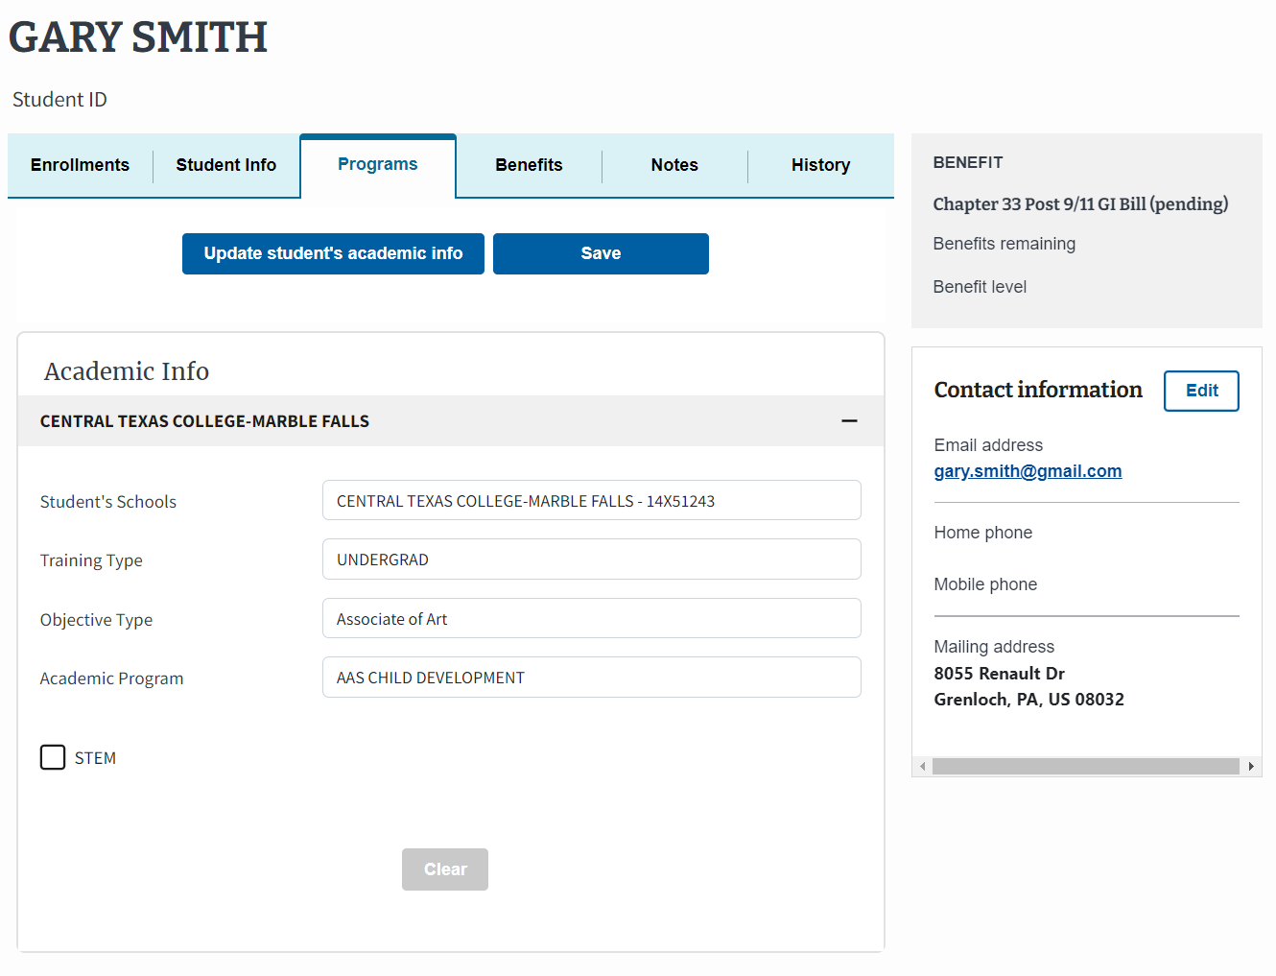
Student Profile – Programs Tab
The third tab in the student profile is the “Programs” tab, which displays both previous and current programs a student is enrolled in by facility. The top program listed is the current or active program the student is pursuing.
Bachelors of Science
BIOLOGY
Note: This view only populates programs at the SCO’s designated school. If necessary, select the “+” to view programs at other facilities.
Return to Table of Contents

Slide 113
Student Profile – Programs Tab – STEM Scholarship
If applicable, SCOs must choose if the student is a STEM scholarship recipient by selecting the “STEM” box.
Bachelors of Science
BIOLOGY
Return to Table of Contents

Slide 114
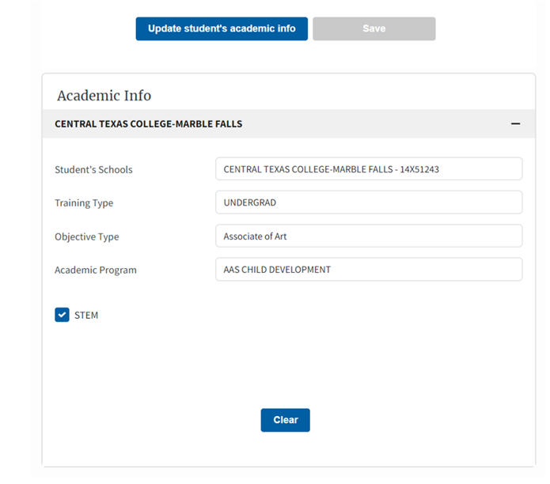
Student Profile – Programs Tab – STEM Scholarship Cont’d
Once the box is checked, another box appears allowing the SCO to add the CIP code. If changes are made on this screen, users must select the “Save” button to confirm these changes.
Note: The “Save” button is only selectable after the “STEM” box is checked. CIP Code is not required to save changes.
Bachelors of Science
BIOLOGY
Return to Table of Contents

Slide 115
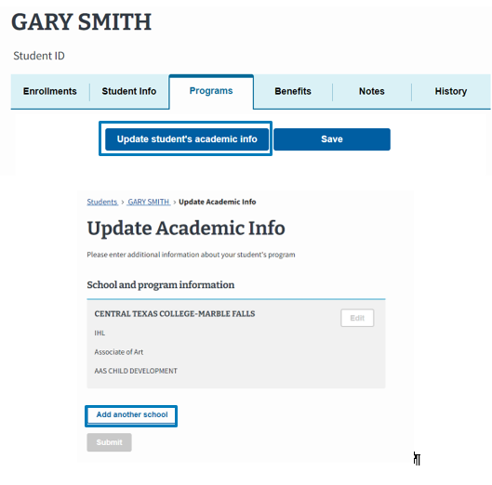
Student Profile – Programs Tab – Updating Student’s Academic Info
To make changes to a student’s program or school, select the “Update student’s academic info” button and then select the “Add another school” button.
Bachelors of Science
BIOLOGY
Return to Table of Contents

Slide 116
Student Profile – Programs Tab – Updating Student’s Academic Info Cont’d
Please note that any mismatched information produced during the migration to EM removes the editing capability of that information.
Note: The data migration process is the transfer of system data from the previously used VA-ONCE to the newly adapted system, EM. Any mismatched information produced during the data migration process will remain non-editable.
Bachelors of Science
BIOLOGY
Return to Table of Contents

Slide 117
Student Profile – Programs Tab – Updating Student’s Academic Info Cont’d 1
In the “Additional school and program” section, select the appropriate dropdown option for the “School”, “Training type”, “Objective type”, and “Program” fields.
Once you have made your selection, then select the “Save this school” button to confirm the changes.
Bachelors of Science
BIOLOGY
Bachelors of Science
CHEMISTRY
Return to Table of Contents

Slide 118
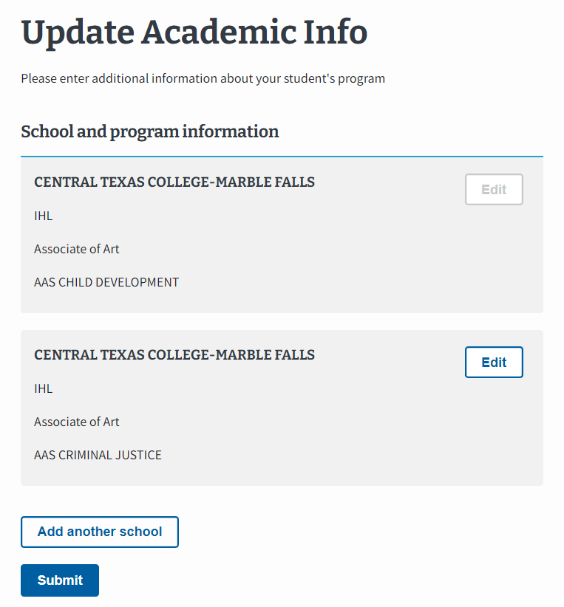
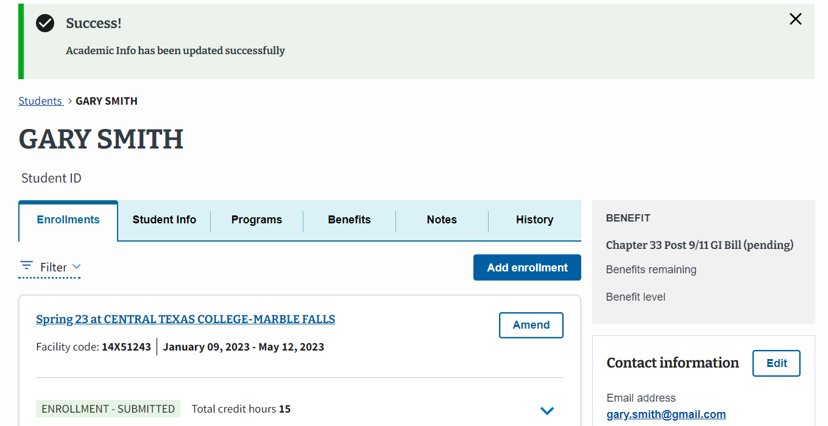
Student Profile – Programs Tab – Updating Student’s Academic Info Cont’d 2
Once all changes have been made, select the “Submit” button.
A success banner appears noting that the academic information has been updated successfully.
Bachelors of Science
BIOLOGY
Bachelors of Science
CHEMISTRY
Return to Table of Contents

Slide 119
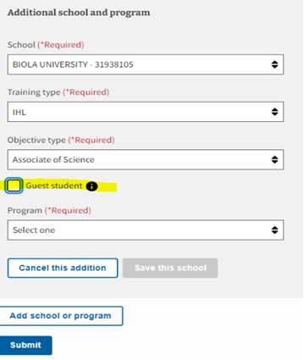
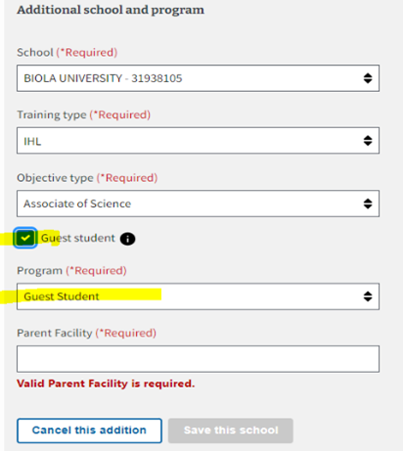
Student Profile – Programs Tab – Adding a Guest Student
If you need to add a student as a guest student, the student first must be added to the SCO’s facilities before. After this, in the Academic Info section the SCO will choose the “Objective type” of the student's degree program at the Primary school.
When the “Guest student” checkbox is selected, the “Program” dropdown auto fills with “Guest Student”. This triggers the “Parent Facility” text field to appear.
In the “Parent Facility” field, enter the name and choose from the populated choices.
To finalize this process, select the “Save this school” button.
Note: Guest students are uncommon at NCD facilities.
Return to Table of Contents

Slide 120
BENEFITS TAB
STUDENT PROFILE

Slide 121
Student Profile – Benefits Tab
The fourth tab in the student profile is “Benefits”, which provides information about what benefits a student is using (such as Post 9/11 GI Bill, Montgomery GI Bill, etc.). This tab also shows how much of that benefit type the student has remaining and the percentage benefit level of the remaining Chapter 33 entitlement. This tool is convenient to reference if students would like an update on how long benefits are available to them. The information does not display for Chapter 31. If a student is eligible for more than one benefit, the most recent displays.
Note:
This information is hidden if the student chooses to opt out of this information being shared. Benefits reflect approved and active benefit types for students.
Remaining entitlement displayed is based on last award action for entire term. For example, if we processed an award at full time for Summer 2023, the entitlement shown reflects what remains after the Summer term ends.
Return to Table of Contents

Slide 122
NOTES TAB
STUDENT PROFILE

Slide 123
Student Profile – Notes Tab
The fifth tab in the student profile is “Notes”, which shows all notes that were added when adding the student or submitting their enrollments. Users can add additional notes when viewing a student profile by selecting the “Add note” button.
Note: Notes are visible in EM for you and all other SCOs to view. Notes are not transmitted to Regional Processing Offices (RPO), Veterans Claims Examiners (VCE), or VA Central Office, but can be viewed by VA employees with EM access. Notes can be filtered and added by facility name.
Return to Table of Contents

Slide 124
HISTORY TAB
STUDENT PROFILE

Slide 125
Student Profile – History Tab
The sixth tab in the student profile is “History”, where all activity pertaining to the student profile and enrollments is listed chronologically. Brief details are displayed, including the user who performed the action and the date and time it occurred. Historical information can be filtered by “User types,” “Action types,” and “Schools”.
Return to Table of Contents

Slide 126
Schools TAB
STUDENT PROFILE

Slide 127
Schools Tab Cont'd
To access preset enrollments, select the “Schools” tab on the Menu Bar.
Return to Table of Contents

Slide 128
Schools Tab Cont’d 1
The “Schools” tab displays all active and inactive preset enrollments, which can be filtered by “School”. The preset enrollments that appear on this screen are from all the facilities to which the SCO has access.
Return to Table of Contents

Slide 129
Reports tab
STUDENT PROFILE

Slide 130
Reports Tab Cont'd
To generate a report, navigate to the “Reports” tab in EM.
Return to Table of Contents

Slide 131
Reports Tab Cont’d 1
Type in the correct facility code in the “Facility Code” field.
Next, enter the period for the report in the “Begin date”. The “End date” auto-populates to a week after the “Begin date”.
Return to Table of Contents

Slide 132
Reports Tab Cont’d 2
Choose either “Summary” or “Detail” in the “Type of report” dropdown. Once all pertinent information has been entered, select the “Generate report” button to create your new weekly report.
Return to Table of Contents

Slide 133
Reports Tab Cont’d 2
Choose either “Summary” or “Detail” in the “Type of report” dropdown. Once all pertinent information has been entered, select the “Generate report” button to create your new weekly report.
Return to Table of Contents

Slide 134
Reports Tab Cont'd 3
Once all pertinent information has been entered, select the “Generate report” button to create your new weekly report.
Note:
The Summary report shows you the total number of enrollments, amendments, terminations, and monthly certifications that were processed at the chosen facility.
EM can generate a Weekly Summary Report and a Weekly Detail Report. The Summary Report provides statistics of records submitted in each week, and the Detail Report provides a full readout of each record submitted in a given week. The Detail Report can be exported as a PDF file containing the PDF forms of each record - 22-1999s, 22-1999bs, etc. - allowing schools to keep these records on file offline.
Return to Table of Contents

Slide 135
Reports Tab Cont'd 4
An example of a “Detail” report – pertaining to one facility code and containing one student’s information is shown on the right. Additional student information can be accessed by selecting the corresponding “+” icon on the right side of the screen.
Return to Table of Contents

Slide 136
Reports Tab Cont'd 5
Additional information such as the student’s “Training type”, “Benefit type”, and “Resident hours” and “Online hours” is displayed.
Note:
Export Reports can be used to export and download your report as a CSV.
Print Reports can be used to download each report as a PDF file.
Additional details are displayed by expanding the rows. Expanded information varies by training type.
For IHL, NCD, and VET TEC, expanded fields contain details regarding credits (e.g., resident hours, online hours, remedial/deficiency hours, clock hours), tuition and fees, Yellow Ribbon, amendments, and terminations.
For OJT and APP, expanded fields contain details regarding enrollment information (e.g., approved hours, trainee hours per week, prior training time), monthly certifications (e.g., hours trained, month certified), and terminations.
For FLT, expanded fields contain details regarding total program charges, a summary of total hours (e.g., dual, dual simulator hours, solo, ground school, pre/post hours, other), and terminations.
Return to Table of Contents

Slide 137
Certifications by Facility Type

Slide 138
Certifications by Facility Type Cont'd
The process for certifying enrollments depends on your facility type. Locate your facility or program type. Select the hyperlinked text or navigate to the corresponding page number:
Institutions of Higher Learning (IHL) – Navigate to page 138
Non-College Degree Programs (NCD) – Navigate to page 178
On-the-Job Training /Apprenticeship (OJT/APP) Programs – Navigate to page 217
Flight Schools – Navigate to page 250
Note: Automated emails are automatically sent to students each time a certification is submitted.
Return to Table of Contents

Slide 139
Institution of higher learning

Slide 140
IHL – Table of Contents
Select the hyperlinked text or navigate to the corresponding page number:
Add a Preset Enrollment – Navigate to page 141
Edit a Preset Enrollment – Navigate to page 148
Add and Submit an Enrollment – Navigate to page 152
Amend an Enrollment – Navigate to page 165
Note: Automated emails are automatically sent to students each time a certification is submitted.
Return to Table of Contents

Slide 141
IHL – Preset Enrollment Overview
Preset enrollments are term dates on approved school calendars that can be pre-populated. In EM,
The “Active” status for preset enrollments refers to enrollment periods currently being used and displayed in your dropdown menu.
The “Inactive” status refers to enrollment periods you no longer wish to see displayed. These are usually terms in the past you are no longer certifying.
Return to Table of Contents

Slide 142
Add a Preset Enrollment

Slide 143
Add a Preset Enrollment
To access preset enrollments, select the “Schools” tab on the Menu Bar.
Return to Table of Contents

Slide 144
Add a Preset Enrollment Cont'd
The “Schools” tab displays all active and inactive preset enrollments, which can be filtered by “School”. The preset enrollments that appear on this screen are from all the facilities to which the SCO has access.
Return to Table of Contents

Slide 145
Add a Preset Enrollment Cont'd 1
Select the “Create preset enrollment” button.
Return to Table of Contents

Slide 146
Add a Preset Enrollment – Basic information
Input the following information under the “Basic Information” section:
“Name” – Of Enrollment Period is an optional field (e.g., Fall 2021, Spring 2022)
“School” – Dropdown list contains all facilities the SCO has access to
“Begin date”
“End date”
Note: A warning message will appear if the begin date inputted is more than 180 days (6 months) in the future.
Return to Table of Contents

Slide 147
Add a Preset Enrollment – Vacation periods
Input any relevant “Vacation Periods” coinciding with this enrollment and select the “Save vacation period” button. Select the “Delete” button to discard the vacation period.
Note: The term holiday vacation means a customary, reasonable vacation period that is identified as a holiday vacation in the educational institution's literature, approved by the State Approving Agency of jurisdiction. Vacation Periods should not be entered unless they are seven or more calendar days long. Vacation Periods are used when certifying non-standard enrollment periods for all benefits. You can hover over the “What Constitutes a Vacation Period?” text for more information. This newly created preset enrollment associates with the specific facility when creating a preset enrollment.
Return to Table of Contents

Slide 148
Add a Preset Enrollment – Vacation periods Cont'd
Select the “Create preset enrollment” button to save the preset enrollment.
Return to Table of Contents

Slide 149
Edit a Preset Enrollment

Slide 150
Edit a Preset Enrollment
To edit a preset enrollment, select the specific enrollment to be updated, then select the “Edit preset enrollment” button.
Return to Table of Contents

Slide 151
Correct existing information for this preset enrollment period such as the begin or end date or vacation period dates. The school cannot be changed while editing a preset enrollment. Select the “Save preset enrollment” button when finished making edits.
Edit a Preset Enrollment Cont’d
Return to Table of Contents

Slide 152
Edit a Preset Enrollment Cont’d 1
When preset enrollment periods are edited:
New, updated preset enrollment appears as “Active”.
Old enrollment appears as “Inactive”.
Note: Certifications already submitted using the original preset enrollment do not automatically change. If changes need to be made to certifications that were already submitted, the SCO must amend the certification to change the certified dates and/or vacation period.
Return to Table of Contents

Slide 153
Add and Submit an Enrollment

Slide 154
Add and Submit an Enrollment
Select the “Students” tab in the Dashboard menu to navigate to the student profile to add an enrollment.
Return to Table of Contents

Slide 155
Add and Submit an Enrollment Cont'd
If the student has already been enrolled with your institution, they populate under the “Search Results” tab. Select the student profile and then select the “Go to profile” button on the right-side pane.
Note: If the student has not been enrolled at your facility, utilize the “Search all students” function to find the student and add their program information. Then you can add their enrollment. If the student is not searchable after using both search methods, follow the steps to create a new student profile.
Return to Table of Contents

Slide 156
Add and Submit an Enrollment Cont’d 1
Select the “Add enrollment” button on the Enrollments tab to begin adding an enrollment.
Notes:
A message is displayed to make SCOs aware this student does not have any enrollments added to their profile.
SCOs can add multiple IHL enrollments by selecting the "Add multiple enrollment" option from the "Add enrollment" dropdown on the enrollments tab. The multiple enrollments and single enrollment views require the same information to be entered.
Return to Table of Contents

Slide 157
Add and Submit an Enrollment Cont'd 2
Input the appropriate information below for each section:
“Enrollment Information”
“Credits and Tuition”
“Vacation Periods”
“Remarks and Notes”
Return to Table of Contents

Slide 158
Add and Submit an Enrollment – Enrollment Information
Input the student’s enrollment information.
“Training facility” – This dropdown contains all the facilities the student has been enrolled in.
“Enrollment name” – You can select the preset enrollment that you created earlier to pre-fill in the begin and end dates, if applicable.
“Begin date”
“End date”
Note:
• If you have access to certify for more than one facility, you can see all the facilities in the “Training facility” drop-down and can select which one the student is attending.
• Enrollments can not be submitted more than 6 months in advance for Ch33 and 4 months for non-33 benefit types.
Return to Table of Contents

Slide 159
Add and Submit an Enrollment – Credits and Tuition
Input the student’s “Credit” information. Refer to the number of residential or classroom credits taken to populate the corresponding fields. If WEAMS indicates the school is online only, these fields are disabled.
Note:
• Online credits refer to the number of distance (online or non-classroom) credits taken during the term.
• Clock Hours refer to the number of clock hours taken per week and are typically found in NCD programs, internships, and externships.
• Remedial/Deficiency refers to the number of remedial or deficiency credits taken during a term.
• A warning message will appear if users fail to enter at least one hour type with a value greater than zero.
Return to Table of Contents

Slide 160
Add and Submit an Enrollment – Credits and Tuition Cont'd
Input the student’s “Tuition & Fees amount”.
Note:
"Net" T&F should be entered for all Chapter 33 students. If T&F are required for a non-Chapter 33 student, "Charged" T&F should be entered.
EM will automatically insert a remark regarding foreign currency when the student is being certified at a foreign school (This is determined by the last 2 digits of the facility code).
Return to Table of Contents

Slide 161
Add and Submit an Enrollment – Vacation Periods
If this is a non-standard length term with a published vacation period of 7 or more calendar days, it can be entered when submitting an enrollment.
To make changes to the vacation period, select the “Edit” button.
To add additional vacation periods for this enrollment, select the “+ Vacation period” button.
Note: The Vacation period auto-populates from the Preset Enrollment if one was set up but please check to make sure the vacation period is correct and edit it or add any other breaks as-necessary. You can hover over the text that says, “What counts as a vacation period?” for more information. “A vacation period must be 7 days or longer and occur during the student's enrollment".
Return to Table of Contents

Slide 162
Add and Submit an Enrollment – Remarks
Before submitting the enrollment, select any relevant “VBA remarks”. Please only create “Custom Remark” when necessary, as they slow down processing time.
Note: Feel free to add any notes for yourself or for other SCOs at your facility. Notes are not be submitted to VA with the enrollment but can be reviewed by VA if necessary.
Return to Table of Contents

Slide 163
Add and Submit an Enrollment – Submit or Discard
Select “Submit enrollment” button to submit the new enrollment information or select “Save as draft” button to finish the process later. To discard edits to the enrollment, select the “Discard edits” button.
Note: If for any reason, user navigates away from the enrollment page, a pop-up screen with a message prompting user to stay on the page or discard data displays.
Return to Table of Contents

Slide 164
Add and Submit an Enrollment Cont’d 3
Once the enrollment is submitted, a success banner appears in green at the top of the page.
Note:
To view an overview of the enrollment submitted, select the down arrow under the “Amend” button.
VR&E Counselors now receive emails when enrollments and amendments are submitted for their students.
Return to Table of Contents

Slide 165
Add and Submit an Enrollment Cont’d 4
Before adding or submitting an enrollment, please review the following functionality changes in EM:
The option to add Multi-Line Enrollments is not a current functionality of EM. This is a planned function for a future release.
Dual Degree / Dual Objectives Enrollments cannot be certified currently in EM.
To document a student’s Dual Degree or Dual Objective Enrollment in EM, select one program from the available “Program” dropdown options and “Add a Custom Remark”.
An example custom remark could be, “Student concurrently pursuing 2 degrees additional program is [program name]”.

Slide 166
Amend an enrollment

Slide 167
Amend an Enrollment
In EM, “Amendment” refers to any change made to an enrollment after it is submitted, including terminations.
There is no differentiation between amend and adjust.
Note:
EM can process more than one amendment on a single certification in a 24-hour period for Chapter 33 students. For non-Chapter 33 students, continue with submitting successive adjustments on separate days.
SCOs can now submit new enrollments and amendments for pre-existing Veteran Rapid Retraining Assistance Program (VRRAP) students. The addition of new VRRAP students is not possible. VRRAP students only applies for non-degree seeking IHL programs.
Return to Table of Contents

Slide 168
Amend an Enrollment Cont'd
After you search and select the student, navigate to the student’s “Enrollments” tab, identify the enrollment to Amend, and select the “Amend” button. The information for the selected enrollment, appears, which may or may not be current, since amendments can be made to previously completed enrollments.
Return to Table of Contents

Slide 169
Amend an Enrollment – Enrollment Information
Once Amend is selected, you are taken to a page that shows all existing information about the selected enrollment. There, you can change the “Begin date” and “End date” fields to display corrected dates but the “Enrollment name” is read-only.​
Note: You cannot change the facility. If the student was certified under the wrong facility terminate the cert and add a Custom Remark. This off-ramps the cert to ensure no debt is created. Then, add the student under the correct facility and recertify the term.
Return to Table of Contents

Slide 170
Amend an Enrollment – Enrollment Information Cont'd
To make changes to the “Credits and tuition” section, navigate to the appropriate fields and input accurate values for the “Resident credits”, “Online credits”, “Clock hours”, “Remedial/deficiency credits” and/or the “Tuition & Fees” field.
Note: Once you make changes to credit or clock hours, a new section automatically appears called Amendment Information. Here, you select the applicable amendment reason pertaining to this enrollment and input the effective date. Depending on the amendment reason that is chosen, a Revised End Date may be required.
Return to Table of Contents

Slide 171
Amend an Enrollment – Credits and Tuition
If the student is graduating or completing the program, select the “Graduation /End of Term or Course” checkbox. If the student is terminating their enrollment, select the “Termination” checkbox.
Note: If the “Termination" checkbox is selected, all the pre-existing values under the “Credits and tuition” section following the effective date update to zero.
Return to Table of Contents

Slide 172
Amend an Enrollment – Amendment information
For both graduation/end of term or course or termination, it is required to fill out the “Amendment information” section. Depending on which box is selected, the amendment reasons specify based on selection.
Note: Any other option chosen beside “Other” for termination or graduation/end of term or course auto populates the “Amendment effective date”. The “Amendment effective date” for graduation and completion should always be the last day of the reported term, NOT the date of the graduation ceremony. The only exception is for students who finish the term earlier than expected.
Termination
Graduation/End of Term or Course
Return to Table of Contents

Slide 173
Amend an Enrollment – Credits and Tuition Cont'd
If “Other” is selected, it is required to manually input the “Amendment effective date” as well as a “VBA” or “Custom Remark” to explain the amendment reason.
Note:
EM auto-generates a remark noting an amendment was made when a SCO enters any change to a begin date, end date, or tuition and fees.
When submitting an amendment if increase or reduction in hours do not match the amendment reason, an error message displays.
Mitigating Circumstances do not always appear and are only required when the “Withdraw after drop period - non-punitive grades assigned (Typical Termination)” amendment reason is selected.
Return to Table of Contents

Slide 174
Amend an Enrollment – Notes
After inputting all required values for the enrollment and any optional notes, submit the amendment or save the amendment as a draft.
Note:
If you are submitting an amendment for the second 1010 enrollment verification, you also have the option to submit a no-change amendment, if there is no change to the submitted enrollment. To do so, simply scroll to the bottom and select the “Submit amendment” button or save the amendment as a draft by selecting the “Save as draft” button. Once an amendment is submitted, the status of the amendment displays, just like the enrollment status. For more information on the second 1010 enrollment verification, review Section 1010.
If notes are added, these notes are viewable to anyone with EM access who needs to view information about a student’s enrollment. They are not sent to VA for processing purposes.
Return to Table of Contents

Slide 175
Amend an Enrollment Cont’d 1
A success banner appears noting that the amendment has been added.
Return to Table of Contents

Slide 176
Amend an Enrollment Cont'd 2
The status of the amendment appears on the “Enrollments” tab of the student profile.
Return to Table of Contents

Slide 177
Amend an Enrollment Cont’d 3
If the amendment terminates the enrollment, no further changes can be made. If the enrollment was terminated by mistake, recreate the enrollment to amend it further. When recertifying a terminated enrollment for a CH33 certification SCOs must add the following remark "correcting previously terminated enrollment. Notice of Change in Student Status to follow” on the recertification so T&F are not released to the school again. Then the SCO must resubmit any amendments and/or corrections and then re-terminate the term.
Return to Table of Contents

Slide 178
Select here to navigate to the Helpful Resources section.
Congratulations!
This is the end of the instructions for the selected facility type.

Slide 179
Non-College Degree

Slide 180
NCD – Table of Contents
Select the hyperlinked text or navigate to the corresponding page number:
Add a Preset Enrollment – Navigate to page 180
Edit a Preset Enrollment – Navigate to page 188
Add and Submit an Enrollment – Navigate to page 192
Amend an Enrollment – Navigate to page 204
Note: Automated emails are automatically sent to students each time a certification is submitted.
Return to Table of Contents

Slide 181
NCD Add a Preset Enrollment
Add a preset enrollment

Slide 182
Preset Enrollment Overview
Preset enrollments are enrollment dates on approved school calendars that can be pre-populated.
In EM, the “Active” status for preset enrollments refers to enrollment periods that are currently being used and displayed in the dropdown menu. “Inactive” refers to enrollment periods that you no longer wish to see displayed. These are usually enrollment periods in the past that you are no longer certifying.
Return to Table of Contents

Slide 183
Add a Preset Enrollment Cont'd
To access preset enrollments, select the “Schools” tab on the Menu Bar.
Return to Table of Contents

Slide 184
Add a Preset Enrollment Cont’d 1
The “Schools” tab displays all active and inactive preset enrollments, which can be filtered by “School”. The preset enrollments that appear on this screen are from all the facilities to which the SCO has access.
Return to Table of Contents

Slide 185
Add a Preset Enrollment Cont'd 2
To add a preset enrollment, select the “Create preset enrollment” button.
Return to Table of Contents

Slide 186
Add a Preset Enrollment – Basic information
Fill out the following information under the “Basic Information” section:
Name – Of Enrollment Period is an optional field (e.g., Fall, 2021, Spring 2022)
School – Dropdown list contains all facilities the SCO has access to
Begin date
End date
Note: A warning message will appear if the begin date inputted is more than 180 days (6 months) in the future.
Return to Table of Contents

Slide 187
Add a Preset Enrollment – Vacation periods
Enter any relevant “Vacation Periods” that coincide with this enrollment and select the “Save vacation period” button. Select the “Delete” button to discard the vacation period.
Note: The term holiday vacation means a customary, reasonable vacation period which is identified as a holiday vacation in the educational institution's literature, approved by the State Approving Agency of jurisdiction. Vacation Periods should not be entered unless they are seven or more consecutive days long. Vacation periods are used when certifying an enrollment period other than a standard-length semester or quarter. You can hover over the text that says, “What counts as a Vacation Period?” for more information. This newly created preset enrollment associates with the specific facility when creating an enrollment.
Return to Table of Contents

Slide 188
Add a Preset Enrollment Cont’d 3
Select the “Create preset enrollment” button to save the preset enrollment.
Return to Table of Contents

Slide 189
NCD EDIT a preset enrollment
EDIT a preset enrollment

Slide 190
Edit a Preset Enrollment Cont'd
To edit a preset enrollment, select the specific enrollment to update, then select the “Edit preset enrollment” button.
Return to Table of Contents

Slide 191
Edit a Preset Enrollment Cont'd 1
Correct existing information for this enrollment period such as the begin or end date or vacation period dates. The school cannot be changed while editing a preset enrollment. Select the “Save preset enrollment” button when finished making edits.
Return to Table of Contents

Slide 192
Edit a Preset Enrollment Cont'd 2
When preset enrollment periods are edited:
New, updated preset enrollment appears as “Active”.
Old enrollment appears as “Inactive”.
Note: SCO that any certs already submitted using the original preset enrollment do not automatically change. If changes need to be made to certs already submitted, the SCO must amend the cert to change the certified dates and/or vacation period.
Return to Table of Contents

Slide 193
NCDAdd and Submit an enrollment
Add and Submit an enrollment

Slide 194
Add and Submit an Enrollment Cont’d
Select the “Students” button in the Dashboard menu to navigate to the student profile to add an enrollment.
Return to Table of Contents

Slide 195
Add and Submit an Enrollment Cont'd 1
If the student has already been associated with your education or training institution, they populate under the “Search Results” tab. Select the student profile and then select the “Go to profile” button on the right-side pane.
Note: If the student has not been enrolled at your facility, you need to utilize the “Search all students” function to find the student, add their program information, then you can add their enrollment. If the student is not searchable after using both search methods, you need to follow the steps to create a new student profile.
Return to Table of Contents

Slide 196
Add and Submit an Enrollment Cont’d 2
On the student profile, select the “Add enrollment” button to begin adding an enrollment.
Note:
A message is displayed to make SCOs aware this student does not have any enrollments added to their profile.
SCOs can add multiple IHL enrollments by selecting the "Add multiple enrollment" option from the "Add enrollment" dropdown on the enrollments tab. The multiple enrollments and single enrollment views require the same information to be input.
Return to Table of Contents

Slide 197
Add and Submit an Enrollment Cont’d 3
Input the appropriate information in each section detailed below:
“Enrollment Information”
“Credits and Tuition”
“Vacation Periods”
“Remarks and Notes”
Return to Table of Contents

Slide 198
Add and Submit an Enrollment – Enrollment information
Input the student’s enrollment information.
“Training facility” – This dropdown contains all the facilities the student has been enrolled in.
“Enrollment name” – You can select the preset enrollment that you created earlier to pre-fill in the begin and end dates, if applicable.
“Begin date”
“End date”
Note:
While SOCs no longer must report prior credit to the VA, SCOs must evaluate prior credit, grant credit as appropriate, notify the student of the evaluation, and shorten the program certified accordingly.
Enrollments can not be submitted more than 6 months in advance.
If you have access to certify for more than one facility, you can see all the facilities in the “Training facility” drop-down and can select which one the student is attending.
Return to Table of Contents

Slide 199
Add and Submit an Enrollment – Credits and tuition
Input the student’s tuition information.
“Resident credits”– The number of residential or classroom credits taken. This field is disabled if WEAMS indicates the school is online only.
“Online credits” – The number of distance (online or non-classroom) credits taken during the term.
“Clock Hours” – The number of clock hours taken per week and are typically found in NCD programs, internships, and externships.
“Remedial/Deficiency” – The number of remedial or deficiency credits taken during a term.
Note: A warning message will appear if users fail to enter at least one hour type with a value greater than zero.
Return to Table of Contents

Slide 200
NCD - Add and Submit an Enrollment – Credits and tuition Cont'd
Add and Submit an Enrollment – Credits and tuition
Input the student’s “Tuition & Fees amount".
Return to Table of Contents

Slide 201
Add and Submit an Enrollment – Vacation periods
Vacation periods are entered when certifying an enrollment period other than a standard-length semester or quarter. Only vacation periods of 7 or more consecutive days should be entered. To make changes to the vacation period, select the “Edit” button. To add additional vacation periods for this enrollment, select the “+ Vacation period” button.
Note: The Vacation period auto-populates from the Preset Enrollment if one was set up but please check to make sure the vacation period is correct and edit it or add any other breaks as-necessary. You can hover over the text that says, “What Constitutes a Break?” for more information. A vacation period must be 7 days or longer and occur during the student's enrollment.
Return to Table of Contents

Slide 202
NCD Add and Submit an Enrollment – Remarks
Add and Submit an Enrollment – Remarks
Before submitting the enrollment, select any relevant “VBA remarks". Only create “Custom remarks” when necessary as they slow down processing time.
Note: Feel free to add any notes for yourself or for other SCOs at your facility. Notes are not be submitted to VA with the enrollment but can be reviewed by VA if necessary.
Return to Table of Contents

Slide 203
Add and Submit an Enrollment Cont'd 4
Select the “Submit enrollment” button to submit the new enrollment information or select the “Save as draft” button to finish the process later. To discard edits to the enrollment, select the “Discard edits” button.
Return to Table of Contents

Slide 204
Add and Submit an Enrollment Cont'd 5
Once the enrollment is submitted, a success banner appears in green at the top of the page.
Note:
To view an overview of the enrollment submitted, select the down arrow under the “Amend” button.
Return to Table of Contents

Slide 205
NCD Amend an Enrollment
Amend an Enrollment

Slide 206
Amend an Enrollment Cont'd
In EM, “Amendment” refers to any change made to an enrollment after it is submitted, including terminations.
There is no differentiation between amend and adjust.
Note:
EM can process more than one amendment on a single certification in a 24-hour period for Chapter 33 students. For non-Chapter 33 students, continue with submitting successive adjustments on separate days.
SCOs can now submit new enrollments and amendments for pre-existing VRRAP students. The addition of new VRRAP students is not possible.
Return to Table of Contents

Slide 207
Amend an Enrollment Cont’d 1
After you search and select the student, navigate to the student’s “Enrollments” tab, identify the enrollment to Amend, and select the “Amend” button. Once amend is selected, the page shows the information for the selected enrollment, which may or may not be current, since amendments can be made to previously completed enrollments.
Return to Table of Contents

Slide 208
Amend an Enrollment – Enrollment Information
Once Amend is selected, you are taken to a page that shows all existing information about the selected enrollment. There, you can change the “Begin date” and “End date” fields to display corrected dates but the “Enrollment name” is read-only.​
Note: You cannot change the facility. If the student was certified under the wrong facility terminate the cert and add a Custom Remark. This off-ramps the cert to ensure no debt is created. Then, add the student under the correct facility and recertify the term.
Return to Table of Contents

Slide 209
Amend an Enrollment – Credits and Tuition & Amendment information
To make changes to the Credits and tuition section, navigate to the appropriate fields and input accurate values for the “Resident credits”, “Online credits”, “Clock hours”, or “Tuition & fees amount” fields.
Note: Once you make changes to any of these fields, a new section automatically appears called Amendment Information. Here, select the applicable amendment reason pertaining to this enrollment and input the effective date. Depending on the amendment reason that is chosen, a “Revised End Date” may be required.
Return to Table of Contents

Slide 210
Amend an Enrollment – Credits and Tuition
If the student is graduating or completing the program, select the “Graduation/End of Term or Course” checkbox. If the student is terminating their enrollment, select the “Termination” checkbox.
Note: If the “Termination" checkbox is selected, all the pre-existing values under the “Credits and tuition” section zero out.
Return to Table of Contents

Slide 211
Amend an Enrollment – Amendment information
For both graduation/end of term or course or termination, it is required to fill out the “Amendment information” section. Depending on which box is selected, the amendment reasons tailor based on selection.
Note:
Be mindful of the amendment reason selected. Certain amendment reasons automatically populate the amendment effective date, whereas others need to be manually entered.
When submitting an amendment of increase or reduction in hours does not match the amendment reason an error message displays .
Termination
Graduation/End of Term or Course
Return to Table of Contents

Slide 212
Amend an Enrollment – Amendment information Cont'd
If “Other” is selected, it is required to manually input the amendment effective date as well as a VBA or Custom Remark to explain the amendment reason.
Note:
EM auto-generates a remark noting an amendment was made when a SCO enters any change to a begin date, end date, or tuition and fees.
Mitigating Circumstances do not always appear and are only required when the “Withdraw after drop period - non-punitive grades assigned (Typical Termination)” amendment reason is selected.
Return to Table of Contents

Slide 213
NCD Amend an Enrollment – Notes
Amend an Enrollment – Notes
After inputting all required values for the enrollment and any optional notes, submit the amendment or save the amendment as a draft by selecting the “Submit amendment” button or “Save as draft” button. Once an amendment is submitted, the status of the amendment displays, just like the enrollment status.
Note:
If you are submitting an amendment for the second 1010 enrollment verification, you also have the option to submit a no-change amendment, if there is no change to the submitted enrollment. To do so, simply scroll to the bottom and select the “Submit amendment” button or save the amendment as a draft by selecting the “Save as draft” button. Once an amendment is submitted, the status of the amendment displays, just like the enrollment status. For more information on the second 1010 enrollment verification, review Section 1010.
If notes are added, these notes are viewable to anyone with EM access who need to view information about a student’s enrollment. They are not sent to VA for processing purposes.
Return to Table of Contents

Slide 214
Amend an Enrollment Cont’d 2
Once an amendment is submitted, a success banner appears noting that the amendment has been added.
Return to Table of Contents

Slide 215
Amend an Enrollment Cont'd 3
The status of the amendment appears on the “Enrollments” tab of the student profile.
Return to Table of Contents

Slide 216
Amend an Enrollment
If the amendment terminates the enrollment, no further changes can be made. If the enrollment was terminated by mistake, the enrollment needs to be recreated to amend it further. When recertifying a terminated enrollment for a CH33 certification SCOs must add the following remark "correcting previously terminated enrollment. Notice of Change in Student Status to follow” on the recertification so T&F are not released to the school again. They then have to resubmit any amendments and/or corrections and then re-terminate the term.
Return to Table of Contents

Slide 217
NCD End of Section.
Congratulations!
This is the end of the instructions for the selected facility type.
Select here to navigate to the Helpful resources section.

Slide 218
On-the-Job Training / Apprenticeship

Slide 219
OJT/APP — Table of Contents
Select the hyperlinked text or navigate to the corresponding page number:
Add and Submit an Enrollment – Navigate to page 219
Amend an Enrollment – Navigate to page 229
Add and Monthly Certification – Navigate to page 236
Terminate an Enrollment – Navigate to page 243
Return to Table of Contents

Slide 220
OJT/APP Add and Submit an Enrollment
Add and Submit an Enrollment

Slide 221
Add and Submit an Enrollment Cont'd
Select the “Students” button in the Dashboard menu to navigate to the trainee’s profile that you would like to add an enrollment to.
Return to Table of Contents

Slide 222
Add and Submit an Enrollment Cont’d 1
If the trainee has already been associated with your education or training institution, they populate under the “Search Results” tab. Select the correct trainee and then select the “Go to profile” button on the right-side pane.
Note: If the trainee has not been enrolled at your facility, you need to utilize the “Search all students” function to find the trainee, add their program information, then you can add to their enrollment. If the trainee is not searchable after using both search methods, you need to follow the steps to create a new student profile.
Return to Table of Contents

Slide 223
OJT/APP Add and Submit an Enrollment Cont’d 2
Add and Submit an Enrollment Cont’d 2
Once you are on the trainee’s profile, select the “Add enrollment” button to begin adding an enrollment.
Note: A message is being displayed to make SCOs aware this student does not have any enrollments added to their profile.
Return to Table of Contents

Slide 224
Add and Submit an Enrollment Cont’d 3
Input all required information in each unique section:
“Enrollment Information”
“Hours and Time”
“Remarks and Notes”
Return to Table of Contents

Slide 225
Add and Submit an Enrollment – Enrollment Information
Input the trainee’s enrollment information.
“Training facility” – This dropdown contains all the facilities the student has been enrolled in.
“Enrollment name” – You can select the preset enrollment that you created earlier to pre-fill in the begin and end dates.
“Begin date”
“End date”
Note:
If you have access to certify for more than one facility, all facilities are visible in the “Training facility” dropdown.
Apprenticeships: Enrollments are usually longer than 4 years. A warning message displays if the enrollment is longer than 2,920 days (8 years) from the begin date. SCOs can proceed to submit an enrollment even when this warning message is displayed.
OJT: A warning message displays if the length of the enrollment period exceeds 780 days (26 months). SCOs can proceed to submit an enrollment even when this warning message is displayed.
1/03/2027
Return to Table of Contents

Slide 226
Add and Submit an Enrollment – Hours and Time
Navigate to the “Hours and Time” section and input the following information:
“Trainee’s hours per week” – Number of hours that the trainee is regularly employed per week in the training program
“Standard work hours per week” – Number of hours that are considered the standard hours in the work week for this program
“Prior training time” – Prior hours the trainee has worked for a different employer (military or civilian) or if the trainee previously worked for this employer and has returned to training. This would shorten the length of the trainee’s current training program.
Return to Table of Contents

Slide 227
Add and Submit an Enrollment – Remarks
Before submitting the enrollment, select any relevant “VBA remarks". Please only create “Custom remarks” when necessary as they slow down processing time.
Note: Feel free to add any notes for yourself or for SCOs at your facility. Notes are not be submitted to VA with the enrollment but can be reviewed by VA if necessary.
Return to Table of Contents

Slide 228
Add and Submit an Enrollment – Submit or Discard
Select the “Submit enrollment” button to submit the new enrollment information or select the “Save as draft” button to finish the process later. You can discard edits to the enrollment by selecting the “Discard edits” button.
Return to Table of Contents

Slide 229
Add and Submit an Enrollment Cont’d 4
Once your enrollment is submitted, a success banner appears in green at the top of the page.
Note:
You can also view an overview of the enrollment you submitted if you select the down arrow under the “Amend” button.
VR&E Counselors now receive emails when enrollments and amendments are submitted for their students.
2027
Return to Table of Contents

Slide 230
OJT /APP Amend an Enrollment
Amend an Enrollment

Slide 231
OJT/APP Amend an Enrollment
Amend an Enrollment
Enrollments may be amended if a trainee's hours, dates or prior training time was certified incorrectly.
Note: A alternate means of reporting a change to hours, dates, or prior credit is to report the update as a “Remark” on the Monthly Certification of hours.
Return to Table of Contents

Slide 232
OJT/APP Amend an Enrollment Cont’d
Amend an Enrollment Cont'd
From the main page, search for the trainee needing an amended enrollment. Refer to the previous “Search for a student” instructions in this User Guide for more details.
2027
Return to Table of Contents

Slide 233
OJT/APP Amend an Enrollment Cont’d 1
Amend an Enrollment Cont’d 1
Open the trainee’s profile to view the “Enrollments” tab and select the “Amend” button.
2027
Return to Table of Contents

Slide 234
OJT/APP Amend an Enrollment – Enrollment information & Hours and Time
Amend an Enrollment – Enrollment information & Hours and Time
Amendments to OJT/App enrollments are less common but errors occur when entering trainee hours, or prior training time. Errors may occur when inputting dates, trainee hours, or prior training time. If a correction is necessary, those fields are available to amend the information.
01/03/2027
Return to Table of Contents

Slide 235
OJT/APP Amend an Enrollment Notes
Amend an Enrollment – Notes
Once you finish inputting all the required values for the enrollment, submit the amendment or save the amendment as a draft by selecting the “Submit amendment” or “Save as draft” button.
Note: Notes are viewable to anyone with EM access who need to view information about a student’s enrollment. They are not sent to VA for processing purposes.
Return to Table of Contents

Slide 236
Amend an Enrollment Cont’d 2
OJT/APP Amend an Enrollment Cont’d
Once you submit the amendment, you can see the status of the amendment on the “Enrollments” tab of the trainee’s profile.
Return to Table of Contents

Slide 237
Add a Monthly Certification

Slide 238
Add a Monthly Certification Cont’d
Navigate to the “Enrollments” tab on the trainee’s profile. Select the "Add Monthly Cert" button to add a certification to the enrollment.
2027
Return to Table of Contents

Slide 239
Add a Monthly Certification – Certification information
Complete the necessary certification information. The fields include “Certification begin date,” “Certification end date,” and “Hours trained".
Note:
“Certification begin date” and “Certification end date” must be within the same month.
SCOs must certify all months in the training period, even if there are no hours worked during a month, and months must be certified in order.
The period certified must be the full month, except the first month when the start date is not the first day of the month. Each certification month must also be the full month unless the trainee was terminated, or the training period ended.
01/03/2027
Return to Table of Contents

Slide 240
OJT/APP Add a Monthly Certification – Certification information
Add a Monthly Certification – Certification information
A series of “Yes” or “No” questions appear. If you select “No” for questions 1 or 2, additional information is required, such as the trainee’s new wage rate and effective date, or the trainee’s termination date and termination reason.
Return to Table of Contents

Slide 241
Add a Monthly Certification – Remarks
Before submitting the enrollment, relevant custom remarks, by selecting the “+ Add Custom Remarks” button. Alternatively, add notes by select typing in the “Notes” field.
Return to Table of Contents

Slide 242
Add a Monthly Certification Cont’d 1
Once all fields have been completed, submit the certification by selecting the “Submit certification” button or save the certification as a draft by selecting the “Save as draft“ button.
Note: Enrollment Manager does not currently have the ability to replace a monthly certification. If an error is found, SCOs should add the corrected information as a custom remark on a subsequent monthly certification. For ex: It was discovered while certifying the hours for August that 12 hours were certified for June. 120 should have been certified for June. On the Aug monthly cert, add a remark such as "June hours reported as 12. Correct June hours are 120.
Return to Table of Contents

Slide 243
Add a Monthly Certification Cont'd 2
Once submitted, a success banner appears at the top of the student profile page.
Note:
The last date of training of the certification can be viewed on the printed 22-6553d form.
In the initial version of EM, there is no ability to replace a monthly certification with a new one.
If a monthly certification requires correction, the SCO should add a remark on the next monthly certification submitted. For example, "Please correct monthly cert from MM/YYYY from XX hours to XX hours."
Return to Table of Contents

Slide 244
Terminate an Enrollment

Slide 245
Terminate an Enrollment Cont’d
Navigate to the “Enrollments” tab on the student profile. Select the "Add Monthly Cert" button to add a certification to the enrollment.
2027
Return to Table of Contents

Slide 246
Terminate an Enrollment – Certification information
Complete the necessary certification information. The fields include “Certification begin date”, “Certification end date”, and “Hours trained“ fields.
01/03/2027
Return to Table of Contents

Slide 247
OJT/APP Terminate an Enrollment – Certification information
Terminate an Enrollment – Certification information
A series of “Yes” or “No” questions appears. If you select “No” for questions 1 or 2, additional information is required, such as the trainee’s new wage rate and effective date, or the trainee’s “Date Terminated” and “Termination Reason".
Return to Table of Contents

Slide 248
Terminate an Enrollment – Remarks
Once the fields have been completed, select the “Submit Certification” button or select the “Save as Draft“ button. You may add relevant remarks or notes.
Return to Table of Contents

Slide 249
Terminate an Enrollment Cont’d 1
Once submitted, a green confirmation banner at the top of the student profile page.
Return to Table of Contents

Slide 250
OJT/APP End of Section.
Congratulations!
This is the end of the instructions for the selected facility type.
Select here to navigate to the Helpful resources section.

Slide 251
FLIGHT

Slide 252
Flight – Table of Contents
Select the hyperlinked text or navigate to the corresponding page number:
Create Flight Instructions – Navigate to page 253
Add and Submit an Enrollment – Navigate to page 269
Amend and Enrollment – Navigate to page 278
Add a Monthly Certification – Navigate to page 285
End an Enrollment – Navigate to page 296
Note:
Automated emails are automatically sent to students each time a certification is submitted.
Return to Table of Contents

Slide 253
Create Flight Instructions

Slide 254
Create Flight Instructions Cont’d
To create a Flight instruction type, navigate to the “Dashboard” tab.
Return to Table of Contents

Slide 255
Create Flight Instructions Cont’d 1
Select the “Create or edit Flight instruction types” button under the “Flight instruction setup” section.
Return to Table of Contents

Slide 256
Create Flight Instructions Cont'd 2
The “Flight instruction setup” page appears. To add relevant Flight instruction type, select the corresponding button for “Ground Instruction”, “Pre/post Instruction”, and “Aircraft & Full Flight Simulator Instructions” to report additional Flight categories.
Note:
The instruction setup should mirror the information as approved by your SAA. It should also appear on the 1998 report from the ELR.
The “Type and Rate” must not exceed the WEAMS max approved rate.
The Rate must be equal to or greater than zero.
Return to Table of Contents

Slide 257
Create Flight Instructions – Ground Instruction
To create a ground rate Flight instruction, select the “Add new ground rate” button.
Return to Table of Contents

Slide 258
Create Flight Instructions – Ground Instruction Cont’d
Select the “Type” text field and enter “Ground” and select the “Rate” text field and enter the rate. When values are entered, select the “Save” button.
Return to Table of Contents

Slide 259
Create Flight Instructions – Ground Instruction Cont’d 1
After the record is saved, a confirmation of the data entered appears. To edit the record select the “Pencil” icon or delete the record by using the “Trashcan” icon.
Return to Table of Contents

Slide 260
Create Flight Instructions – Pre/post Instruction
To create a new Pre/post instruction type, select the “+ Add new pre/post rate” button.
Return to Table of Contents

Slide 261
Create Flight Instructions – Pre/post Instruction Cont’d
Select the “Type” text field and enter “Pre/post” then select the “Rate” text field and enter the rate. When values are entered, select the “Save” button.
Return to Table of Contents

Slide 262
Create Flight Instructions – Pre/post Instruction Cont’d 1
After the record is saved, a confirmation of the data entered appears. To edit the record select the “Pencil” icon or delete the record by using the “Trashcan” icon.
Return to Table of Contents

Slide 263
Create Flight Instructions – Aircraft & Full Flight Simulator instructions
If applicable, add “Aircraft & Full Flight Simulator instructions” buttons by selecting the “Add new aircraft instruction” button, the “Add new flight simulator instruction” button, or by selecting both. The next two pages show how to input both options.
Return to Table of Contents

Slide 264
Create Flight Instructions – Add new aircraft instruction
To add new aircraft instructions, input the required text in the following fields:
“Instruction Type”
“Horsepower”,
“Solo Rate”,
“Dual Rate”
Once inputted, select the “Save” button to confirm changes to the aircraft instruction.
Return to Table of Contents

Slide 265
Create Flight Instructions – Add new flight simulator instructions
If applicable, select the “Add new flight simulator instruction” button to add new flight simulator instructions.
Return to Table of Contents

Slide 266
Create Flight Instructions – Add new flight simulator instructions Cont'd
Input the required text in the following fields:
“Instruction Type”
“Dual Sim Rate”
Then, select the “Save” button.
Return to Table of Contents

Slide 267
Create Flight Instructions Cont'd 3
If you need to make changes to any entries, select the “Pencil” icon located to the right of the line of the saved instruction to adjust the information. To delete an instruction after it has been saved, select the “Trashcan” icon located next to the “Pencil” icon.
Return to Table of Contents

Slide 268
Create Flight Instructions Cont'd 4
Once flight instructions are created, they can be filtered. To filter flight instructions, search for the “Flight instructions” using the “Flight instructions” text field.
Return to Table of Contents

Slide 269
FLIGHT Add and Submit an Enrollment
Add and Submit an Enrollment

Slide 270
FLIGHT Add and Submit an Enrollment Cont'd
Add and Submit an Enrollment Cont'd
Select the “Students” button in the Dashboard menu to navigate to the student profile that you would like to add an enrollment to.
Return to Table of Contents

Slide 271
FLIGHT Add and Submit an Enrollment Cont’d1
Add and Submit an Enrollment Cont’d 1
If the student has already been associated with your school, they populate under the “Search Results” tab. Select the student profile and then select “Go to profile” button on the right-side pane.
Note: If the student has not been enrolled at your facility, you need to utilize the “Search all students” function to find the student, add their program information, then you can add to their enrollment. If the student is not searchable after using both search methods, you need to follow the steps to create a new student profile.
Return to Table of Contents

Slide 272
FLIGHT Add and Submit an Enrollment Cont’d12
Add and Submit an Enrollment Cont’d 2
From the student profile, select “Add enrollment” buttons to begin adding an enrollment.
Note: A message is being displayed to make SCOs aware this student does not have any enrollments added to their profile.
Return to Table of Contents

Slide 273
Add and Submit an Enrollment – Enrollment information Cont'd
Input the student’s enrollment information.
“Training facility”
“Begin date”
“Medical certification type”
“Exam date”
“Certificate and Ratings”
Note:
If you have access to certify for more than one facility, you can see all the facilities in the “Training facility” dropdown and can select which one the student is attending.
For the “Begin date”, enter the date the student enrolled in the program. This is not necessarily the first date of actual flight training.
Return to Table of Contents

Slide 274
Add and Submit an Enrollment – Course hours and charges
Input the student’s course hours and charges information:
“Dual hours”
“Dual simulator hours”
“Solo hours”
“Ground school hours”
“Pre/post hours”
“Other hours”
“Prior training time” – if you select the “Enter numbers of hours” options, a new section populates.
“Total charges (in $)”
20.00
15.00
5.00
5.00
5.00
Return to Table of Contents
21,198.36

Slide 275
Add and Submit an Enrollment – Remarks Cont'd
Before submitting the enrollment, add any necessary custom remarks by selecting the “+ Add custom remark” button.
Note: Only create remarks when necessary as they slow down processing time. Feel free to add any notes for yourself or for other SCOs in the “Notes” field. Notes are not be submitted to VA with the enrollment and do not impact processing.
Return to Table of Contents

Slide 276
FLIGHT Add and Submit an Enrollment Cont3d1
Add and Submit an Enrollment Cont’d 3
Select the “Submit enrollment” button to submit the new enrollment information or select the “Save as draft” button to finish the process later. To discard edits to the enrollment, select the “Discard edits” button.
Return to Table of Contents

Slide 277
FLIGHT Add and Submit an Enrollment Cont’d 4
Add and Submit an Enrollment Cont’d 4
Once your enrollment is submitted, a success banner appears in green at the top of the page.
Note:
To view an overview of the enrollment submitted select the down arrow under the “Amend” button.
Return to Table of Contents

Slide 278
FLIGHT Amend an Enrollment
Amend an Enrollment

Slide 279
FLIGHT Amend an Enrollment Cont'd
Amend an Enrollment Cont'd
Enrollments may be amended if incorrect information was reported. All fields are editable except the school field, and the begin date can only be amended if no monthly certifications have been submitted. If the facility code or a noneditable begin date need correction, the enrollment must be terminated on a monthly certification and a new enrollment certification must be submitted. All monthly certifications need resubmission.
Note:
If you submitted original enrollments at multiple facility codes for the same student, please wait 10 minutes before amending any of these enrollments. For example, you can submit enrollments for your primary facility and an extension campus, then wait at least 10 minutes to correct either enrollment.
Return to Table of Contents

Slide 280
FLIGHT Amend an Enrollment Cont’d 1
Amend an Enrollment Cont’d 1
From the main page, search for the student that needs an amended enrollment. Refer to the previous Search for a student instructions in this User Guide for more details.
Return to Table of Contents

Slide 281
Amend an Enrollment Cont’d 2
Open the student profile to view the “Enrollments” tab and select the “Amend” button.
Return to Table of Contents

Slide 282
Amend an Enrollment – Course hours and charges
Edit or change any of the enrollment information.
20.00
15.00
5.00
5.00
5.00
Return to Table of Contents
21,198.36

Slide 283
FLIGHT FLIGHT Amend an Enrollment Cont’d 1
Amend an Enrollment – Notes
Once finished inputting all the corrected information for the enrollment, submit the amendment or save the amendment as a draft by selecting the “Submit amendment” button or the “Save as draft” button. Once you submit the amendment, you can see the status of the amendment, just as you can see the enrollment status.
Note: Notes are viewable to anyone with EM access who need to view information about a student’s enrollment. They are not sent to VA for processing purposes.
Return to Table of Contents

Slide 284
Amend an Enrollment Cont’d 3
Once an amendment is submitted, the status of the amendment is displayed on the “Enrollments” tab of the student profile.
Return to Table of Contents

Slide 285
FLIGHT Add a Monthly Certification
Add a Monthly Certification

Slide 286
Add a Monthly Certification Cont'd
Navigate to the “Enrollments” tab on the student profile. Select the "Add Monthly Cert" button to add a certification to the enrollment.
Return to Table of Contents

Slide 287
Add a Monthly Certification – Monthly certification information
Next, review all the pre-populated information in the "Monthly certification information section" detailed below. Some of these fields are editable.
"Training facility"
"Enrollment begin date"
"Reporting period begin date"
"Reporting period end date”
Note:
A monthly certification must be submitted every month a student completes a flight. "Reporting period begin date" and "Reporting period end date" must be within the same month. These guidelines must be followed to avoid errors and complete submission.
Excluding the very first flight month, the reporting period begin date MUST be the first day of the month.
If the date selected for "Reporting period end date" is not the last day of the month, a new required field, "Reason for ending enrollment" appears. You need to select a reason from the dropdown menu for ending this enrollment earlier than the end of the month.
Return to Table of Contents

Slide 288
Add a Monthly Certification – Course hours and charges
Select the "Add Flight instruction" button and input the following information:
"Begin Date"
"End Date"
"Category"
"Flight Instruction" - Prepopulates flight instruction options associated with the specific school based on the Category selected
Return to Table of Contents

Slide 289
Add a Monthly Certification – Course hours and charges Cont'd
"Horsepower" - Prepopulates based on Flight Instruction type selected
"Rate" - Prepopulates based on Flight Instruction type selected
"Hours"
"Total cost" (If applicable) – Prepopulates with the cumulative total cost (Rate x Hours + Taxes)
Return to Table of Contents

Slide 290
Add a Monthly Certification – Course hours and charges Cont’d 1
Select the calendar icon in the "Begin Date" and "End Date" fields and select the appropriate dates. Select the "Category" dropdown menu and select the appropriate option.
Return to Table of Contents

Slide 291
Add a Monthly Certification – Course hours and charges Cont'd 2
Select the "Flight Instruction" dropdown menu and choose the appropriate flight instruction. Since the "Horsepower" and "Rate" fields are not applicable, select the "Hours" field and input the total hours. Select the "Save" button.
Return to Table of Contents

Slide 292
Add a Monthly Certification – Course hours and charges Cont’d 3
In the "Summary" sub-section, select the field labeled "State or local taxes apply for the period“ checkbox, if applicable. The summary information for this certification period is displayed in this section.
Note: If you select the “State and local taxes apply for this period” checkbox, then a new field “State and local taxes” will appear. Submit the cumulative state and local taxes for the reporting period to continue.
Return to Table of Contents

Slide 293
Add a Monthly Certification – Remarks and notes
Enter any additional remarks or notes in the "Remarks and notes (optional)" section. Keep custom remarks to a minimum as they slow down processing time. Feel free to add any notes for yourself or for other SCOs. Notes are not be submitted to VA with the enrollment. Once all fields are completed accurately, select the "Submit certification" button.
Note: If the SCO needs to replace a Monthly Certification, they should wait until they submit the following Monthly Certification and be sure should include a custom remark with the corrected information for the previous month.
Return to Table of Contents

Slide 294
FLIGHT Add a Monthly Certification Cont’d 1
Add a Monthly Certification Cont’d 1
Once the enrollment is submitted, a success banner appears in green at the top of the page.
Return to Table of Contents

Slide 295
Add a Monthly Certification Cont'd 2
After submitting the certification, view certification details under the “Enrollments” tab on the student profile.
Return to Table of Contents

Slide 296
END an enrollment

Slide 297
End an Enrollment Cont'd
For Flight, SCOs should only end an enrollment if the student has completed their Flight program. SCOs should not end enrollments for other reasons.
Navigate to the "Enrollments" tab of the student profile and select the "Add Monthly Cert" button to add the last monthly certification for this program.
Return to Table of Contents

Slide 298
End an Enrollment– Monthly certification information
Input the "Reporting period begin date" and select the "Reporting period end date" for the date that the enrollment will end or has ended.
Note: If the "Reporting period end date" is not the end of the month, then the "Reason for ending enrollment" section displays.
Return to Table of Contents

Slide 299
End an Enrollment– Monthly certification information Cont'd
Select the dropdown menu in the "Reason for ending enrollment" section and select the “Completed Training” option.
Return to Table of Contents

Slide 300
End an Enrollment– Course hours and charges
Select the "Add Flight instruction" button and enter the required information for each component of the flight instruction in the "Course hours and charges" section.
Return to Table of Contents

Slide 301
End an Enrollment– Course hours and charges Cont'd
Select the calendar icon in the "Begin Date" and "End Date" fields and select the appropriate dates. Select the "Category" dropdown menu and select the appropriate option.
Return to Table of Contents

Slide 302
End an Enrollment– Course hours and charges Cont’d 1
Select the "Flight Instruction" dropdown menu and choose the appropriate flight instruction. Select the "Hours" field and input the total hours. Once all required information is inputted, select the "Save" button.
Return to Table of Contents

Slide 303
End an Enrollment– Course hours and charges Cont'd 3
In the "Summary" sub-section, select the "State or local taxes must apply for the period” checkbox, if applicable. The summary information for this certification period is displayed in this section. When reporting, input the cumulative state and local taxes for the reporting period.
Return to Table of Contents

Slide 304
End an Enrollment– Remarks and notes
Enter any additional remarks or notes in the "Remarks and notes (optional)" section. Please keep custom remarks to a minimum as they slow down processing time. Feel free to add any notes for yourself or for other SCOs. Notes are not submitted to VA with the enrollment. Once all fields are completed accurately, select the "Submit certification" button.
Return to Table of Contents

Slide 305
End an Enrollment Cont’d 1
After submission, a success banner appears noting that the monthly certification has been updated successfully.
Return to Table of Contents

Slide 306
End an Enrollment Cont’d 2
When reporting the end of training on the monthly certification, this reports the termination on the enrollment as well. No additional action is needed.
Return to Table of Contents

Slide 307
Flight section end.
Congratulations!
This is the end of the instructions for the selected facility type.
Select here to navigate to the Helpful resources section.

Slide 308
HELPFUL RESOURCES

Slide 309
BILLIE, THE GI BILL CHATBOT

Slide 310
Billie, the GI Bill Chatbot Cont'd
Billie is the EM Chatbot! Billie can be found in the bottom right section of the screen when you are in EM.
Select Billie’s icon to see recommended topics and questions to ask Billie. If those topics or questions do not pertain to your needs, you may enter a question for Billie to answer. For example, you can type “What is an amendment?”
SCOs must type a greeting such as “Hi” or “Hello” to return to Billie’s starting screen. You can learn more about Billie in this video.
Return to Table of Contents

Slide 311
Billie, the GI Bill Chatbot Cont’d 1
Answers focus on the following areas:
85/15. Provides general information on 85/15.
Associated Schools. Provides general information on schools associated with a Certifying Official’s profile and the differences between main, branch, and extension campuses.
Credits and Hours. Provides information and proper use of certifying resident hours, online hours, remedial/deficiency hours, and clock hours.
Debts and Overpayments. Provides general information on school and student debt creation.
Effective Dates. Provides information on reporting effective dates used for amendments.
Flight Training. Provides information on how to certify flight enrollments and monthly certifications.
GI Bill Comparison Tool. Provides general information on the Comparison Tool.
Legislative and Policy Changes. Provides information on recent changes and how enrollments are impacted.
Preset Enrollments. Provides information on how to create, manage, and select an enrollment.
STEM. Provides general information on the STEM Scholarship and how to certify.
Supplemental and Concurrent Enrollments. Provides information applicable to primary and secondary schools and how to certify guest students.
Preset Enrollments. Provides information on how to create, manage, and select an enrollment.
Vacation Periods. Provides information on when and how to certify vacation periods.
VBA Remarks and Custom Remarks. Provides information and proper use of VBA Remarks and Custom Remarks and encourages the use of VBA Remarks over Custom Remarks.
Yellow Ribbon. Provides general information on the Yellow Ribbon Program.
Note: Selecting the “i” icon by Billie’s lower left-hand search box will populate FAQs.
Return to Table of Contents

Slide 312
ADDITIONAL RESOURCES

Slide 313
Additional Resources
Enrollment Manager Resources
Enrollment Manager FAQs
Multi-factor Authentication video
ID.me And Login.gov Resources
ID.me Help Center
VA.gov Resources and Support
VA & ID.me – ID.me Help Center
SCO Resources
SCO Training Portal – Enrollment Manager Trainings
Monthly Office Hours Q&A
Quick Start Guides
Flight
OJT/APP
NCD
IHL
Return to Table of Contents

Slide 314
Additional Resources – Bookmarking EM
​We encourage you to manually bookmark: https://iam.education.va.gov​
Follow these steps: ​
Navigate to https://iam.education.va.gov to add to your favorites.​
At the top-right of the screen, select the "Star".
Next, select the "More…" button to edit the URL.​
In the URL text field, input the exact URL https://iam.education.va.gov​ you want to associate with this bookmark. ​
Select the "Save" button to save the bookmark.​
Return to Table of Contents

Slide 315
Additional Resources – VBA Remarks Guide
As a reminder, these 4 new VBA Remarks are typically not required for submission given the updated enrollment will already contain this information.
There are 9 other VBA Remarks to choose from which are less commonly used but may be applicable depending on the scenario.
These remarks should be considered before attempting to submit a custom remark.
Terminations are still required if the student is graduating or completing the end of term or course.
Return to Table of Contents

Slide 316
END

